Slide 1




Smart CommunicationPlatformsfor Smart Cities -
Evolution from Next Generation Network towards Future Internet
Prof. Dr. Thomas Magedanz,
FOKUS Next Generation Network Infrastructures (NGNI)
{thomas.magedanz, niklas.blum}@fokus.fraunhofer.de
TU Berlin Chair for Next Generation Networks (AV)
thomas.magedanz@tu-berlin.de

Slide 2
Evolution of Telecommunication Platforms toward Smart Communications
IT Impact on Telecoms
Cloud Applications:
RCS, UC, eGov, eHealth,
eTransport, eUtilities
Open APIs
OSA/Parlay/JAIN
Telecom APIs
Parlay X, GSM One,
OMA NGSI, etc
Intelligent
Network (IN)
Open Service APIs (Enablers)
APIs (Enablers)
Service Delivery Platform
(SOA based)
Smart City /
Future Internet
Core Platform
IN Services
based on SIBs
Network Abstraction
IN Overlay
Architecture
IP Multimedia
System (IMS)
Network Abstraction
Evolved Packet
Core (EPC)
IMS
MTC
Circuit Switched
Networks
VoIP / SIP
All-IP
Mobile Broadband
IP Networks
IP Networks
(NGN)
PSTN
IP
Cable
LTE
WiMAX
GSM
DSL
WLAN
UMTS
WLAN

Slide 3

Evolution of Telecommunication Platforms toward Smart Communications
Future Internet Research
IT Impact on Telecoms
Cloud Applications:
RCS, UC, eGov, eHealth,
eTransport, eUtilities
Open APIs
OSA/Parlay/JAIN
Telecom APIs
Parlay X, GSM One,
OMA NGSI, etc
Intelligent
Network (IN)
Internet of Services
Open Service APIs (Enablers)
APIs (Enablers)
Service Delivery Platform
(SOA based)
Smart City /
Future Internet
Core Platform
IN Services
based on SIBs
Internet of Things
Network Abstraction
IN Overlay
Architecture
IP Multimedia
System (IMS)
Network Abstraction
Evolved Packet
Core (EPC)
IMS
MTC
Network of the Future
Circuit Switched
Networks
VoIP / SIP
All-IP
Mobile Broadband
IP Networks
IP Networks
(NGN)
PSTN
IP
Cable
LTE
WiMAX
GSM
DSL
WLAN
UMTS
WLAN

Slide 4





Related FOKUS Testbed Evolution
Future Internet Research
IT Impact on Telecoms
FI Applications
Smart Cities, eGov, eHealth,
eTransport, eUtilities
Open APIs
OSA/Parlay/JAIN
Telecom APIs
Parlay X, GSM One,
OMA NGSI, etc
Intelligent
Network (IN)
OSA/Parlay
Playground
APIs (Enablers)
Open Service APIs (Enablers)
Service Delivery Platform
(SOA based)
Future Internet
Core Platform
IN Services
based on SIBs
Network Abstraction
IN Overlay
Architecture
IP Multimedia
System (IMS)
Network Abstraction
Evolved Packet
Core (EPC)
Circuit Switched
Networks
VoIP / SIP
All-IP
Mobile Broadband
IP Networks
IP Networks
(NGN)
PSTN
IP
Cable
LTE
WiMAX
GSM
DSL
WLAN
UMTS
WLAN

Slide 5
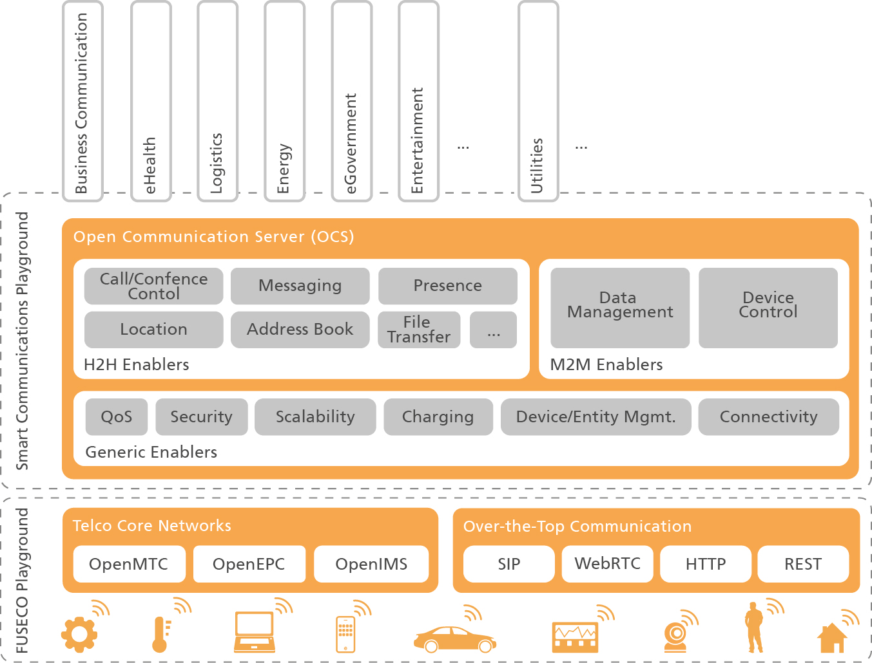
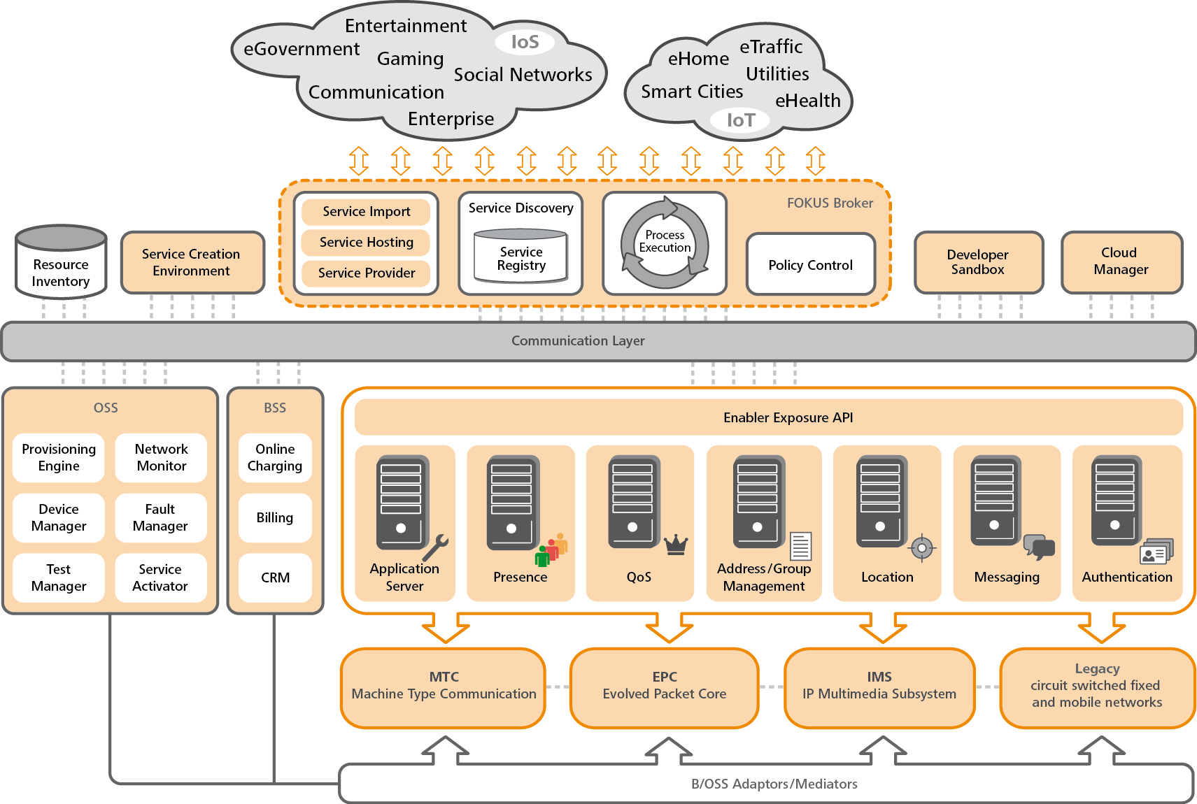
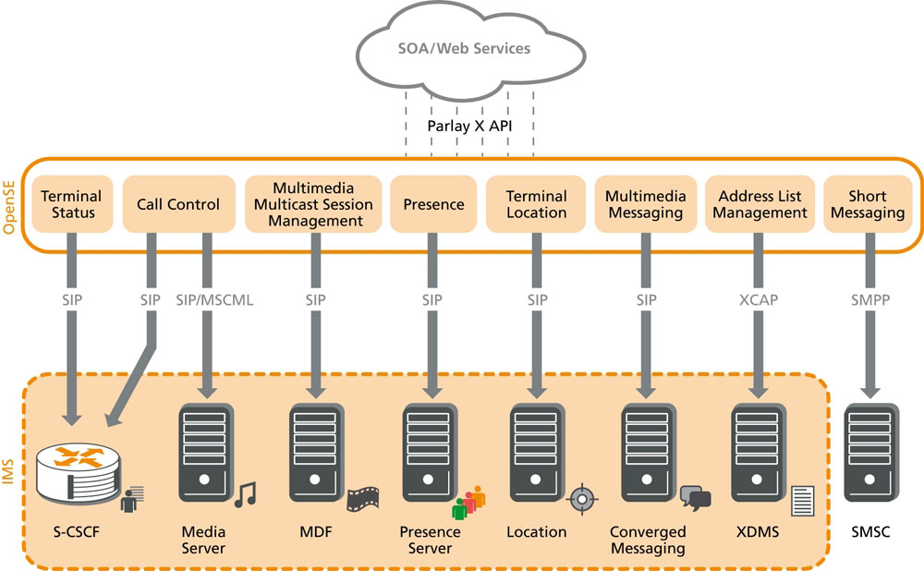
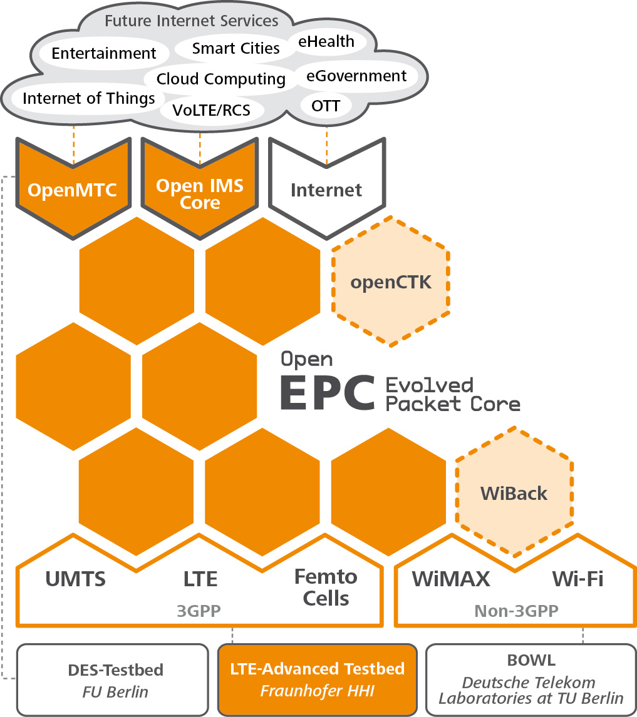
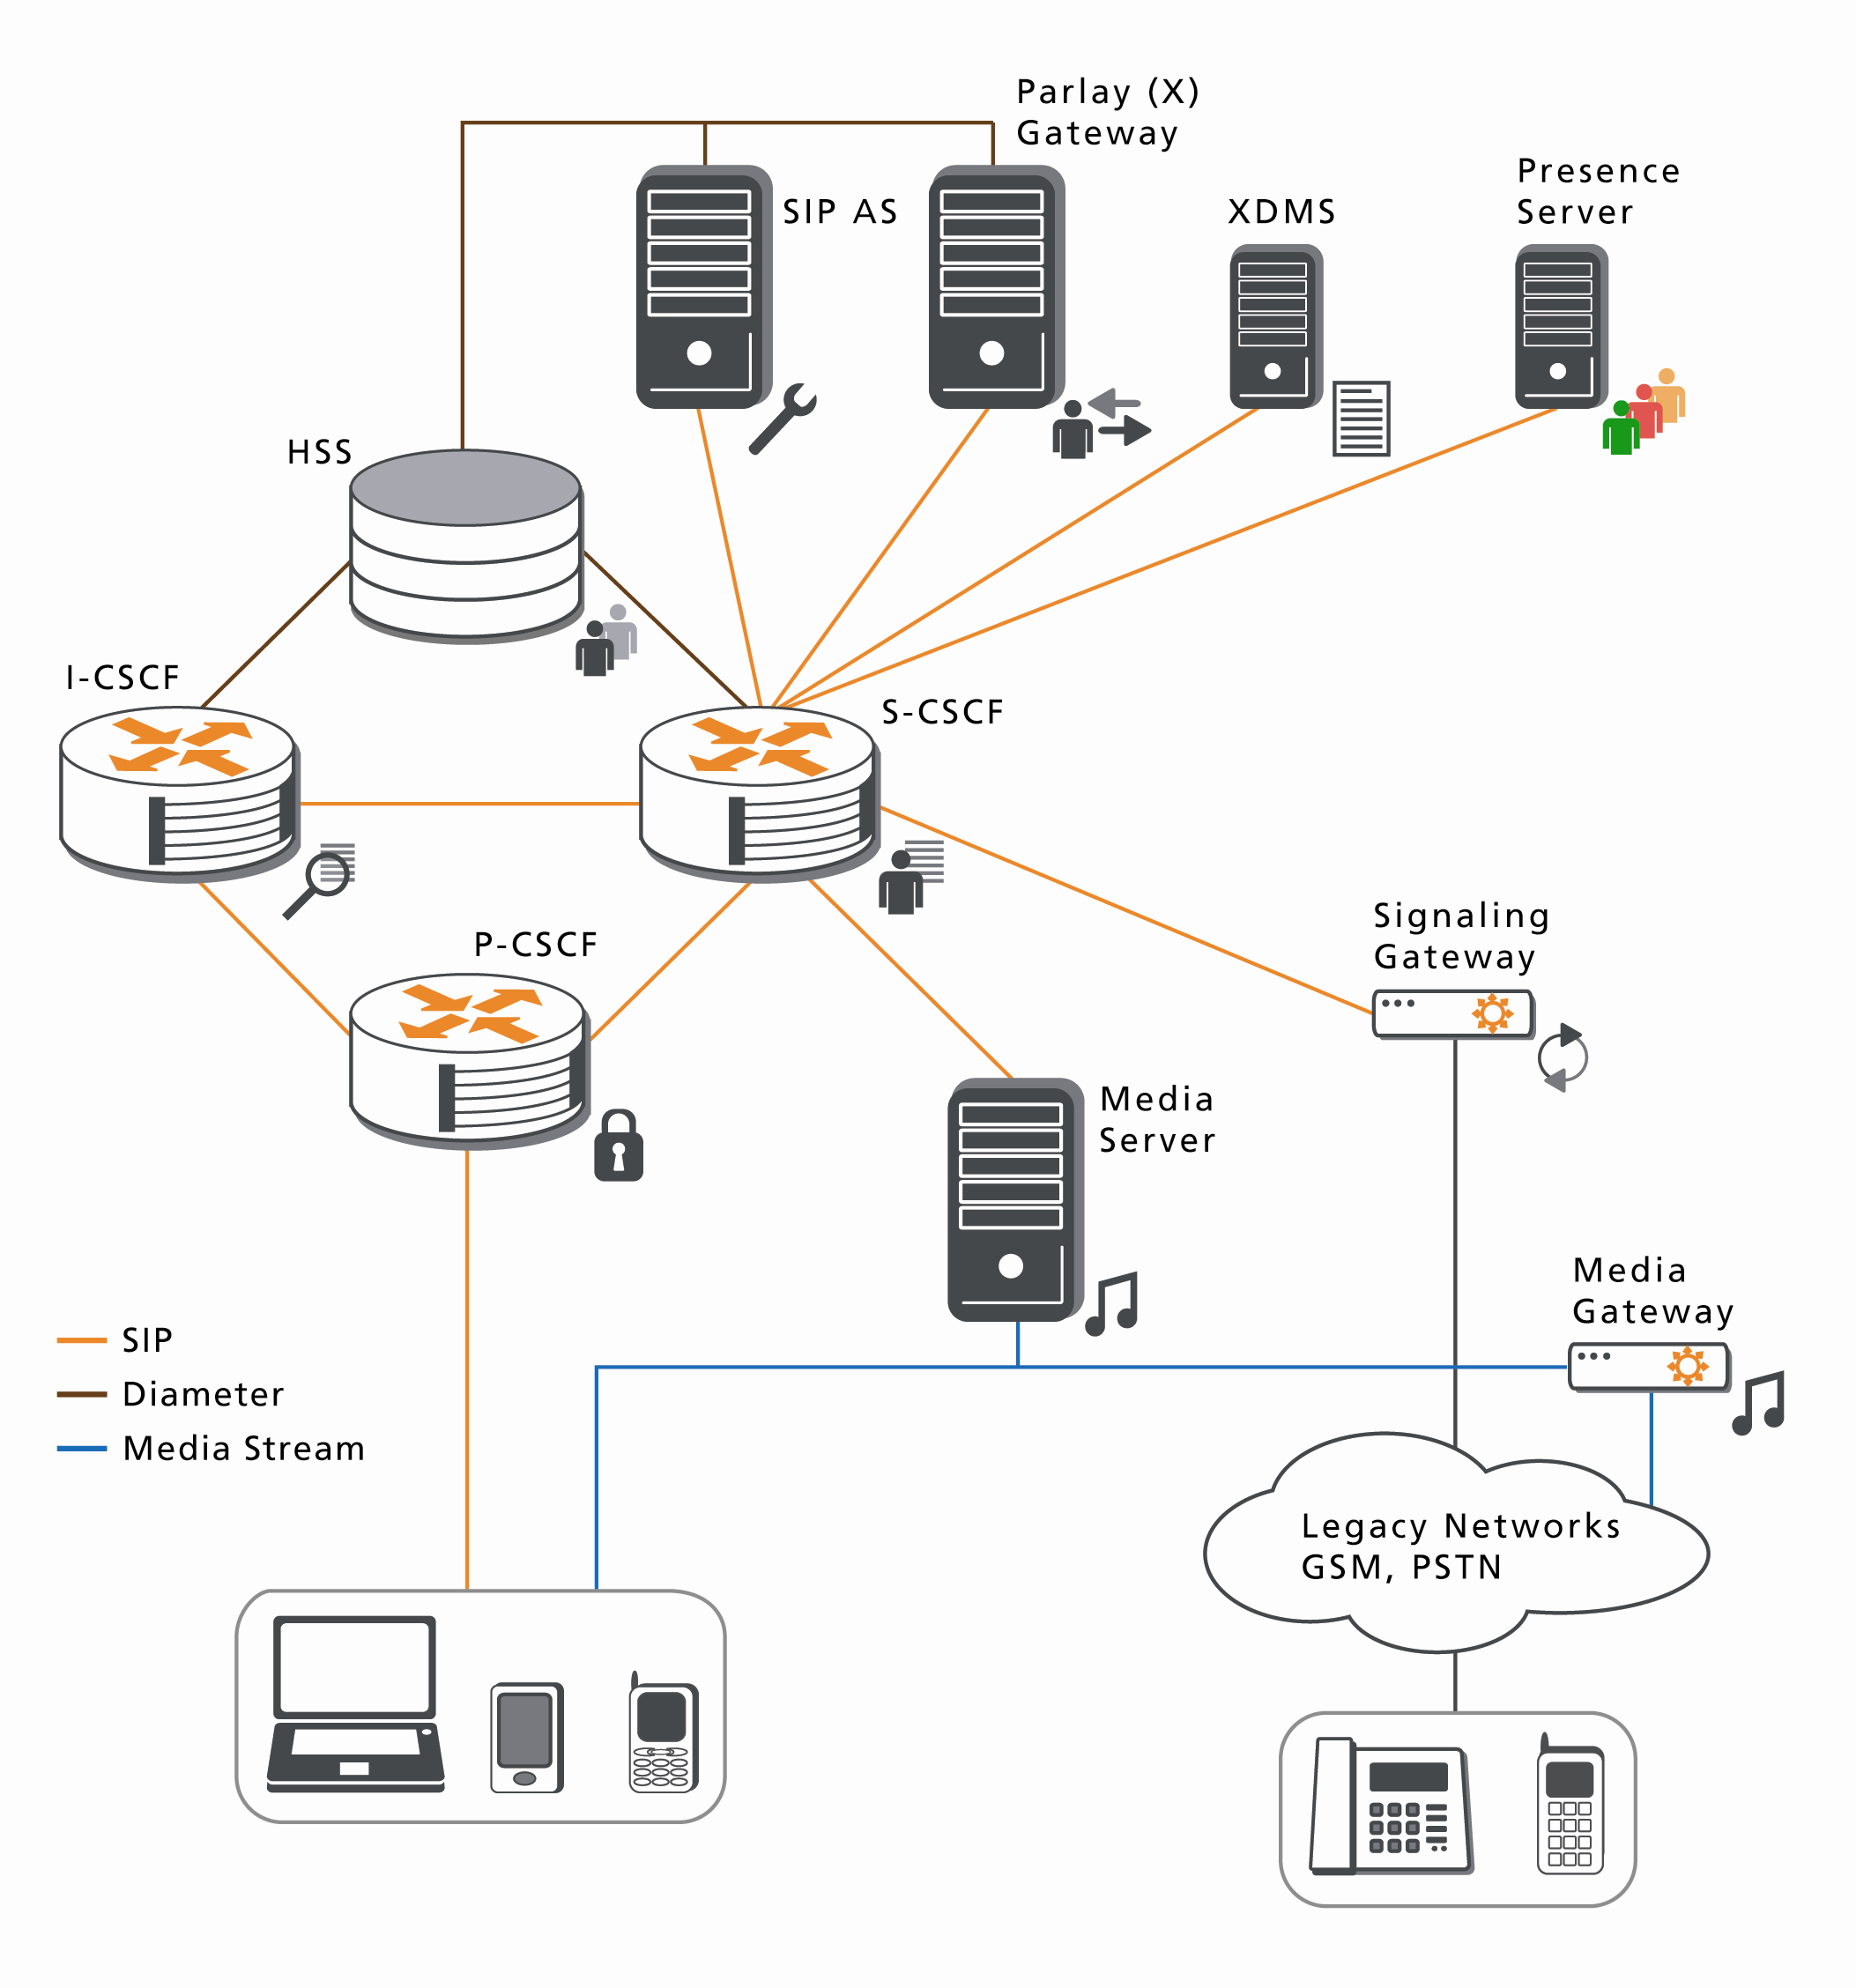

Related FOKUS Testbed Evolution
OSA/Parlay
Playground

Slide 6


Fraunhofer Testbeds / Playgrounds Evolution
NGN2FI Lab
G-Lab Deep, Panlab, Openlab
www.SC-Playground.org
www.FUSECO-Playground.org

Slide 7
Fraunhofer Testbeds / Playgrounds Evolution
Internet of Services
www.SC-Playground.org
Internet of Things
Network of the Future
www.FUSECO-Playground.org

Slide 8
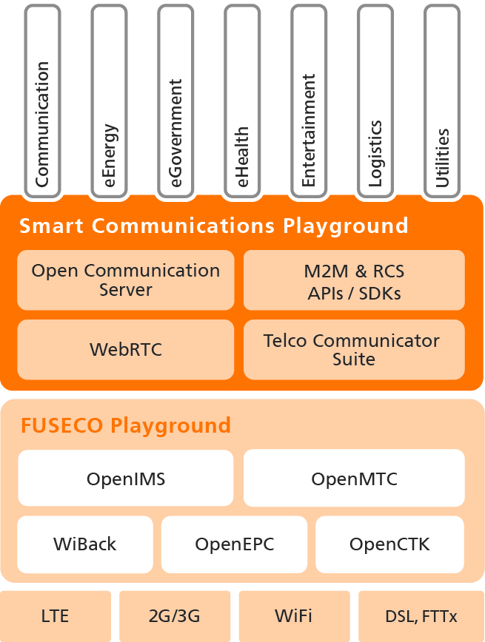
www.SC-Playground.org
www.FUSECO-Playground.org

Slide 9

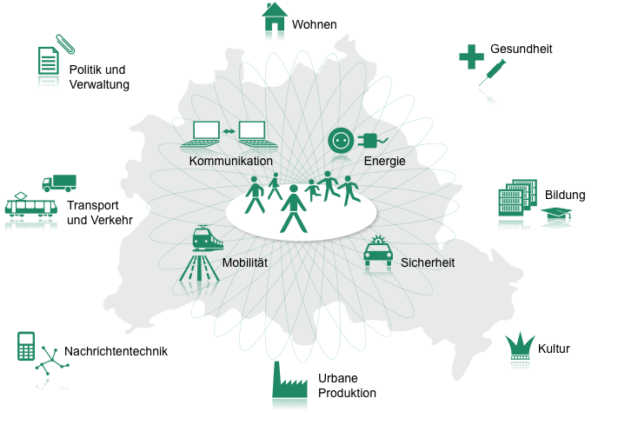

Future Internet … to make our cities smart
A Smart City is a huge Future Internet Show Case
E-Living
E-Health
Politics &
E-Government
Communications
Energy
Education
Transport &
Traffic
Mobility
Security
Signal Transmission & Networks
Culture
Urban
Production
www.fokus.fraunhofer.de/go/ngn2fi

Slide 10
Assessment of Platform Requirements
Separation of communication-centric services and enablers into three categories:
  Machine-to-Machine (M2M) Communication
  Human-to-Human (H2H) Communication
  Overarching Services and Enablers
Mapping of service and enablers towards different service domains where applicable
Exemplary refinement for one specific service vertical (facility management)

Slide 11
Ubiquitous Communication Enablers & Sectors
Enabling Services |  | Business / Collaboration | Leisure time communication | E-Health | Utilities | Facility Management | E-Energy | Logistics
Machine-2-machine | Retrieve data |  |  | X | X | X | X | X
 | Control devices |  |  | X | X | X | X | X
 | Send data |  |  | X | X | X | X | X
Human-2-human | A/V Call | X | X | X | X | X
 | A/V conference | X |  | X | X | X
 | Messaging / File transfer | X | X | X | X | X
 | Presence | X | X |  |  | X |  | X
 | Location | X | X | X | X | X | X | X
 | Address Book | X |  |  |  | X
Overarching enablers | QoS | X | X | X | X | X
 | Device/entity mgmt | X | X | X | X | X | X | X
 | Security | X | X | X | X | X | X | X

Slide 12
Example Use Case: In-Depth Analysis for Facility Management
Facility Management |  | Video surveillance | Utility Metering | Condition monitoring (temp., humidity, …) | Automation (light, air conditioning, etc.) | Alarm system monitoring
Machine-2-machine | Retrieve data | X | X | X | X | X
 | Control devices |  |  |  | X | X
 | Send data |  |  |  | X | X
Human-2-human | A/V Call | X |  |  |  | X
 | A/V conference |  |  |  |  | X
 | Messaging / File transfer |  | X
 | Presence | X |  |  |  | X
 | Location | X | X | X | X | X
 | Address Book | X |  | X
Overarching enablers | QoS | X |  | X | X | X
 | Device/entity mgmt | X | X |  | X | X
 | Security | X | X | X | X | X

Slide 13
Smart Cities … making it tangible
Example sector
Facility Management
E-Health
Utilities
Logistics
Facility Management
Retail and Leisure
eEnergy
Devices, Infrastructure, and Communication Platforms
Devices, Infrastructure, and Communication Platforms
Application fields
Alarm system monitoring
Utility Metering
Facility Management
Video surveillance
Condition monitoring
Automation

Slide 14
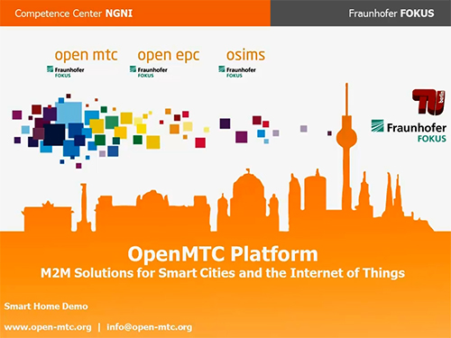
Smart Cities … making it tangible
Facility Management Application fields
Communication requirements
Alarm system monitoring
Retrieve data
Control devices
Send data
A/V Call
A/V conference
Messaging / File transfer
Presence
Location
Address Book
QoS
Device/entity mgmt
Security
Demos that we have build @ FOKUS
Utility Metering
Utility Metering
Video surveillance
Condition monitoring
Condition monitoring
Automation
Automation
Demo video
http://www.open-mtc.org/_videos/OpenMTC_Demo_video.mp4

Slide 15
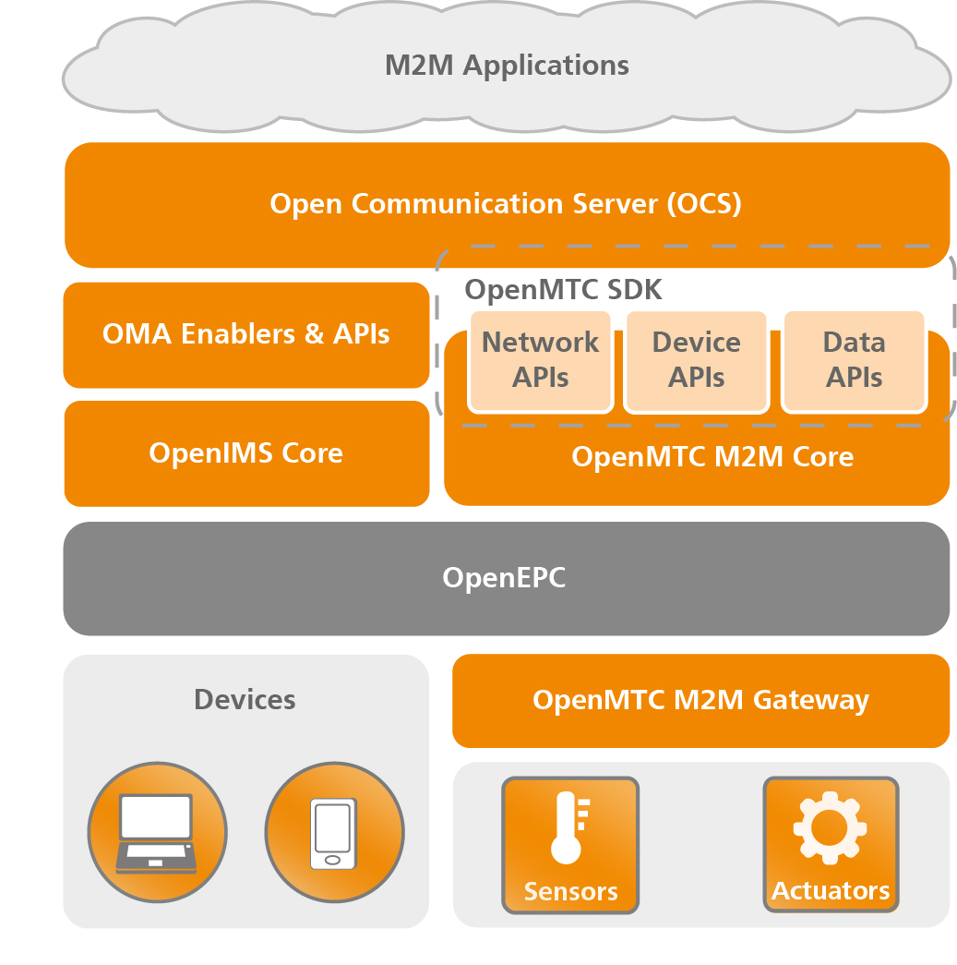
Definition of a Generic Smart Communication Architecture
Connecting Smart City objects across application domains
Enabling the Internet of Things by using M2M gateways and network middleware to communicate efficiently
Enabling multimedia communication services by integrating Telecoms APIs and platforms.
Enable rapid application development using M2M and H2H network APIs and software development kits (SDK)
Enable cross domain data analytics and fusion to serve the need of Smart Cities

Slide 16
High-level Architecture Open Communication Server – an open platform for Smart City services

Slide 17


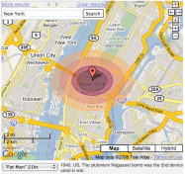
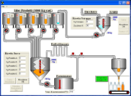
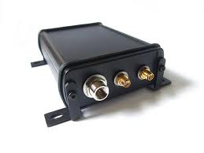
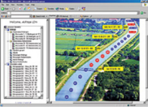





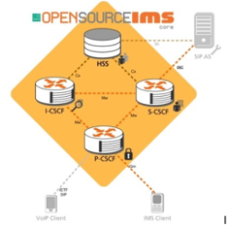
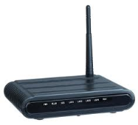





Elements of the Smart Communications Infrastructure
Connected
Devices
Operator Networks
Services and
Applications
Physical Vicinity
Sensor
Actuator
(Sensor)
Gateway
Operator Core Network
Mash-Up
Service Platform
Business
Front-end
Telecom Network
Light
Temperature
Movement
QoS & Charging
Seamless Mobility
Security
Delivery to multimedia warning device
Gateway to Core-Network
Communication Management
Application mash-up
M2M resources
M2M session support
Device and connectivity mgmt.
M2M data handling

Slide 18

Future Seamless Communication (FUSECO) Playground
State of the art testbed infrastructure as a cooperation of Berlin’s Next Generation Mobile Network expertise for
  Open IMS for H2H communications
  OpenMTC for M2M communications
  OpenEPC for seamless access
  Various access network technologies
Enabling to prototype application support for
  handover optimization across heterogeneous networks
  support for Always Best Connected (ABC)
  subscriber profile based service personalization
  QoS provisioning and related charging
  controlled access to IMS-based services
  controlled access to Internet/Mobile Clouds

Slide 19
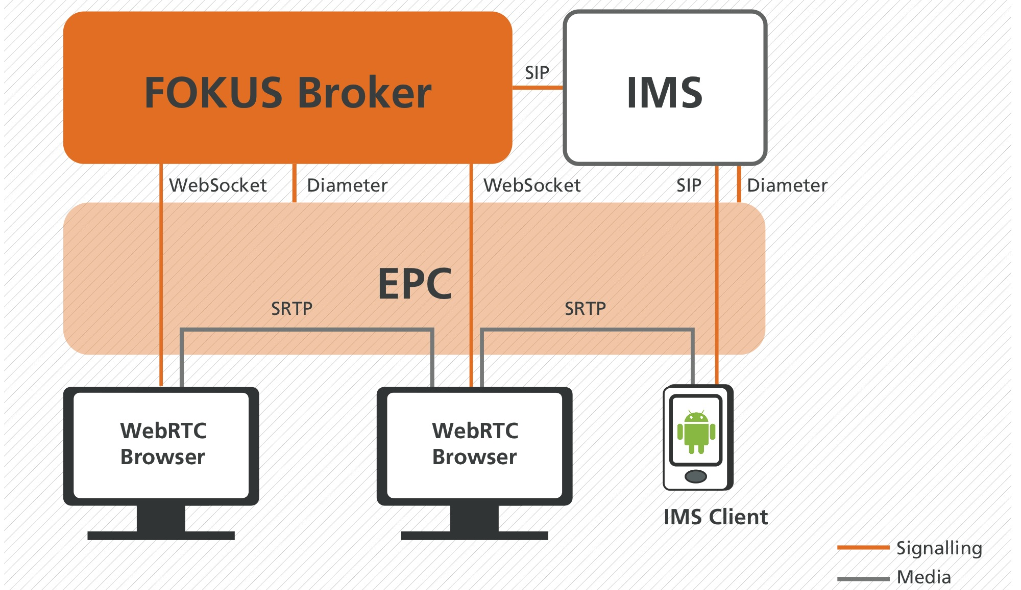
Use Case:
Application-driven QoS for WebRTC
WebRTC communication is enhanced by session-based QoS control.
REST-based API towards PCRF allows setting of QoS policies for temporary bandwidth increase.
Extension of OMA NGSI APIs in FOKUS Cloud Broker for application-driven QoS and network selection.
Mobility manager on Android allows seamless vertical hand-overs.

Slide 20
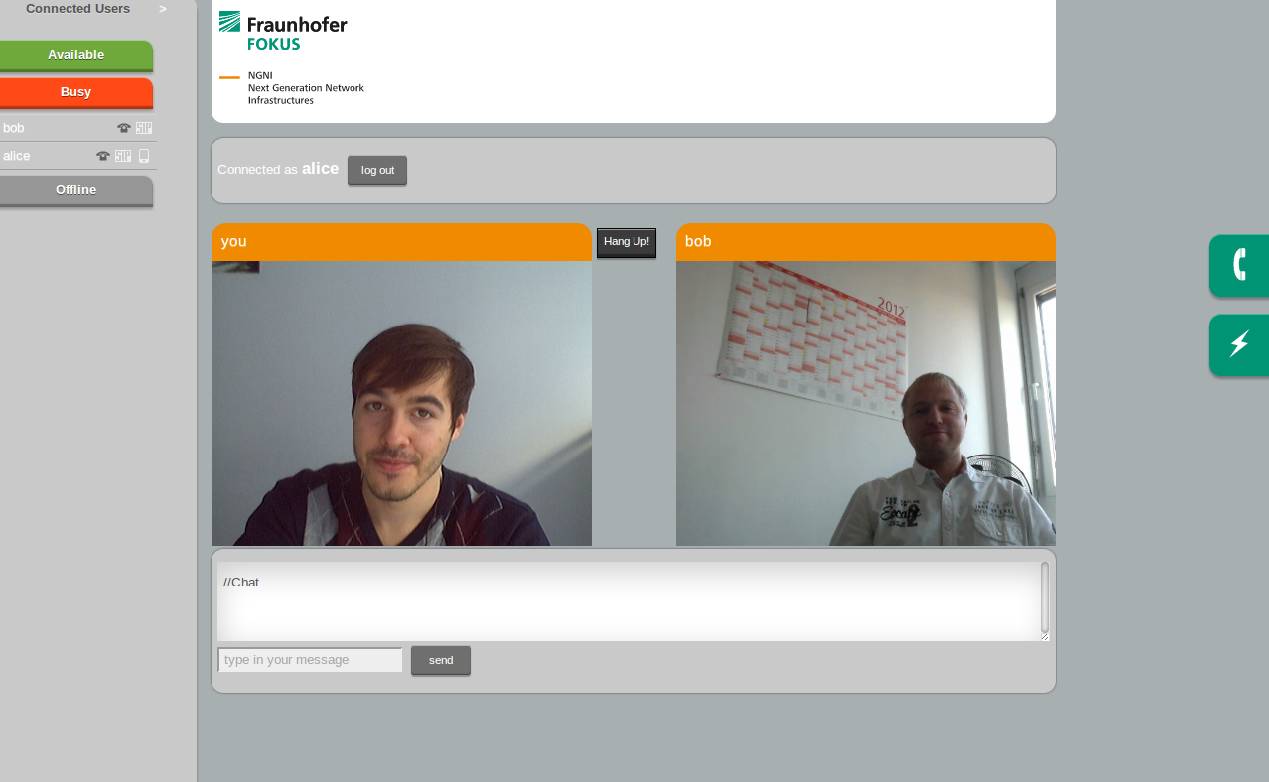
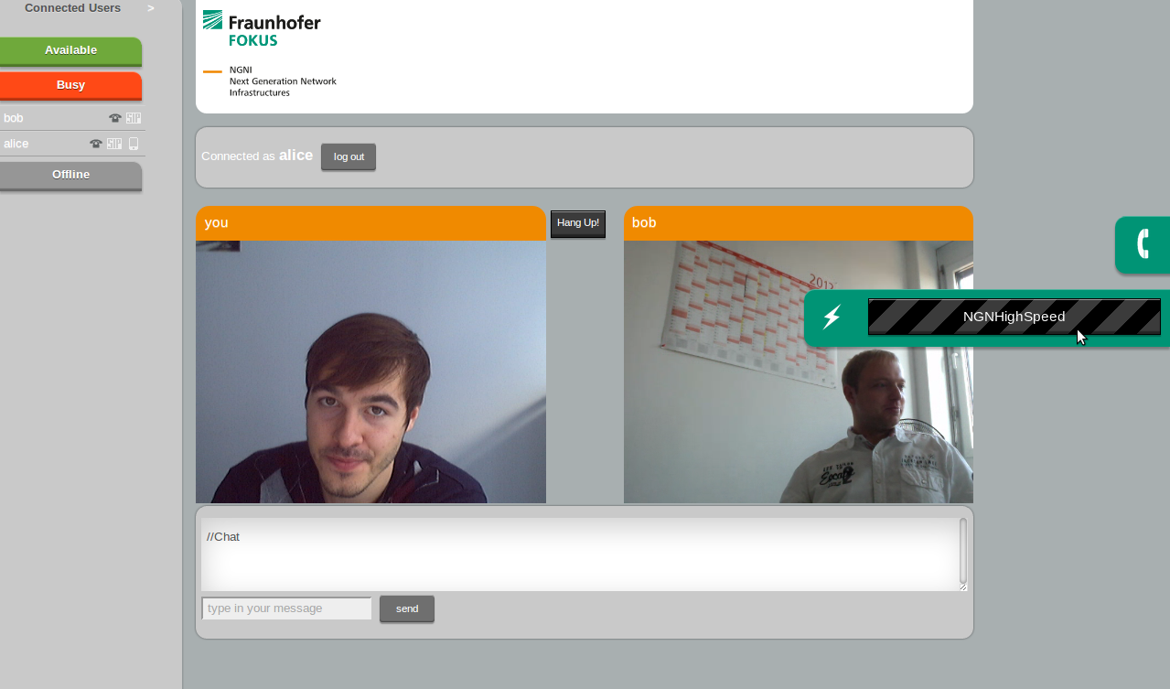
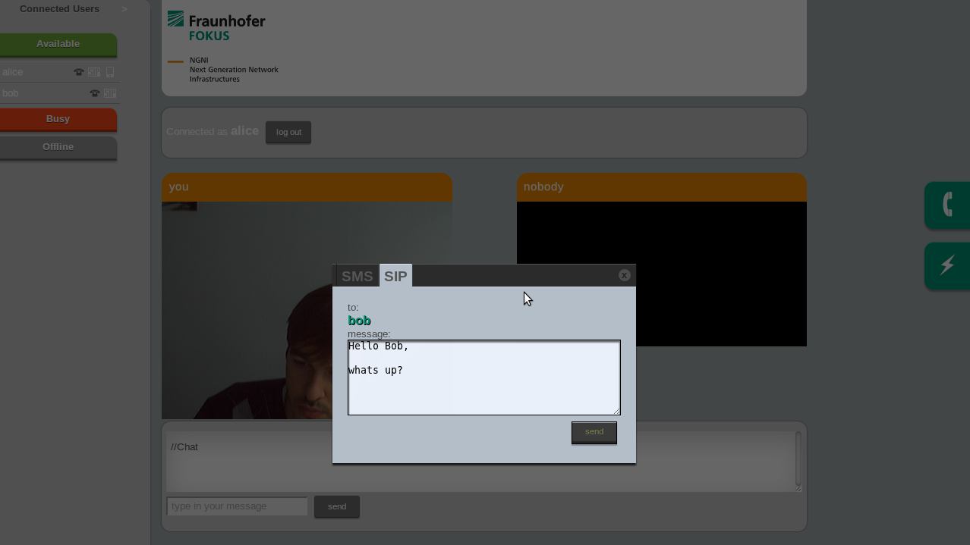
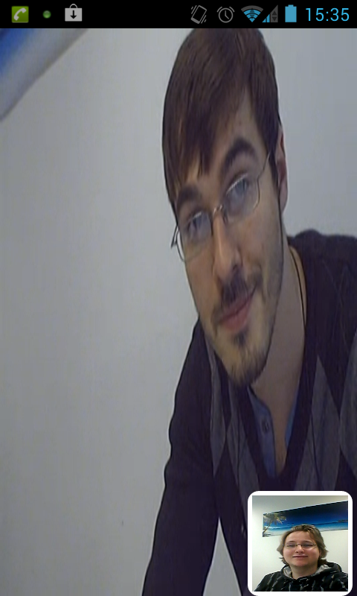
Screenshots FOKUS WebRTC to IMS Demo
WebRTC
WebRTC to SIP messaging
IMS Client

Slide 21
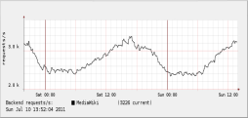
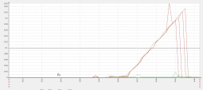


Elasticity for Services Platforms
QoS and Network-aware Cross-domain Cloud Brokerage
The FOKUS Elasticity Engine allows for flexible in- and outsourcing of Telco SDPs and services
The choice of Cloud Providers in terms of costs and QoS is dynamically optimized:
    Based on current demand the up-/down-scaling of cloud-resources is dynamically controlled and optimized
    Based on QoS and costs services are dynamically migrated between different cloud providers and cloud platforms
  Thereby QoS-levels are assured and resource consumption ($) is optimized
Internal Cloud
Amazon
Cloud
Provider
RackSpace
?
$$$
QoS
Elasticity
FOKUS Elasticity Engine
Migration
Wireless Core Network
Fixed Core Network
2G/3G
LTE/LTE-A
WIFI/ WIMAX
LAN/WAN
DSL
Notes:
Terms:
- Cloud Provider / Cloud Infrastructure: A single provider (usually a company) offering to host services in their very own cloud infrastructure (e.g. Amazon)
- Service Provider: Someone who has implemented a cool new service and would like to make it available by running it in the cloud.
Elastic Cloud Services are great:
- no need for overprovisioning
- start with (and only pay for) one VM
- as soon as demand increases, service will be scaled up
- decreasing demand -> service will be scaled down
- possible to deliver “zero maintenance” solution (just give me the service I’ll cater for the rest)
- already available at some providers albeit with varying features
Added benefit can be obtained by a cross provider solution
- Already some competition among cloud providers, foreseen to surge
- Always choose the best cloud provider for a service instance (where “best” is defined by the service provider)
- makes it possible to service geographically dispersed users from different infrastructures
- Migrate Services across providers when necessary (deteriorating quality, better offer, etc)

Slide 22

Cloud Control – Elasticity for OpenNebula
Clouds
  Elastic cloud brokering allows optimized resource utilization across multiple sites by dynamic up- & down-scaling
Enactor
Rules Engine
Aggregator
Control operations
Application traffic
Measurements
VM
VM
Users’ requests
VM
Core Network
Load Balancer
Cloud Manager
Elasticity
VM
VM
req./s
VM
time
Notes:
Elasticity Scenario:
- More requests -> More VMs
- Less requests -> Less VMs

Slide 23
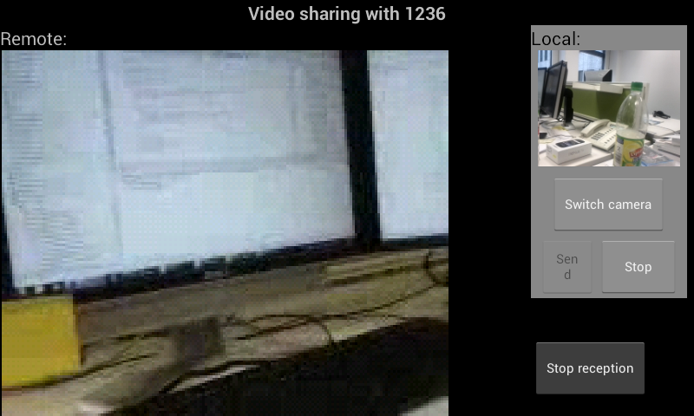




myMONSTER-RCS
Android Communication Client
The software stems
  Extended RCS Stack from Orange Labs for VoLTE
  Compliant to GSMA RCSe 1.2 specification
  Client/Server API allows easy integration with Android native application
Supported RCS/VoLTE key features:
  Enhanced native address book with supported service capabilities and presence info
  Messaging
    File Transfer
    1-1 chat
    Adhoc group chat
    Location
  Rich Call with multimedia content sharing
    Image Sharing
    Video Sharing
    VoIP
Notes:
- Enhanced native address book with supported service capabilities and presence info.
- Rich messaging with a conversationnal view for chat and file transfer.
- Rich call with multimedia content sharing during CS call

Slide 24
VoLTE Support with many Voice Codecs myMONSTER-RCS
FhI IIS AAC-ELD Codec
  Based on MPEG4 AAC, Low delay
AMR-NB
  Adapts to connection quality by using modes that have different bitrate requirements
GSM
  GSM Full-Rate audio codec (GSM-FR)
GSM_EFR
  GSM Enhanced Full-Rate audio codec
PCMA
  G.711 PCM audio codec with a-law
PCMU
  G.711 PCM audio codec with u-law
FOKUS extensions
  Voice over IP
  Integration with Android RTP API
  Integration of external Codec library for VoIP
  Optimization of video streaming for content sharing
EPC may provide QoS Class Identifier (QCI) for dedicted VoLTE bearer
Android Mobility Manager enables seamless session mobility
Notes:
Fraunhofer Institute for Integrated Circuits IIS
The RTP API is available in the android.net.rtp package. Classes include:
RtpStream, the base class of streams that send and receive network packets with media payloads over RTP.
AudioStream, a subclass of RtpStream that carries audio payloads over RTP.
AudioGroup, a local audio hub for managing and mixing the device speaker, microphone, and AudioStream.
AudioCodec, which holds a collection of codecs that you define for an AudioStream.
To support audio conferencing and similar usages, an application instantiates two classes as endpoints for the stream:
AudioStream specifies a remote endpoint and consists of network mapping and a configured AudioCodec.
AudioGroup represents the local endpoint for one or more AudioStreams. The AudioGroup mixes all theAudioStreams and optionally interacts with the device speaker and the microphone at the same time.

Slide 25
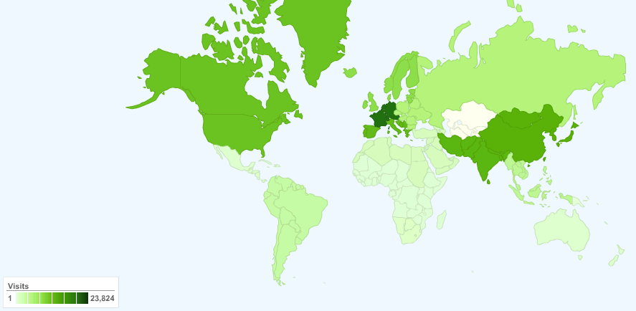


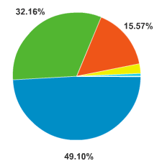

Success Story VoIP / IP Multimedia Subsystem
Providing open source software and toolkits
Early prototyping of Session Initiation Protocol (SIP) server resulted in successful open source project SIP Express Router
  Licenses have been sold to Tekelec through spinning-off iptel.org GmbH
Continuation of development as open source IP Multimedia Subsystem helped FOKUS to gain world-wide knowledge in the telecommunications industry and network operators.
Development of service and development tool kits as non open source solutions building on top of the open source software provided the basis for licenses and joined RnD projects with operators as NTT, Telkom Indonesia, Vodafone, Deutsche Telekom, STC.
Statistics for Open Source project OpenIMS access
FOKUS cooperations with industry partners worldwide
Asia
Americas
Europe

Slide 26

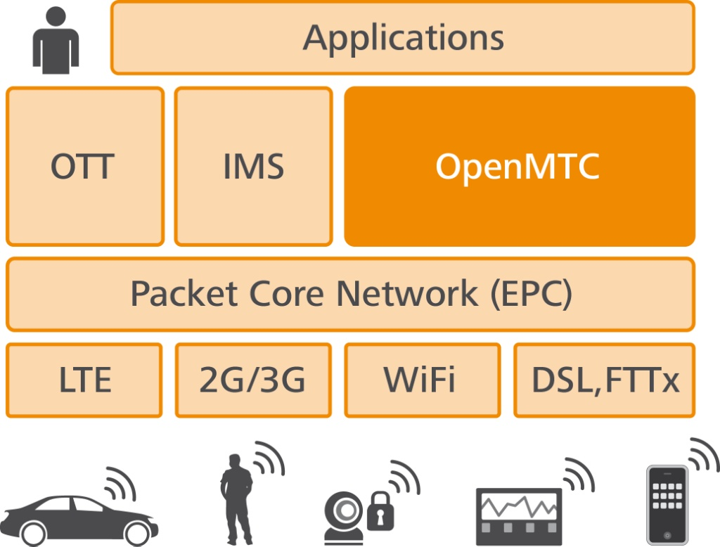
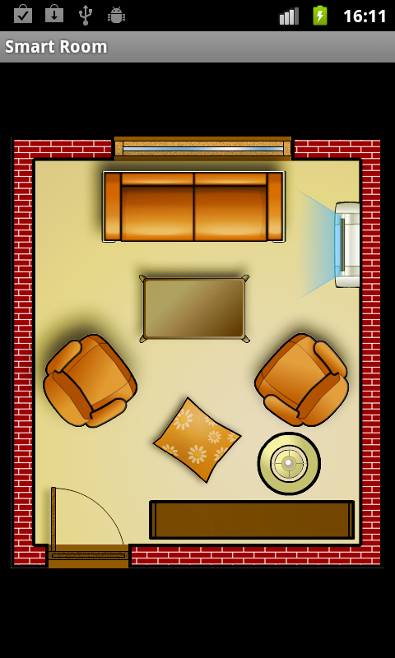
The FOKUS OpenMTC Platform
Based on the success of the Open IMS Core and OpenEPC Fraunhofer FOKUS has developed a NON-OPEN SOURCE Machine Type Communication platform, enabling academia and industry to:
  integrate various machine devices with operator networks
  integrate various application platforms and services
into a single local testbed, thus lowering own development costs
OpenMTC is an intermediary layer between multiple service platforms, the operator network, and devices
This platform can be used to perform R&D in the
fields of machine type communication
OpenMTC implemented features are aligned with ETSI M2M specifications:
  Adaptable to different M2M scenarios (e.g. automotive)
  Extensible to specific research needs
  Configurable
  Performant
  see wwww.open-MTC.org

Slide 27

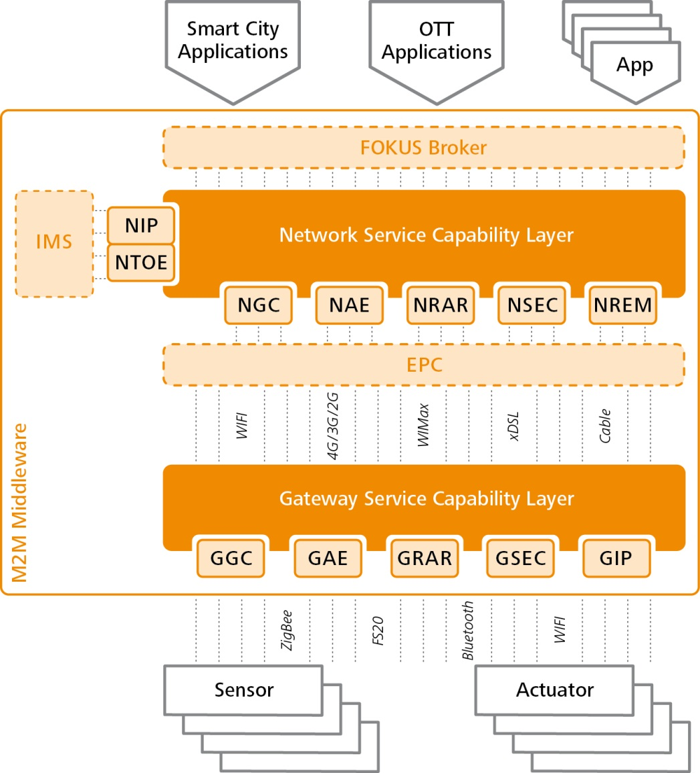
OpenMTC Architecture – Release 1
OpenMTC consists of the two main components
  Network Service Capability Layer (NSCL)
  Gateway Service Capability Layer (GSCL)
Both SCLs contain several modules
  e.g. NGC: Network generic communication, GSEC: Gateway security, etc.
  Some of them are optional
OpenMTC allows interworking with
  OpenEPC (Evolved Packet Core)
  OpenIMS (IP Multimedia Subsystem)
  FOKUS Service Broker
OpenMTC supports:
  Various sensors and actuators (e.g. ZigBee, FS20 devices)
  Multiple Access networks (e.g. fixed, mobile, xDSL, 3G, etc.)
  Various Applications (e.g. Smart Cities, Smart Home, etc.)

Slide 28
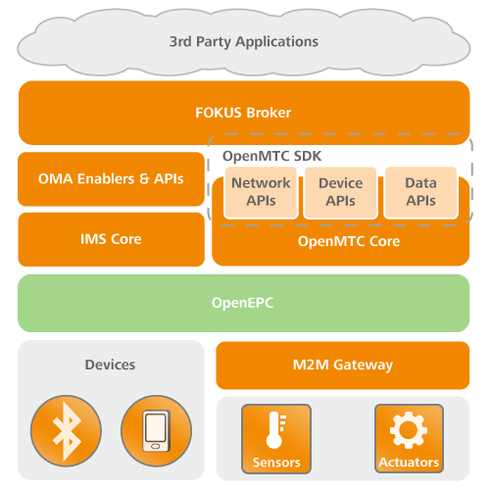
OpenMTC SDK - Standard interface toward the OpenMTC core
Providing developers with standard interface toward the OpenMTC that consists of different service capabilities.
Enabling the OpenMTC SDK within the FOKUS Broker.
  Fast way to combine M2M information with telecommunication or Internet services.
  Allows the creation of new value added services.

Slide 29
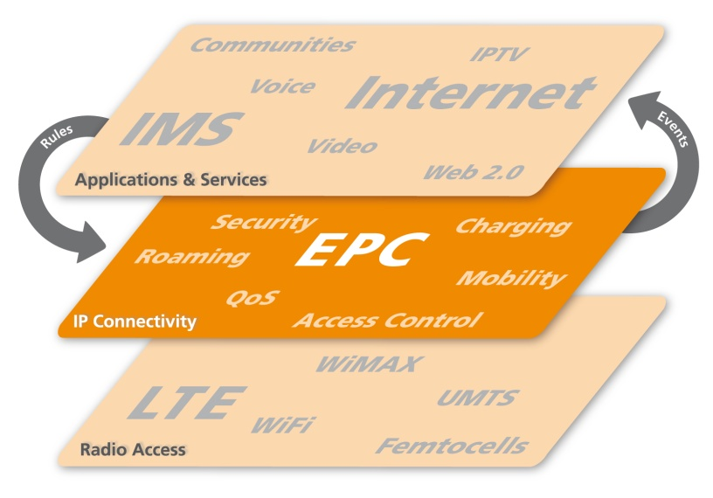
Success Story IP Connectivity / Evolved Packet System
Providing open test-bed software and toolkits
First-time implementation of the latest Next Generation Fixed and Mobile Network architectures and concepts
  Working with major NEPs towards validation of new concepts for NGN-to-Future-Internet evolutions
  Providing small NEPs with a comprehensive prototyping environment
  Establishing test-beds and performing field-trials with major operators towards accelerating the adoption of new technologies
  Enabling the academia with access to the state-of-the-art open prototypes
OpenEPC
  Complements the Open Source IMS Core in providing a comprehensive Voice-over-LTE experimentation
  Provides IP connectivity for Heterogeneous Radio Access Networks
Currently powering world-wide laboratories of 4 major telco operators, 5 universities, 3 research organizations and many commercial companies

Slide 30
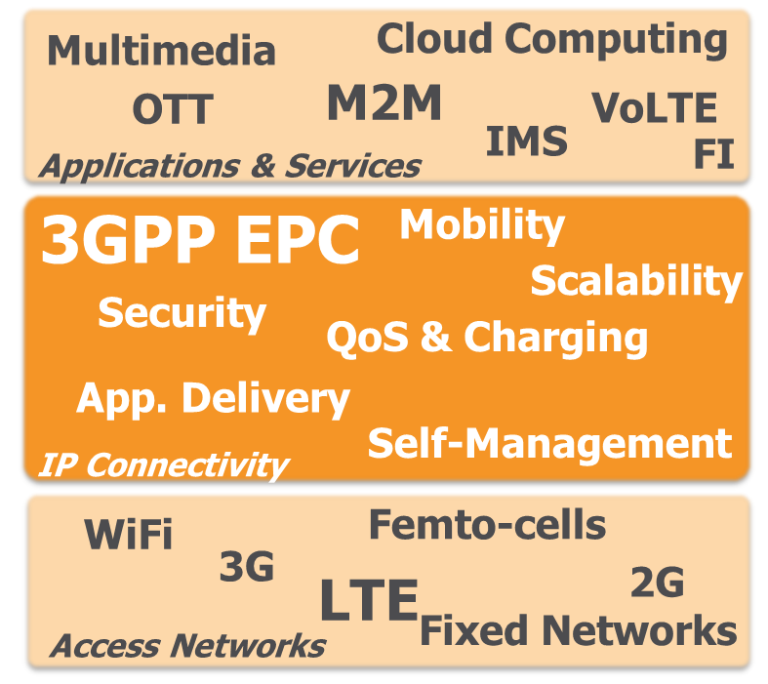
What is FOKUS OpenEPC Platform?
Future massive broadband communications will be realized through multi-access support (LTE, 3G, 2G, WiFi, fixed networks …) and multi-application domains (OTT, IMS, P2P, M2M, Cloud, …)
Fraunhofer FOKUS is developing the NON-OPEN SOURCE OpenEPC toolkit, enabling to:
  integrate various network technologies and
  integrate various application platforms
  into a single local testbed, thus lowering own development costs
This platform can be used to perform R&D in the fields of
  QoS, Charging, Mobility, Security, Management, Monitoring
OpenEPC represents a software implementation of the 3GPP
EPC standard addressing academia and industry R&D:
  Based on 3GPP standards
  Configurable to different deployments
  Customizable to the various testbed requirements
  Extensible to specific research needs
  Reliable & highly performant
More information: www.OpenEPC.net

Slide 31
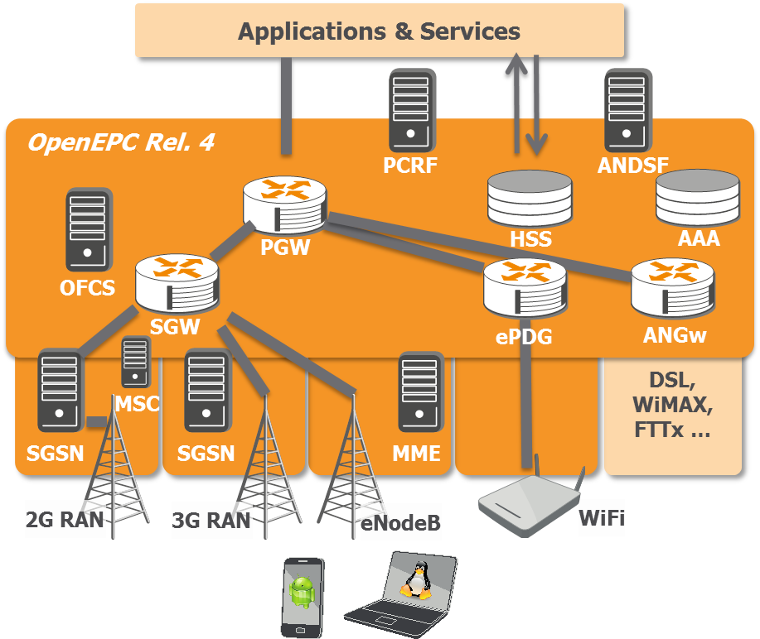
OpenEPC: Features, Functionality, and Components
Core Network Mobility Management
Core Network Support for 3GPP Accesses
  LTE Access Network Integration
  HSPA/UMTS Access Network Integration
  EDGE/GPRS Access Network Integration
Non-3GPP Access Networks AAA
Policy and Charging Control
Accounting and Charging
Subscriber Management & Provisioning
User Plane Realization
Client Mobility Management
Distribution Features
Interconnection with Access Networks & Devices
Interconnection with Applications and Services

Slide 32
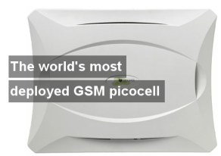

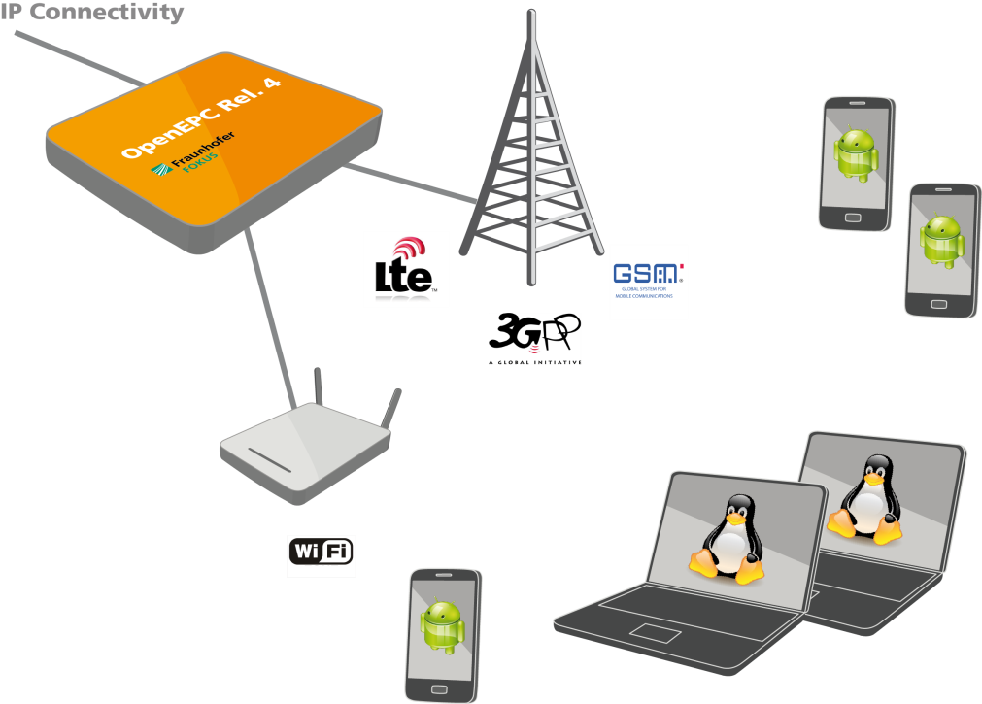
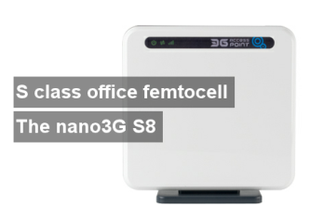


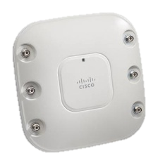
OpenEPC+OpenIMS: Just add Radio, Devices and Applications

Slide 33
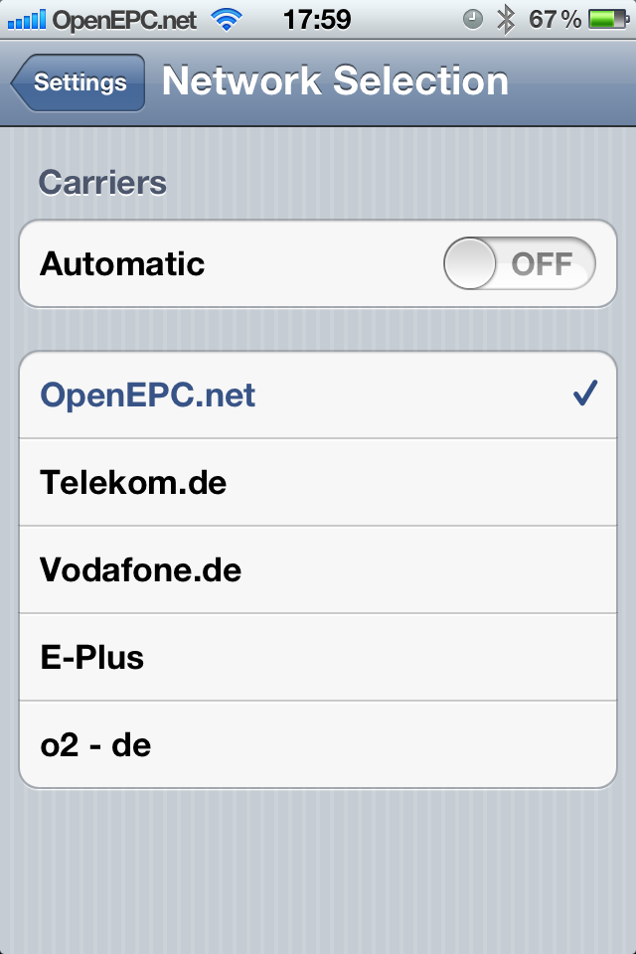

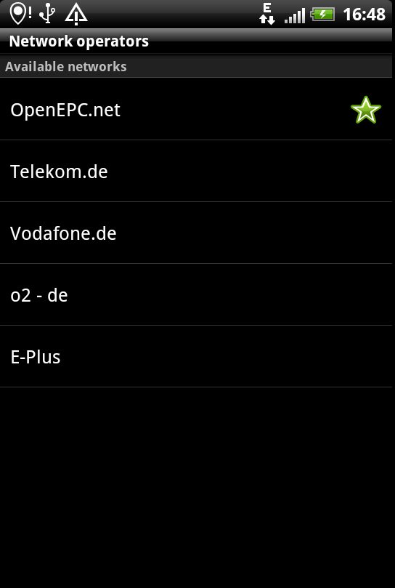
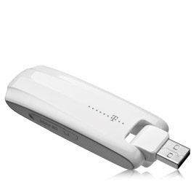

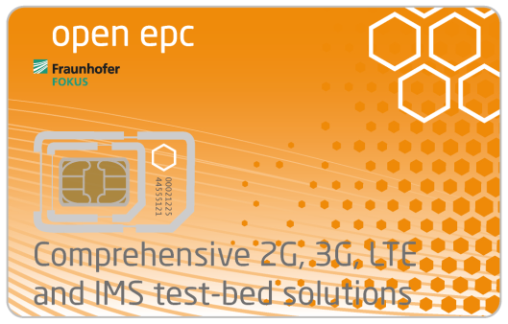
Working with Off-the-Shelf Devices

Slide 34
OpenFlow and SDN-EPC
VoLTE with SRVCC
Network Functions Virtualization
UE/eNodeB-emulation-with-WiFi
Self Organized Networks Features
…
Integration of 3GPP
Offline Charging
Non-3GPP AAA
Extended UE function
Dynamic node selection
Full NAS, GTP stacks
S1AP with APER, X2AP
Rel. 5/6
…
Rel. 4
Nov 2012
Core Network Mobility
Client Mobility
Policy and Charging Control
Subscription Management
Mobile Device support
Rel. 3
Jan 2012
Rel. 2
Feb 2011
Rel. 1
April 2010
LTE RAN integration
2G and 3G RAN integration
Android Mobile Devices Support
Multiple APN Support
Radio conditions based handover
Traffic Shaping for QoS
Preview
Nov. 2009
Extended Mobility
(GTP, MME etc.)
Extended AAA
More Access Networks Integration
Support for specific applications
First demo of the OpenEPC at the 5th IMS Workshop

Slide 35
Network Functions Virtualization (NFV)
Network Functions Virtualization (NFV) is a novel paradigm that presumes that the network functions:
  Are implemented only as software (programs)
  Can run on top of common servers
NFV implies that network functions:
  Can be moved as required
  Do not require special equipment
© NFV White Paper presented at “SDN and OpenFlow World Congress”, Darmstadt Oct 22-24, 2012

Slide 36
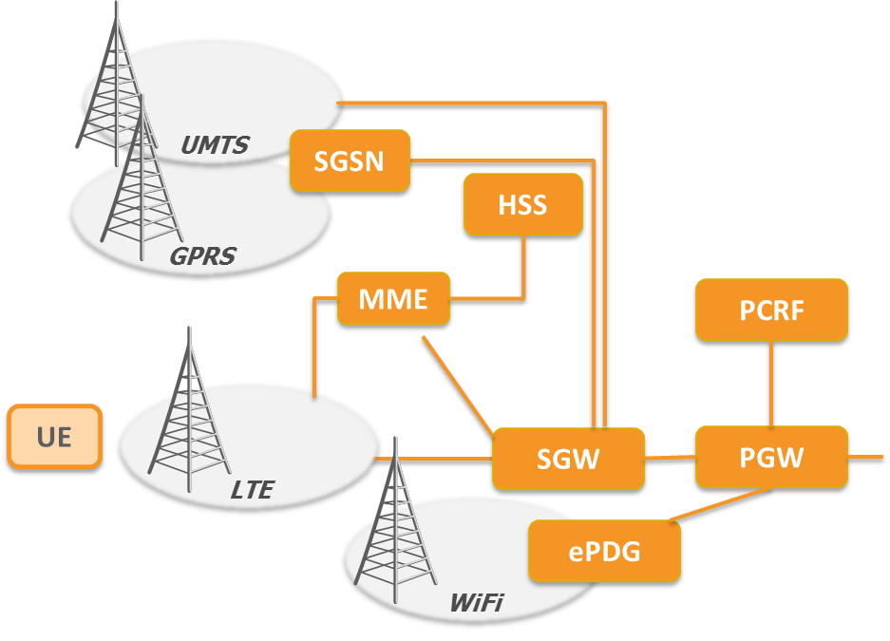
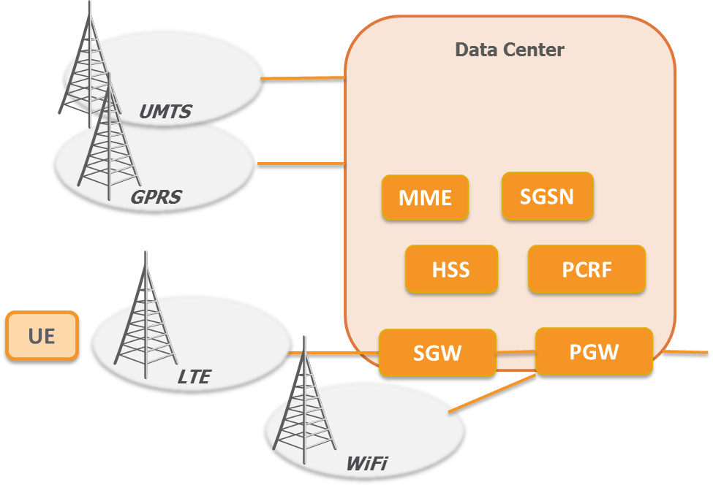
What’s next: Network Functions Virtualization (NFV)
Network Functions Virtualization (NFV) is a novel paradigm that presumes that the network functions:
  Are implemented only as software (programs)
  Can run on top of common servers
Research directions:
  Are the cloud infrastructures ready to deploy NFV (delay, capacity, parallelism)
  Virtualized infrastructures management (networking, elasticity, failover)
  Defining the next core network architecture

Slide 37
What’s next: Mobile Telco Architecture Evolution Path → SDN
UMTS
UMTS
HSPA r7
HSPA r8
SAE/EPS r12
SAE/EPS+OF
GGSN
GGSN
GGSN
GGSN
PGW
PGW
-C
PGW
-D
SGSN
SGSN
SGSN
SGSN
SGW
SGW
-C
SGW
-D
BSC
RNC
RNC
MME
MME
BTS
NodeB
NodeB
NodeB
NodeB
eNB
eNB
Mobile Telco Architecture Evolution Path
3GPP Control Plane
Data Plane
OpenFlow Control Plane

Slide 38
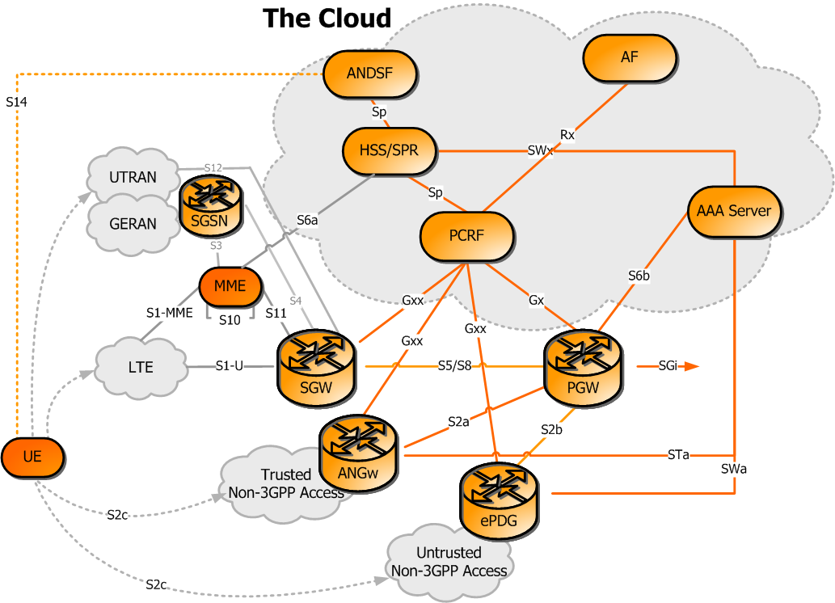
Step 1: Virtualize the Control Plane
Run in the data center software components for : PCRF, HSS, AAA, MME, ANDSF, DPI, OCS, OFCS, ….

Slide 39
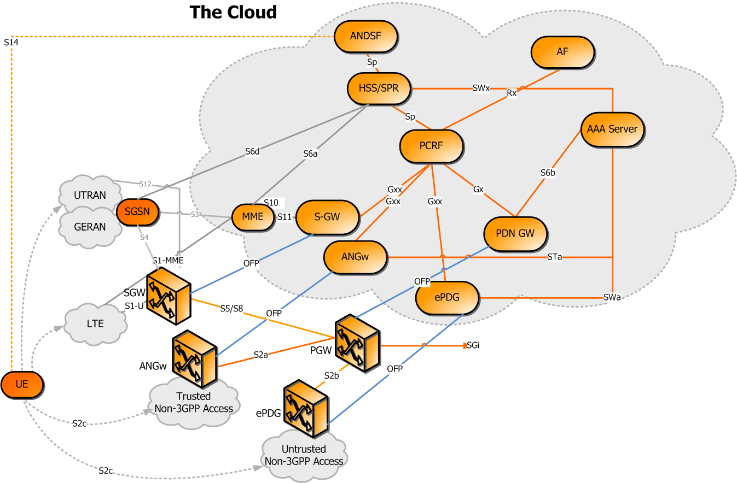
Step 2: Split the User Plane and Use SDN switches
EPC Control, Mobility and all signaling can be virtualized
But the User Data Plane stays in the infrastructure for maximum performance

Slide 40
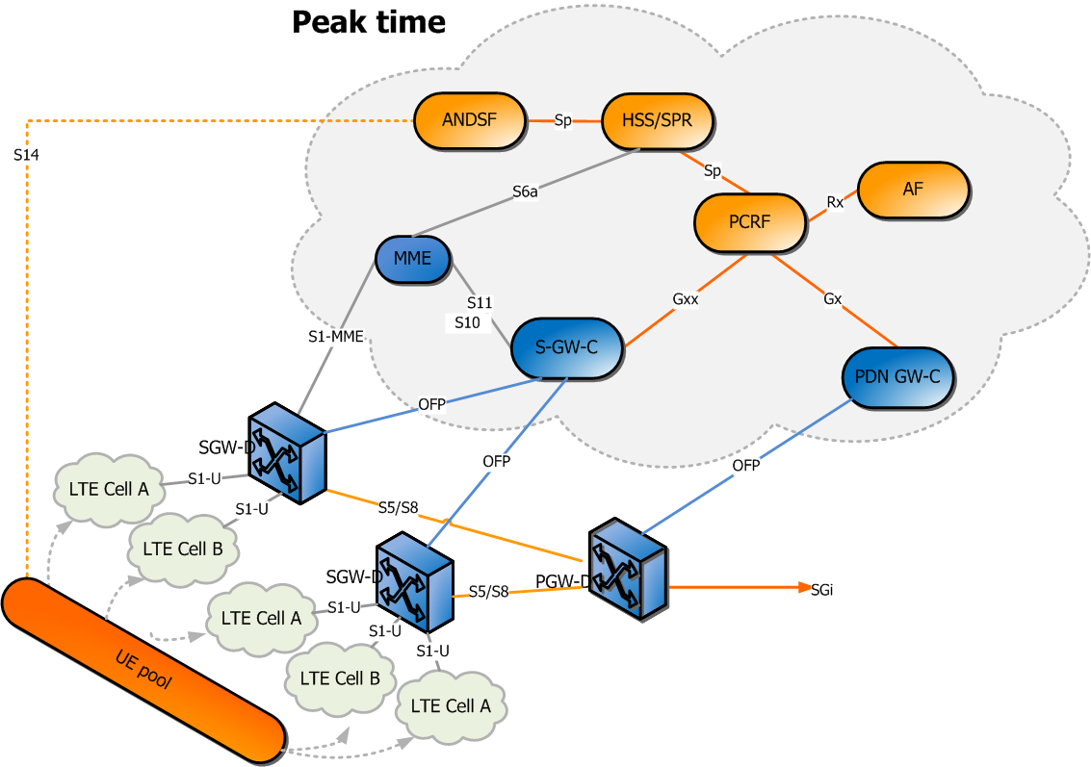
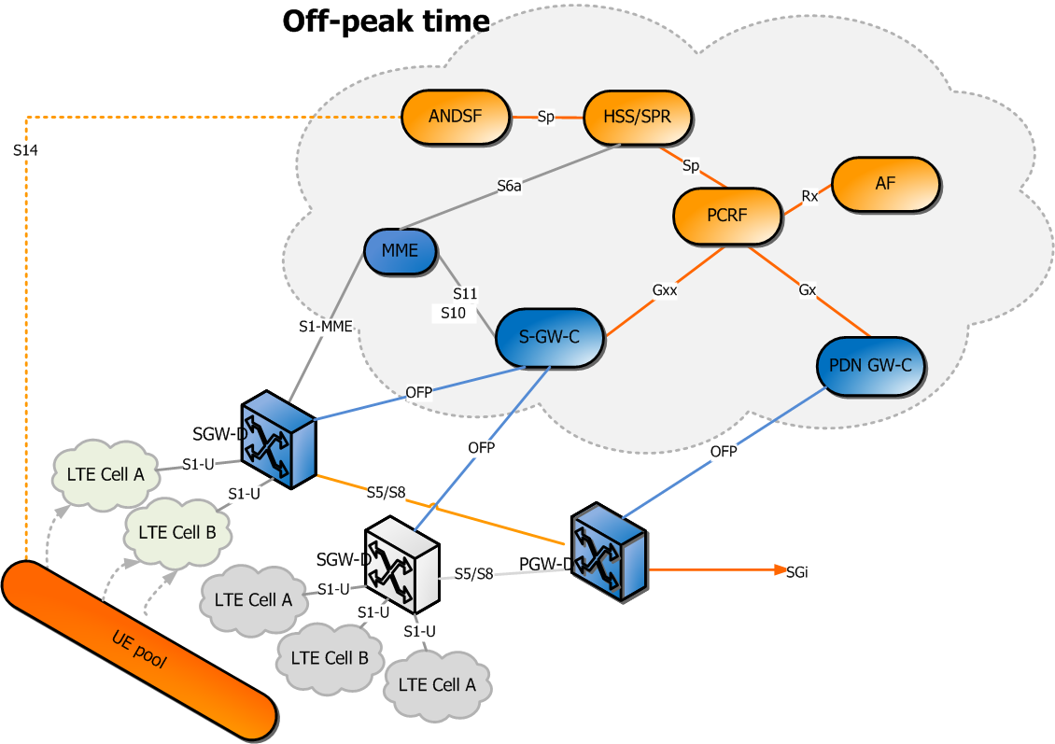
What’s next: Elastic and Flexible Network Design - Example EPS
Elastic network design aligned on real-time network load situations
Enablement and disablement of redundant access- and core-network elements
Optimized energy consumption of the access- and core-network
Network Resources as a Service (NRaaS) and on demand

Slide 41


Commercial FOKUS NGN/IMS/EPC/SOA Testbed Deployments around the world

Slide 42

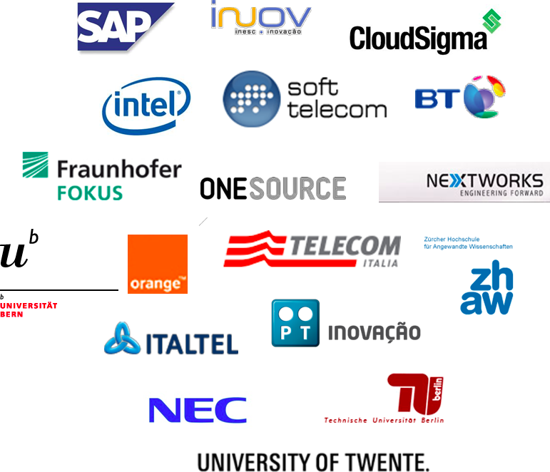
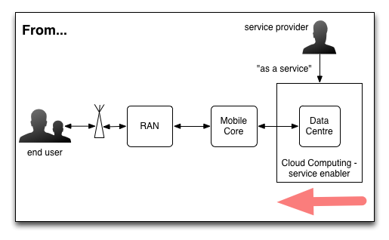
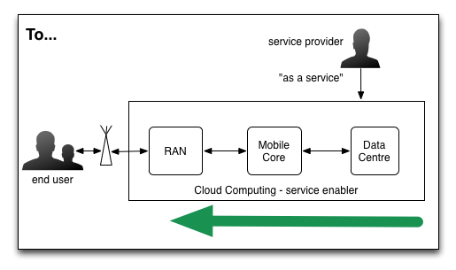
EU Mobile Cloud Networking Project makes use of OpenEPC for EPCaaS Prototyping
FP7 Intergated Project started in November 2012 for 36 month targeting for bringing cloud computing features to mobile operator core networks (EPCaaS):
  Virtualization of components
  Software defined networks
  Elasticity
  Total distribution
  Infrastructure sharing
  Redefining roaming
OpenEPC is used as the basis platform for mobile core network experimentation
Mobile Cloud
Networking
For more: http://mobile-cloud-networking.eu

Slide 43

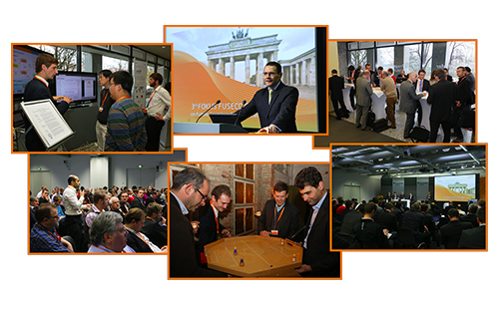
  4th FOKUS „Future Seamless Communication“ Forum (FFF)
  Berlin, Germany, November 28-29, 2013
Theme: „Smart Communications Platforms for Seamless Smart City Applications – Fixed and Mobile Next Generation Networks Evolution towards virtualized network control and service platforms and Seamless Cloud-based H2H and M2M Applications“
FUSECO FORUM is the successor of the famous FOKUS IMS Workshop series (2004-09)
  FFF 2010 attracted 150 experts from 21 nations
  FFF 2011 was attended by around 200 experts from 30 nations
  FFF 2012 was attended again by around 200 experts from 30 nations
See www.fuseco-forum.org

Slide 44

Contact
Thomas Magedanz
Prof. Dr.
Head of Competence Center
Next Generation Network Infrastructures
Fraunhofer Institute for Open Communication Systems
Kaiserin-Augusta-Allee 31 | 10589 Berlin | Germany
Phone +49 30 3463 - 7229 | Fax -8000
thomas.magedanz@fokus.fraunhofer.de
www.fokus.fraunhofer.de

