Slide 1
WebRTC @Kamailio
Berlin, 17.4.2013
Björn Schwarze

Slide 2
What is WebRTC?
High quality secure Realtime Voice and Video
Included in the Browser – PlugIn free
Developing Standard from W3C & IETF
Millions of $ worth of IPR given into Open Source

Slide 3
Why?
Notes:
Several approaches:
Take a look at the business persepctive

Slide 4
Online communication channels today
Telephone
Webpage
Social Media
E-Mail
Notes:
So WebRTC is the mould between Telephone and Webpage, which can be expanded to Social Media and E-Mail
User benefit?

Slide 5
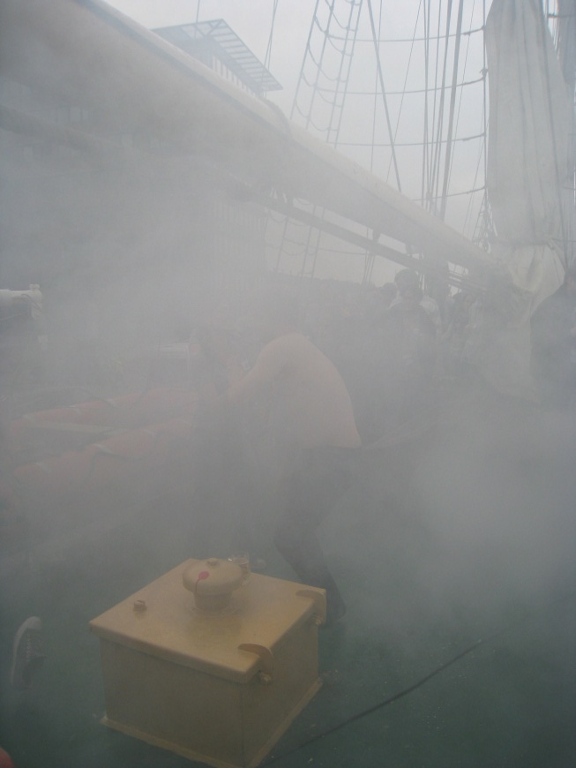
Key benefits for the user?
Context based
Permission
Secure
Identity
Notes:
WebRTC enables context based communication. Additional information from the ‚location‘ from where he called possible
The callee limits or expands the number potential callers. Phone numbers can be guessed from every network
Security: WebRTC requires secure TLS
Identity: as anonymous as the person permits it / the called party requires it

Slide 6
WebRTC lifts customer experience
User is reaching a goal
Part of the successful customer experience
Video may be a component
Rounds up communication strategy

Slide 7
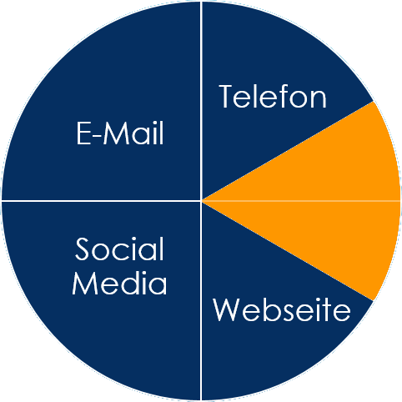
Our Vision „C-Button“
Instant free communication within the browser (audio and video)
Browser connects to the user‘s microphone and webcam
Additional datachannel
Video as add-on during
regular phone call
C-Button

Slide 8
Where does it fit?
Free call – 0800 service
Shared Cost service – impact of legislation in Germany
Unified Communications – integrates with any device, service, application
brings Video to mainstream applications:
Health care
Financial services
Dating platforms
Social network
Notes:
10 of the TOP american banks started WebRTC projects
Genesys as major cc supplier reports, that banks try to get the reps closer to customer, presence can be handled directly
End-to-end encrypted service, no additional servers required, gateway installed on premises of bank. Reinvite reduces traffic in central office and puts it into branches
This is also true for medical doctors: e.g. special online service hours, or especially as doctors need to acuire doctors offices in remote locations they can offer special online visits, where the assistant cares in person and the doctor just is conferenced in

Slide 9
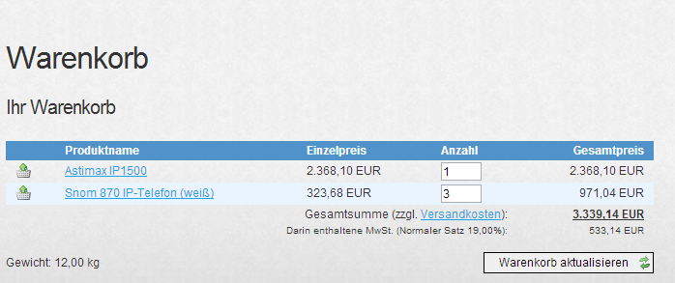
Business opportunity: Webshop
Visitor needs help with shopping cart
Customer service
C-Button Plattform
Questions?
Video and/or Audio
Additional data channel
Support Maske
Warenkorb Nr. 0815
Details: ….

Slide 10
Key benefits
Click to dial is working
Detailed information about caller possible
Customer can be called back, stays anonymous
Instant Co-Browsing
Video to enrich customer service
C-Button platform allows easy integration
=> Increases customer satisfaction!

Slide 11
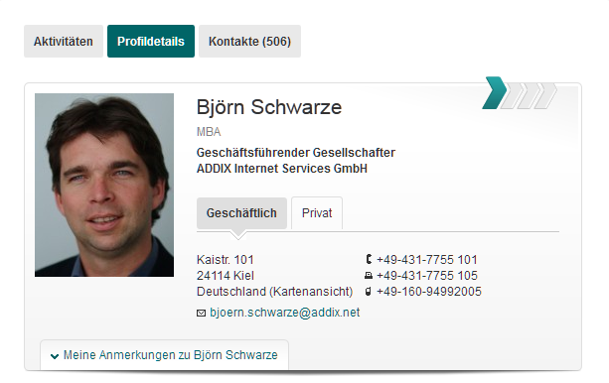
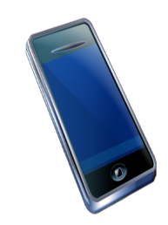
Business opportunity: social network
embedded in
the profile
C-Button Platform
Regular phone call
Call forward to landline
Björns Telephone
Call transfered to video
Notes:
Functionality not limited to social network, video calls, presence evrything is possible, the key benfit of our platform is the ease of use and the cross medial functionality.
Demo, Gateway, sip phone, webrtc client

Slide 12
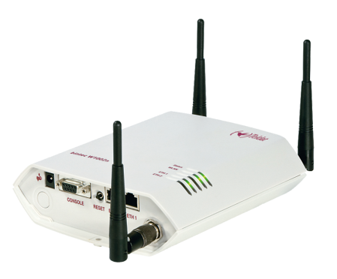
Business opportunity: ITSP
Internet
User
Regular phone call
Gateway
Call forward to landline
Telephone
Webpage
Mail
SMS
Social network
Call transfered to video
Notes:
Advantages:
Every customer of ITSP has opportunity to offer an additional caller channel
Usage up to customer: embed on website, access to everybody
Why: Marketing? USP? Promote brand name?
OTT? Airtime? Interconnection?
Do we now the billing models yet?

Slide 13
Call types
Wanted calls
Regular Calls
Negotiated Calls
Arranged per SMS, IM, Mail
Prescheduled (meetings)
Regular
Ambient Calls
Long running
Join 2 Spaces
‚talk‘ around the water cooler
Unwanted calls
Notes:
Video
Mehrwert für Kunden
individuelle Beratung
gesteigertes Qualitätsempfinden
Mehrwert für Anbieter
Vertrauensverhältnis ausbauen
stärkere Kundenbindung
mehr Umsatz generieren

Slide 14
Bill for value
Privacy
Anonymity
Security
Availability
Convenience
Results
Web-based business model?
Notes:
Video
Mehrwert für Kunden
individuelle Beratung
gesteigertes Qualitätsempfinden
Mehrwert für Anbieter
Vertrauensverhältnis ausbauen
stärkere Kundenbindung
mehr Umsatz generieren

Slide 15
Summary
Lots to do!
Communication is still key
User-centric web thinking
Tim Panton of Voxeo: ‚WebRTC will open the comms universe.‘
Notes:
Video
Mehrwert für Kunden
individuelle Beratung
gesteigertes Qualitätsempfinden
Mehrwert für Anbieter
Vertrauensverhältnis ausbauen
stärkere Kundenbindung
mehr Umsatz generieren

Slide 16
Live Demo
https://www.c-button.de/en/cb4all
Gateway

Slide 17
Thanks !!
Björn Schwarze
www.c-button.de
bs@junghannscom.de

Slide 18
Browser (Client)
RTC2SIP Plattform
IP Telefonanlage
WebRTC JavaScript API
new WebSocket()
WebSocket / HTTP Server
SDP Parsing / Generation
SIP User Agent
→ Zugriff auf Microfon und Webcam erlauben
REGISTER REQUEST senden (JSON)
SIP REQUESTS in SIP Header senden (UDP)
→ RTCPeerConnection erstellen
INVITE REQUEST senden (JSON)
UDP Pakete mit SIP Header empfangen
(local SDP description mitsenden)
INVITE RESPONSE empf. (JSON)
(remote SDP description empfangen)
SRTP Stream
SRTP Stream

Slide 19
Some technical facts
Encrypted connection between WebRTC Browser and C-Button Plattform
RTCPeerConnection enabled with JavaScript
Communication Browser ←→ Platform per JSON/TCP
Communication Platform ←→ destination per SIP/UDP
encoding JSON to SIP transaction done by platform
Established connection end-to-end as SRTP Stream

Slide 20
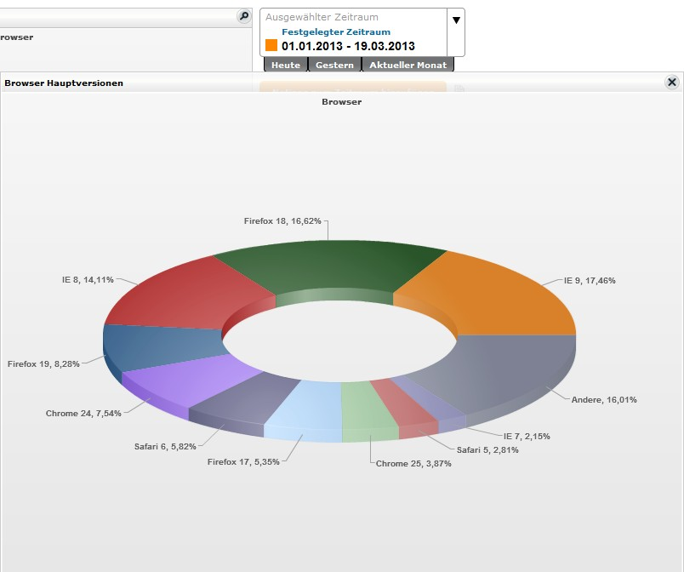
Browser Types

