Slide 1
WHY IVR IS ESSENTIAL TO RTC
ALLISON SMITH
OWNER/CEO THEIVRVOICE.COM
Notes:
Asterisk, also: Vonage, Verizon, Qwest, Cingular, Bell Canada, Cincinnati Bell, Hawaiian Telcom. Cisco Meraki, FreeSWITCH.

Slide 4
WHAT IVR HAS BEEN LIKE IN THE PAST:

Slide 5
WHAT IVR HAS BEEN LIKE IN THE PAST:
“WAITING ROOM”

Slide 6
WHAT IVR HAS BEEN LIKE IN THE PAST:
“WAITING ROOM”
FORMULAIC

Slide 7
WHAT IVR HAS BEEN LIKE IN THE PAST:
“WAITING ROOM”
FORMULAIC
EXPECTED

Slide 8
WHAT IVR HAS BEEN LIKE IN THE PAST:
“WAITING ROOM”
FORMULAIC
EXPECTED
NOT PART OF THE CORPORATE BRAND

Slide 9
WHAT IVR HAS BEEN LIKE IN THE PAST:
“WAITING ROOM”
FORMULAIC
EXPECTED
NOT PART OF THE CORPORATE BRAND
NOT USED TO ITS FULL POTENTIAL

Slide 10
WHAT IVR HAS BEEN LIKE IN THE PAST:
“WAITING ROOM”
FORMULAIC
EXPECTED
NOT PART OF THE CORPORATE BRAND
NOT USED TO ITS FULL POTENTIAL
BORING

Slide 12
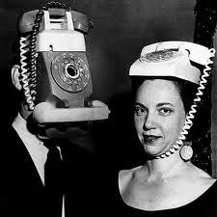

Slide 14
THE CORPORATE BRAND

Slide 15
THE CORPORATE BRAND
WEBSITE

Slide 16
THE CORPORATE BRAND
SOCIAL MEDIA

Slide 17
THE CORPORATE BRAND
BROADCAST

Slide 18
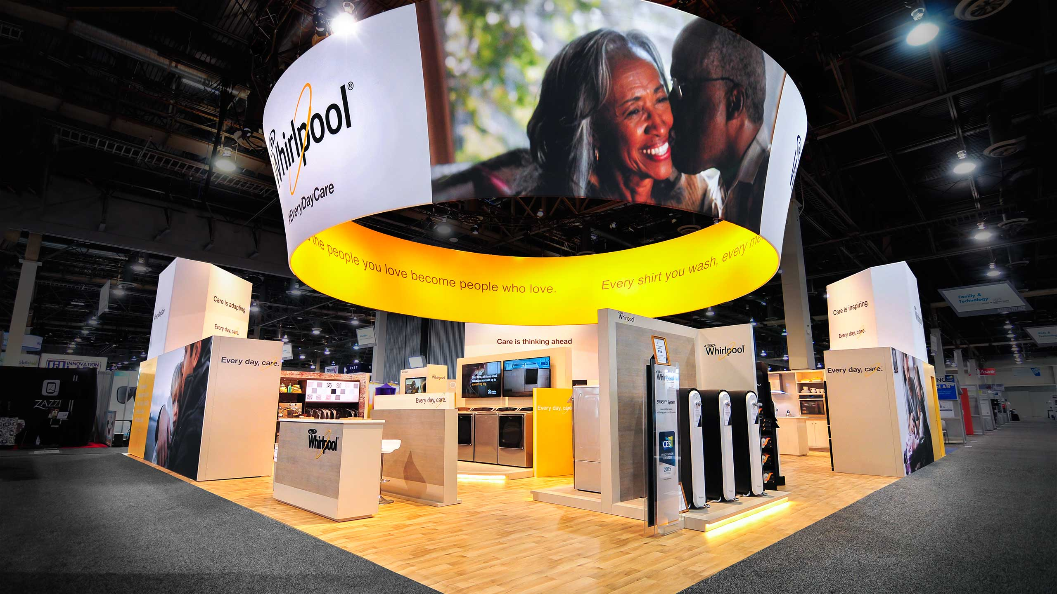
THE CORPORATE BRAND
TRADESHOW PRESENCE

Slide 19
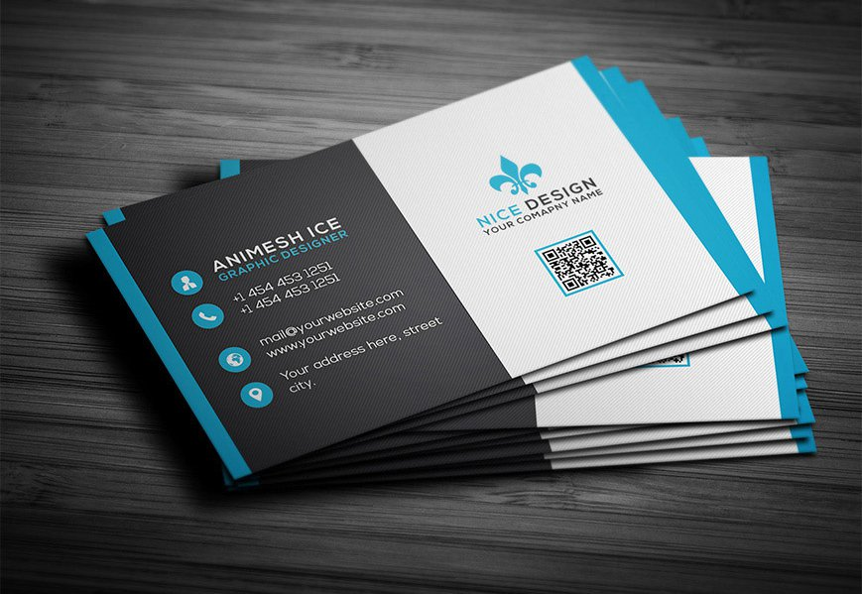
THE CORPORATE BRAND
PRINTED MATERIALS

Slide 20
THE CORPORATE BRAND
…EVEN OFFICE DECOR

Slide 21
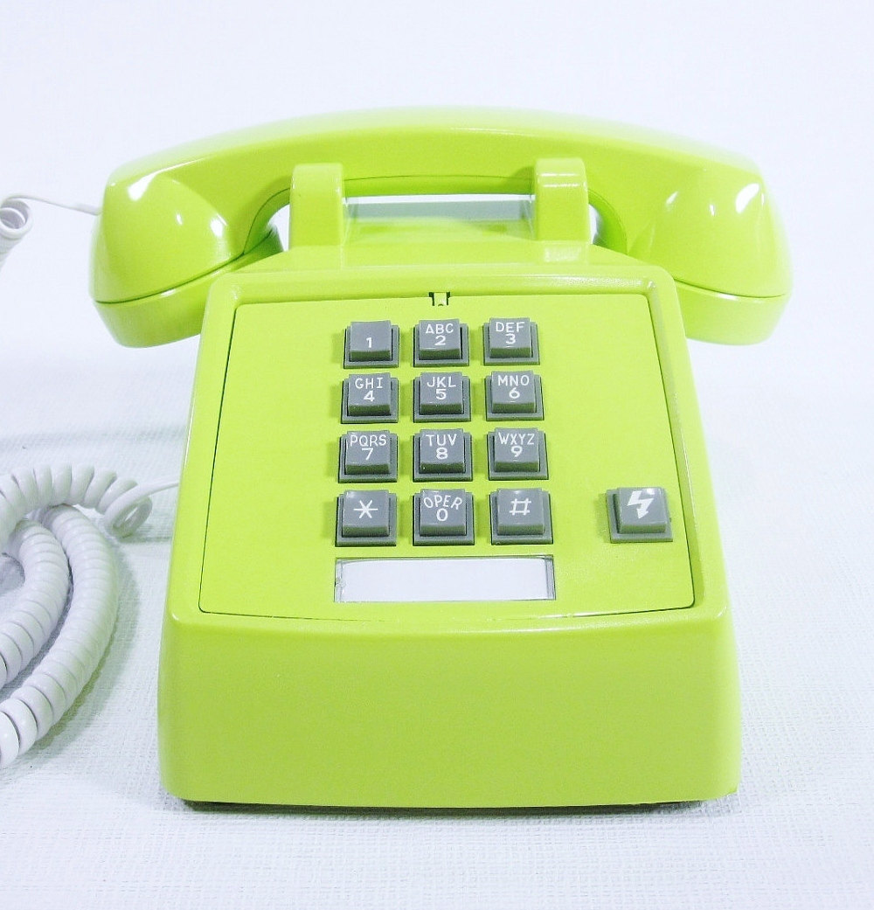
THE CORPORATE BRAND

Slide 22
WHAT IVR SHOULD *NOT* BE:

Slide 23
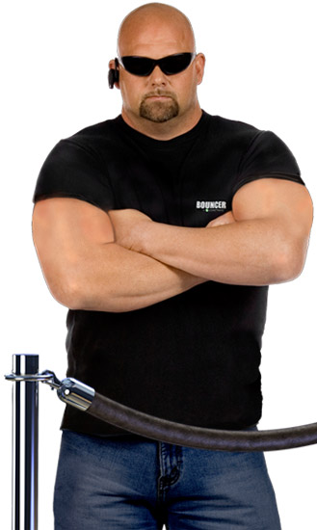
WHAT IVR SHOULD *NOT* BE:
BOUNCER
Notes:
Should not be in the business of velvet roping callers, or – God forbid – ejecting them

Slide 24
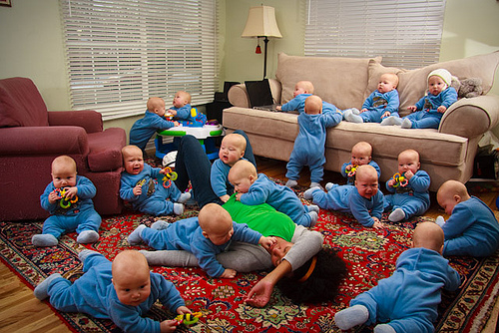
WHAT IVR SHOULD *NOT* BE:
BABYSITTER
BOUNCER
Notes:
IVR is not a daycare

Slide 25
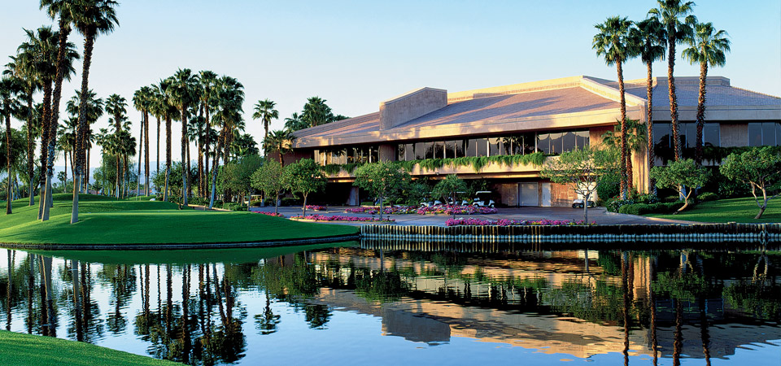
WHAT IVR SHOULD *NOT* BE:
BABYSITTER
COUNTRY CLUB
BOUNCER
Notes:
IVR should not be an elite area where only a few select – and the lucky enough to have called earlier – get in.

Slide 26
Notes:
Stagnant, suspended space

Slide 28
WHAT IVR *SHOULD* BE:

Slide 29
If there’s an IVR Heaven…..

Slide 30
WHAT IVR *SHOULD* BE:
A GATEWAY

Slide 31
WHAT IVR *SHOULD* BE:
A GATEWAY
AN *INTEGRAL* PART OF THE BRAND

Slide 32
WHAT IVR *SHOULD* BE:
A GATEWAY
AN *INTEGRAL* PART OF THE BRAND
THE *START* OF THE TRANSACTION
Notes:
Not *waiting to start* -- it’s already started

Slide 34
WHAT DOES THIS MEAN FOR

Slide 35
WHAT DOES THIS MEAN FOR
…and RTC in general…

Slide 36
YOU’RE PROVIDING:

Slide 37
YOU’RE PROVIDING:
SEAMLESS, CONSISTENT IMAGE THROUGHOUT YOUR SYSTEM
Notes:
Shaw example

Slide 38
YOU’RE PROVIDING:
SEAMLESS, CONSISTENT IMAGE THROUGHOUT YOUR SYSTEM
A PROJECTION OF PROFESSIONALISM

Slide 39
YOU’RE PROVIDING:
SEAMLESS, CONSISTENT IMAGE THROUGHOUT YOUR SYSTEM
A PROJECTION OF PROFESSIONALISM
THE BEGINNING – OR EXTENSION – OF THE COMPANY’S BRAND AND IDENTITY

Slide 40
YOU’RE PROVIDING:
SEAMLESS, CONSISTENT IMAGE THROUGHOUT YOUR SYSTEM
A PROJECTION OF PROFESSIONALISM
THE BEGINNING – OR EXTENSION – OF THE COMPANY’S BRAND AND IDENTITY
A PLAIN AND OBVIOUS STATEMENT OF YOUR COMPETENCY
Notes:
Callers are forming an opinion already

Slide 41
…AND FOR BONUS POINTS

Slide 42
…AND FOR BONUS POINTS
Notes:
You won’t hand it over to the end user for them to figure out recording – with the receptionist….

Slide 43
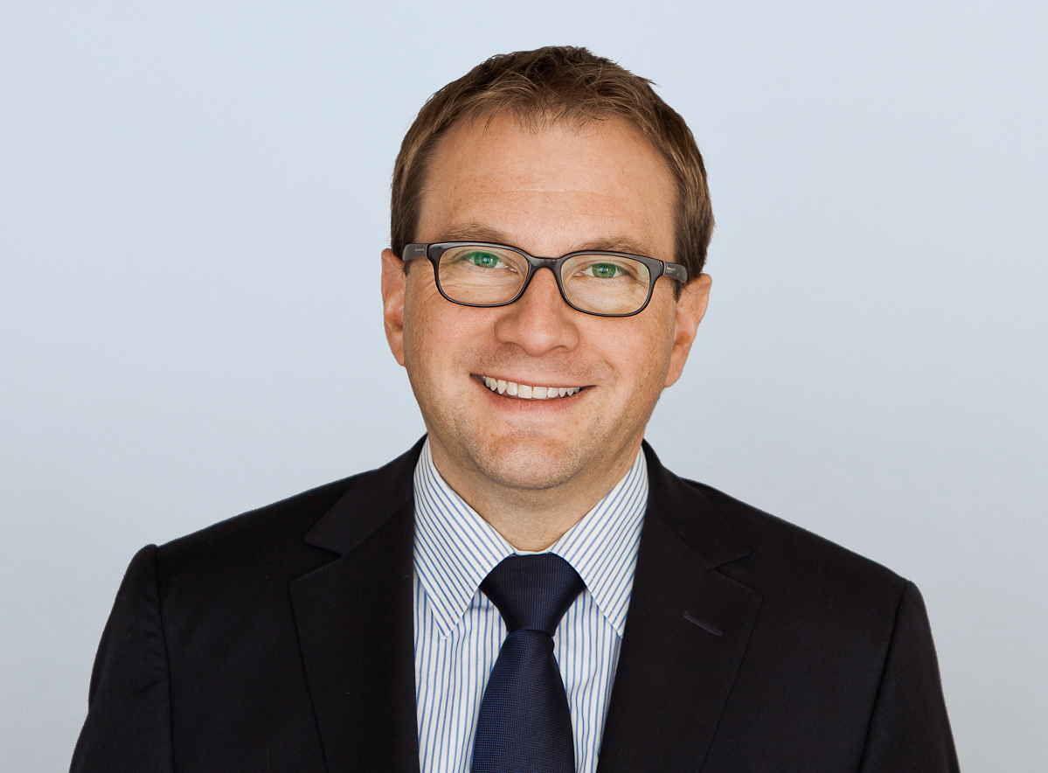
…AND FOR BONUS POINTS
Notes:
….the client themselves

Slide 44
…AND FOR BONUS POINTS
Notes:
….the client themselves

Slide 45
Notes:
Hire a pro

Slide 46
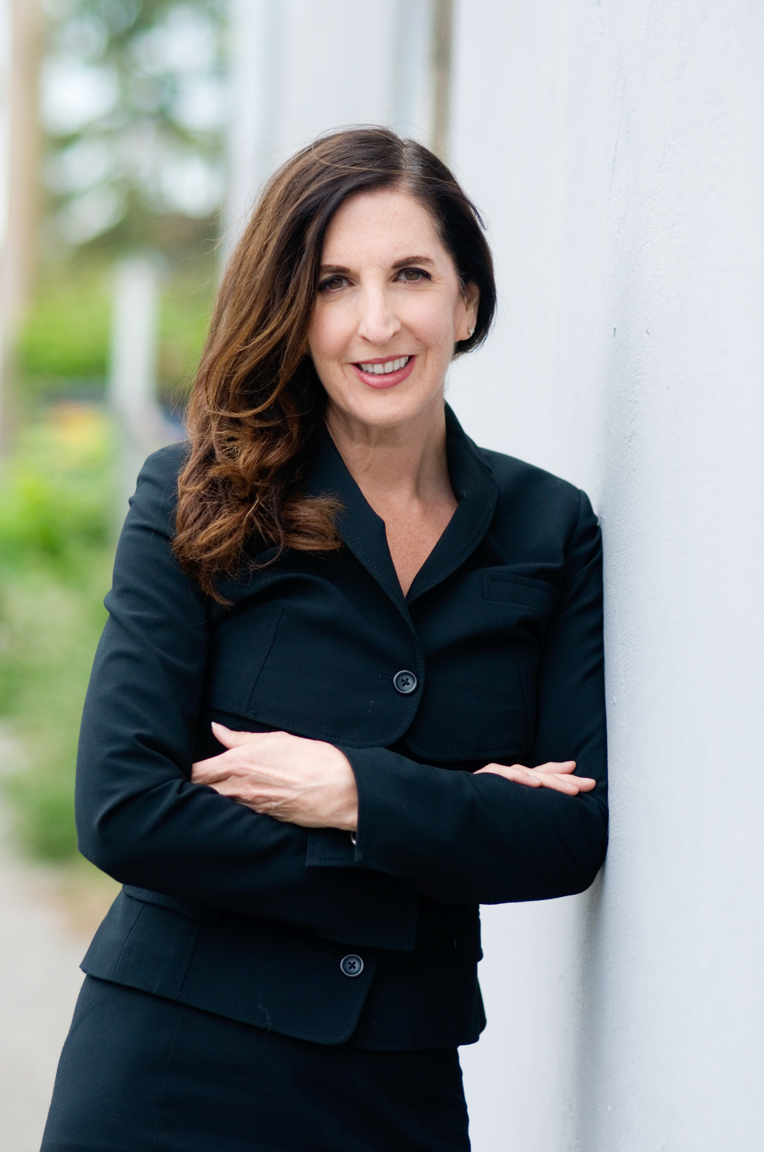
Notes:
Hire THIS pro!

Slide 47
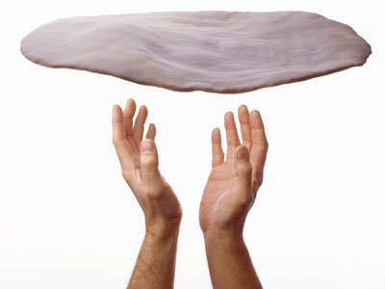
Notes:
It’s a skillset

Slide 48
A GOOD IVR:

Slide 49
A GOOD IVR:
WELCOMES….GENUINELY

Slide 50
A GOOD IVR:
WELCOMES….GENUINELY
SETS THE TONE

Slide 51
A GOOD IVR:
WELCOMES….GENUINELY
SETS THE TONE
INVOLVES THE CALLER

Slide 52
A GOOD IVR:
WELCOMES….GENUINELY
SETS THE TONE
INVOLVES THE CALLER
DOES NOT EXHAUST THE CALLER!

Slide 54
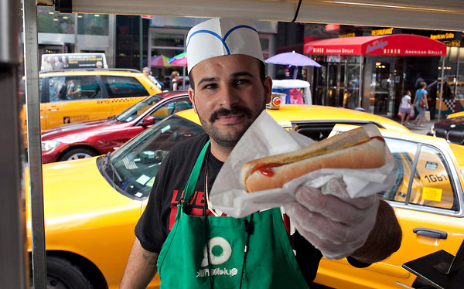

Slide 65
YOU’RE STRIVING FOR AN IVR WHICH….

Slide 66
YOU’RE STRIVING FOR AN IVR WHICH….
REFLECTS THE COMPANY’S PERSONALITY

Slide 67
YOU’RE STRIVING FOR AN IVR WHICH….
REFLECTS THE COMPANY’S PERSONALITY
ESTABLISHES WHAT IT WILL BE LIKE TO DEAL WITH THE COMPANY

Slide 68
YOU’RE STRIVING FOR AN IVR WHICH….
REFLECTS THE COMPANY’S PERSONALITY
ESTABLISHES WHAT IT WILL BE LIKE TO DEAL WITH THE COMPANY
TRULY ENGAGES THE CALLER

Slide 69
YOU’RE STRIVING FOR AN IVR WHICH….
REFLECTS THE COMPANY’S PERSONALITY
ESTABLISHES WHAT IT WILL BE LIKE TO DEAL WITH THE COMPANY
TRULY ENGAGES THE CALLER
MAKES THE CALLER AN ACTIVE PARTICIPANT IN THE PROCESS

Slide 70
YOU’RE STRIVING FOR AN IVR WHICH….
REFLECTS THE COMPANY’S PERSONALITY
ESTABLISHES WHAT IT WILL BE LIKE TO DEAL WITH THE COMPANY
TRULY ENGAGES THE CALLER
MAKES THE CALLER AN ACTIVE PARTICIPANT IN THE PROCESS
RESPECTS THE CALLER’S TIME AND PATIENCE

Slide 71
YOU’RE STRIVING FOR AN IVR WHICH….
REFLECTS THE COMPANY’S PERSONALITY
ESTABLISHES WHAT IT WILL BE LIKE TO DEAL WITH THE COMPANY
TRULY ENGAGES THE CALLER
MAKES THE CALLER AN ACTIVE PARTICIPANT IN THE PROCESS
RESPECTS THE CALLER’S TIME AND PATIENCE
DOESN’T JUST “ANSWER THE PHONE”

Slide 72
WWW.THEIVRVOICE.COM
ALLISON@THEIVRVOICE.COM
@VOICEGAL

