Slide 1
Adding WEB to WEBRTC
Tim Panton @steely_glint

Slide 2
About: Tim Panton
Protocol Droid
Webrtc evangelist
Standards pusher
Consulting at Wire.com

Slide 3
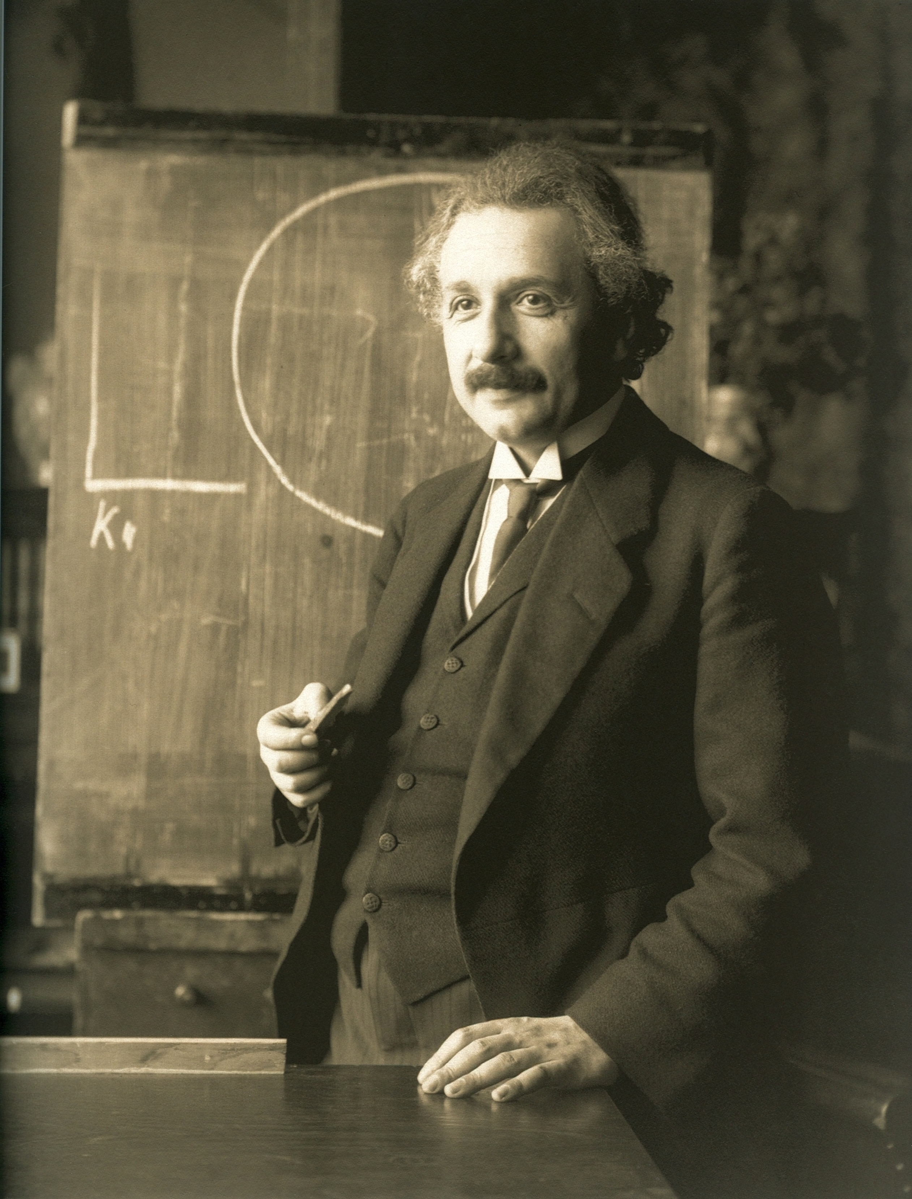
Change is Coming
1905
Newtonian Physics
All wrapped up
Almost…. ->
Photoelectric effect
Quantum view of universe
New possibilities
WebRTC is like that.
Changes communications baseline

Slide 4
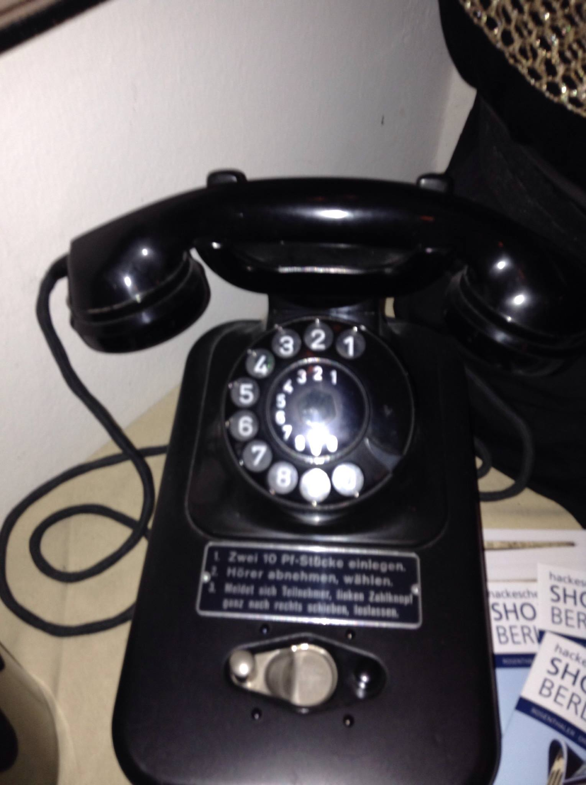
The Old way
Pay per min for calls

Slide 5
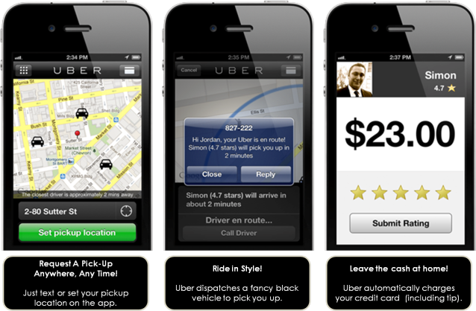
Not JUST ‘CALLS’ any MOre
Twillio will do 1bn webrtc minutes this year
Most of them in apps like Uber and twiddla
It is still communication – but in context
Context first – call second

Slide 6
Web Tools
Don’t underestimate Javascript
Combine
Cookies/context
WebGL
WebAudio
WebRTC

Slide 7
Context
Setting up a call is about establishing a shared context
Who am I?
Who can call who?
Do you want to speak to me?
Login + cookies is one way – but there are others
Text ‘upgrade’ is defacto now.
URLs:
https://appear.in/steely_glint
But that didn’t work for my video-call-my-parrot app.
(YoPet)

Slide 8
WebGL
Video effects in high level language
Realtime
Built into browser
Examples:
http://seriouslyjs.org/ - realtime green-screen in your browser!
http://www.html5rocks.com/en/tutorials/webgl/jsartoolkit_webrtc/AR_mediaStream.html - magic AR
Can also be applied to remote video streams.

Slide 9
YoPet Demo
Use video to
Exchange a token
Out of band
Save it
Proximity based pairing – like bluetooth but easier.
Filed a patent on Token choice
Untrusted (federated) middleman.

Slide 10
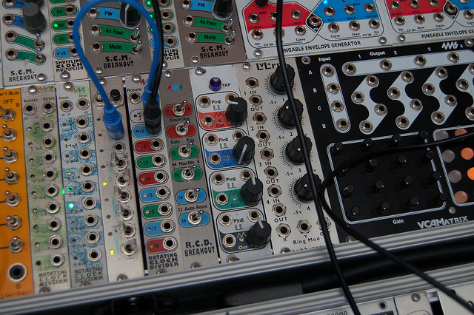
WebAudio
Late 80’s synth in your browser (https://www.flickr.com/photos/gmacklin/)

Slide 11
Literally
http://webaudiodemos.appspot.com/midi-synth/index.html
https://forestmist.org/share/web-audio-api-demo

Slide 12
So What?
WebAudio + WebRTC
Chrome supports outbound webRTC streams from WebAudio
Firefox >=39 supports both directions
Process your audio before sending it (chrome)
Filter, delay, fft, convolve
Combine effects to pitch shift
Display spectrum
Arbitrary maths in webworker
In Firefox you can do the same on the inbound side too

Slide 13
Example – inject test audio
No longer need to talk to yourself
Press a button to inject audio
No EC or ACG in the way
Test code only – not production
window.wire.app.repository.call.inject_audio_into_call( wire.app.repository.conversation.active_conversation().id, ”audio/ready_to_talk.mp3")

Slide 14
Code
_wrap_local_stream: (stream) =>
wrap_stream = stream
#should test for audio stream type here...
@contex = new window.AudioContext()
@localsource = @context.createMediaStreamSource stream
@localdest = @audio_context.createMediaStreamDestination()
@addeffects()
wrap_stream = @local_audio_dest.stream
return wrap_stream

Slide 15
Code
_suck_in_audio_file: =>
AUDIO_PATH = 'ext/audio/webapp-audio/'
knock_url = "#{AUDIO_PATH}ready_to_talk.mp3"
request = new XMLHttpRequest()
request.open('GET', knock_url, true)
request.responseType = 'arraybuffer'
request.onload = =>
load = (buffer) =>
@knock_audio_buffer = buffer
@logger.log "Loaded audio from #{knock_url}"
fail = =>
@logger.log "Failed to load audio from #{knock_url}"
@audio_context.decodeAudioData request.response, load , fail
request.send();

Slide 16
Code
send_audio_file: =>
# we unhook the mic , play our audio , then reconnect
if @knock_audio_buffer isnt undefined
knock_source = @audio_context.createBufferSource()
knock_source.buffer = @knock_audio_buffer
@local_audio_source.disconnect()
knock_source.connect(@local_audio_dest)
knock_source.onended = =>
@logger.log 'finished knock sound'
knock_source.disconnect(@local_audio_dest)
@_hookup_audio()
@logger.log 'play knock sound'
knock_source.start();

Slide 17
Code
_wrap_remote_stream: (stream) =>
wrap_stream = stream
if @context isnt undefined
#only works in ffox >= 39
@remote_source = @context.createMediaStreamSource stream
@remote_dest = @context.createMediaStreamDestination()
@remote_audio_source.connect(@remote_audio_dest)
@add_effects2()
wrap_stream = @remote_audio_dest.stream
@logger.log 'Wrapped remote audio stream'
return wrap_stream

Slide 18
If you like graphics
Firefox debug screen
Various plugboards
Volume meter

Slide 19
latency measurement
Use WebAudio to Inject Audio
Acoustically couple to test device
Compare returning stream from DUT
Measure latency from differences
Tests Audio and network path
Experimental in Firefox nightly

Slide 20
Summary
Web Browser has rich APIs
Use them to delight your user
To make your life easier
Or both!
thp@westhawk.co.uk
@steely_glint
(thanks to wire.com for supporting this talk)

