Slide 1







The Rise of Private Networks in 5G
© Matthias Heyde / Fraunhofer FOKUS
Marius Corici
Dept. Head of the Software-based Network
Fraunhofer FOKUS Institute
marius-iulian.corici@fokus.fraunhofer.de

Slide 2
What is 5G?
“5G is an end-to-end ecosystem to enable a fully mobile and connected society. It empowers value creation towards customers and partners, through existing and emerging use cases, delivered with consistent experience, and enabled by sustainable business models.” NGMN 5G Vision
Multimedia
Automotive
eHealth
Industrial
Massive IoT
Mobile Broadband Connectivity
Enterprise and Private Networks
5G System
5G Radio
LTE
NB-IoT
WLAN
Dedicated or common end devices

Slide 3

Key Communication Changes with 5G
5G is based on a comprehensive software system using all the resources available in the system
The network functions are becoming software only → convergence with IT
  More flexible network infrastructures (growing on demand, adapting to changes)
  Enabling the parallel deployments of multiple dedicated networks
Network functions can be installed in compute nodes at the edge of the network
Development of new types of local private or public access networks (and integrating existing ones)
Integration of existing and new local access networks
Moving the intelligence towards the edge
Softwarization of the network
UE
UE
UE
UE
Infrastructure
Infrastructure
Infrastructure
Local Access Network
Fixed or Mobile/ Backhaul
Wide Area Network
Fog Nodes
Edge Nodes
Central Cloud

Slide 4
Major Advantages of the 5G evolution
The 5G ecosystem takes advantage of these changes when implementing the network functions able to seize the infrastructure advantages
Communication can be executed through dedicated networks
  Using the same network functions
  Customized for the needs of the use cases
Network functions can be placed in different network locations
  Providing differentiated services, security and resilience
Local access networks can use carrier-grade network technologies
  Addressing the vertical requirements with the same technologies
  Enables anybody with communication requirements to install a network
UE
UE
UE
UE
Infrastructure
Infrastructure
Infrastructure
Local Access Network
Fixed or Mobile/ Backhaul
Wide Area Network
Fog Nodes
Edge Nodes
Central Cloud

Slide 5



The Network Functions Perspective
The 5G system is a distributed system
  The network functions should be able to understand the underlying connectivity
  Network functions should be properly synchronized
The 5G system is a software system
  Performance depends on the underlying uncertain infrastructure
New mechanisms for ensuring the resilience and the security
  With different levels of trust on the infrastructure
  With different levels of trust on the backhauling networks
➔ The 5G system should be adaptable enough to run on the available infrastructures (or at least be able to determine on which infrastructures it can run)
UE
UE
UE
UE
Infrastructure
Infrastructure
Fixed or Mobile/ Backhaul
Wide Area Network
Infrastructure
Local Access Network
Fog Nodes
Edge Nodes
Central Cloud

Slide 6
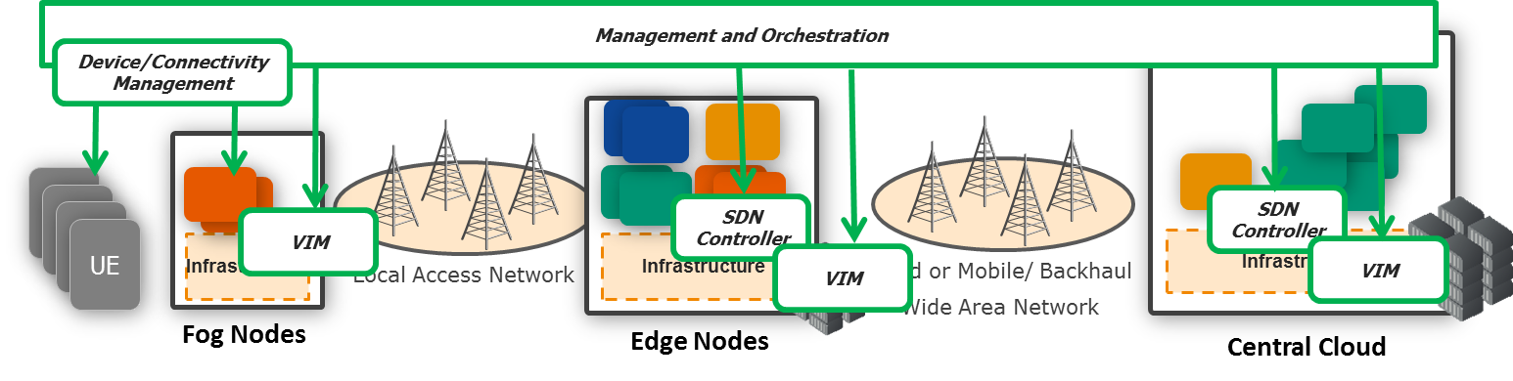
The Infrastructure Perspective
Providing mechanisms and features needed for distributed system deployments (on Device/Fog, Edge, Central nodes)
➔ Moving mechanisms from the 5G system level to the new infrastructure middleware
Performance enhancement – load balancing and high availability
Resilience of the end-to-end communication
Security at infrastructure level
Secure and Reliable Connectivity management (for local private networks or for distributed operator networks)
Real-time autonomous management of the infrastructure (hiding the details)

Slide 7
The Integrated Perspective
Providing a cross-layer communication between the network functions and the infrastructure level
Adapting the deployments to service requirements – dynamically adding network functions according to the service administrator needs, adapting the service based on momentary status
Externalizing functionality to infrastructure – load balancing, high availability, security, backhaul selection
Providing service status and infrastructure information – on the externalized functionality, on the current status of the system
Management and Orchestration
Adapting the deployments to the service requirements
Providing service status and infrastructure information
UE
UE
Externalizing functionality to infrastructure
UE
UE
Infrastructure
Infrastructure
Infrastructure
Local Access Network
Fixed or Mobile/ Backhaul
Wide Area Network
Fog Nodes
Edge Nodes
Central Cloud

Slide 8
The 5G System Architecture
Starting from the 4G EPC, 3GPP defined a new architecture for the 5G system adapted to the software world
Contol-User Plane Separation (CUPC) – enabling full user plane flexibility
Separation of the Access and Mobility from Session Management – enabling that control messages are going only over the control plane
Adding slice selection functionality for running multiple customized networks
Complete integration with the PCF – enabling policy based decisions at AMF level
NSSF
AUSF
UDM
AMF
SMF
PCF
AF
UE
(R)AN
UPF
DN
Notes:
UE – User Equipment
(R)AN – the access network could be anything, not only Radio e.g. Fixed networks, satellite networks, proxying networks over 3GPP access

Slide 9
Mapping to 3GPP EPC
The 5G system represents an evolution of the existing components towards software networks + the control user plane split
HSS
NSSF
AUSF
UDM
MME-DP selection
SGW-C
MME
PGW-C
PCRF
AF
AMF
SMF
PCF
AF
UE
(R)AN
UPF
DN
UE
eNB
PGW-U
SGW-U

Slide 10
Integrating with 3GPP EPC
The integration is made through the colocation of the network functions instead of interworking interfaces
There is no need for dedicated interworking functions (lower end-to-end delay, higher network capacity, less components to manage)
Software upgrades could be used to extend the functionality of existing network functions (as the former GGSN+ component for LTE)
UDM
HSS
PCF
PCRF
SMF
PGW-C
UPF
SGW
PGW-U
MME
AMF
eNB
(5G
UE
UE

Slide 11
Integrating non-3GPP access networks
The non-3GPP accesses are integrated through proxying of the 5G signaling
UEs use the same NAS protocol across all accesses
Control and data plane may be separated over multiple accesses
No interworking is needed for authentication, authorization and mobility management
AUSF
UDM
3GPP Access
AMF
SMF
N3IWF
UPF
DN
Untrusted Non-
3GPP Access
UE
Notes:
UE does not have to use non-3GPP authentication to be translated to 3GPP one.
N1 interface is directy from the UE to the AMF no matter of the access (NAS over whatever physical environment)

Slide 12
5G System: A Service Based Architecture (SBA) perspective
SBA represents a radical re-thinking of the packet core network towards an efficient micro-services architecture
All control plane functions are connected to a “virtual bus” on which direct messages are exchanged
TPC / HTTP2 / JSON – a single unified protocol stack for a large number of components
NSSF
NEF
NRF
UDM
PCF
AF
AUSF
AMF
SMF
NWDAF
UE
(R)AN
UPF
DN
Notes:
Adds three additional network functions:
NRF – Network Repository Function: an extended form of DNS enabling network functions to find the other correspondent network functions AND to receive notifications when they scale (or new ones are deployed)
NEF – Network Exposure Function: similar functionality to the EPC Service Capabilities Exposure Function (SCEF) enabling the communication

Slide 13
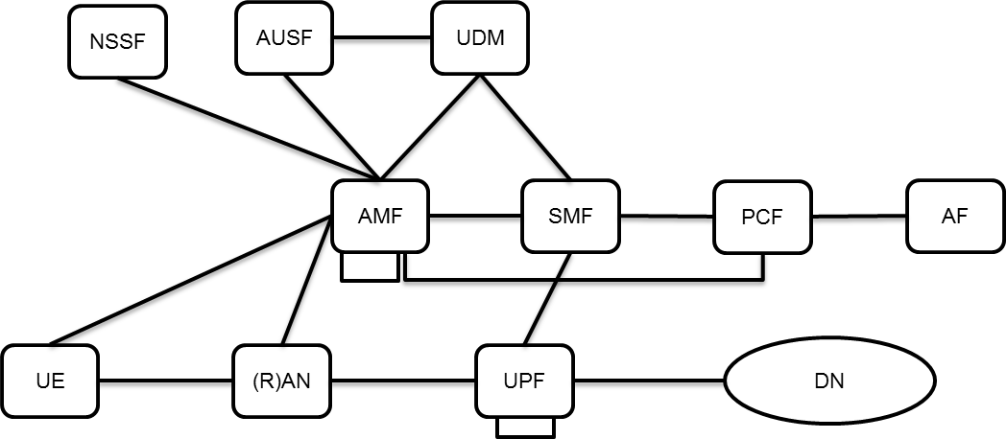
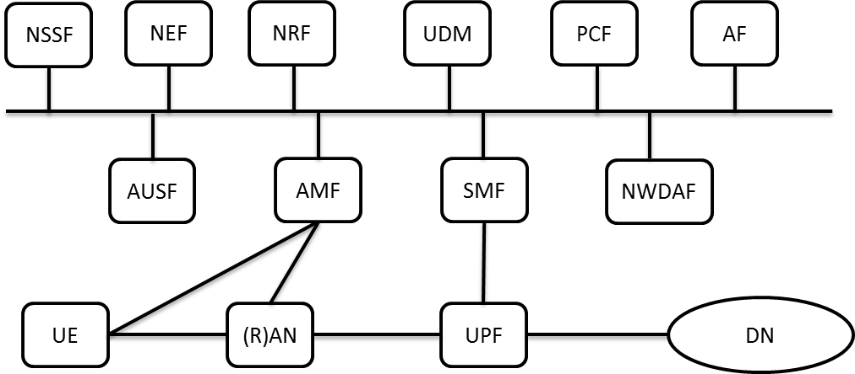
Classic vs. Service Based Architecture
Classic Architecture
Based on telecom protocols
Naturally integrating with the 5G RAN
Easy to migrate and interoperate with LTE (most of the protocols are similar)
Easy to develop starting from existing architecture
Service Based Architecture
Based on optimized internet protocols
Following the micro-services approach (easy to add new services)
Using a uniform easy to automate protocol in the control plane (HTTP2/JSON)
Easy to interact with the service administrator and application functions
Maintains most of the complexity (due to the interaction with RAN and data path)
Notes:
Classic architecture – meant to be fast
Dissadvantages of SBA:
- Adding a new component means modifying the state machine of the exisi

Slide 14
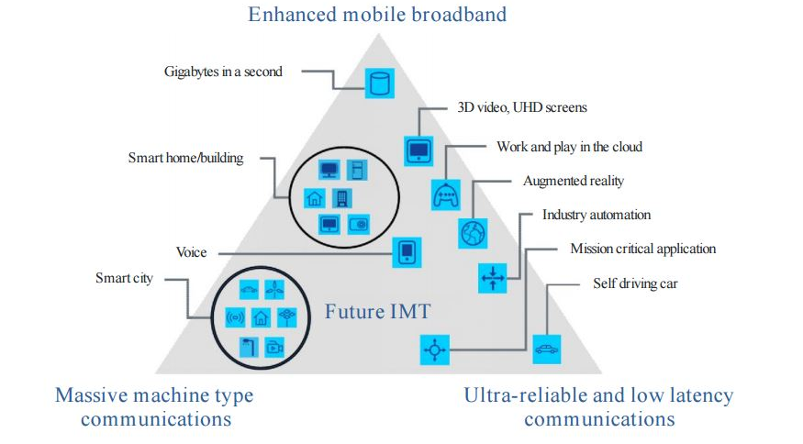
The 5G Use Cases
5G networks aim to address more the mobile broadband use cases, adding especially “vertical” use cases coming from other industries
Usage scenarios for IMT2020 and beyond © ITU-T
Widening of current communication use cases
Network Islands of Gigabit/s communication
Low Cost connectivity for huge number of devices
Critical & low latency communication
50Mbps anywhere
Flexible Networks
Notes:
There are 126 use cases if combining 3GPP, NGMN, 5G America and 5GPPP
Spanning from connectivity for Drone to wireless local loop, to broadcast, to cloud computing, to vehicle-2-X communication, to satellite eNBs.

Slide 15
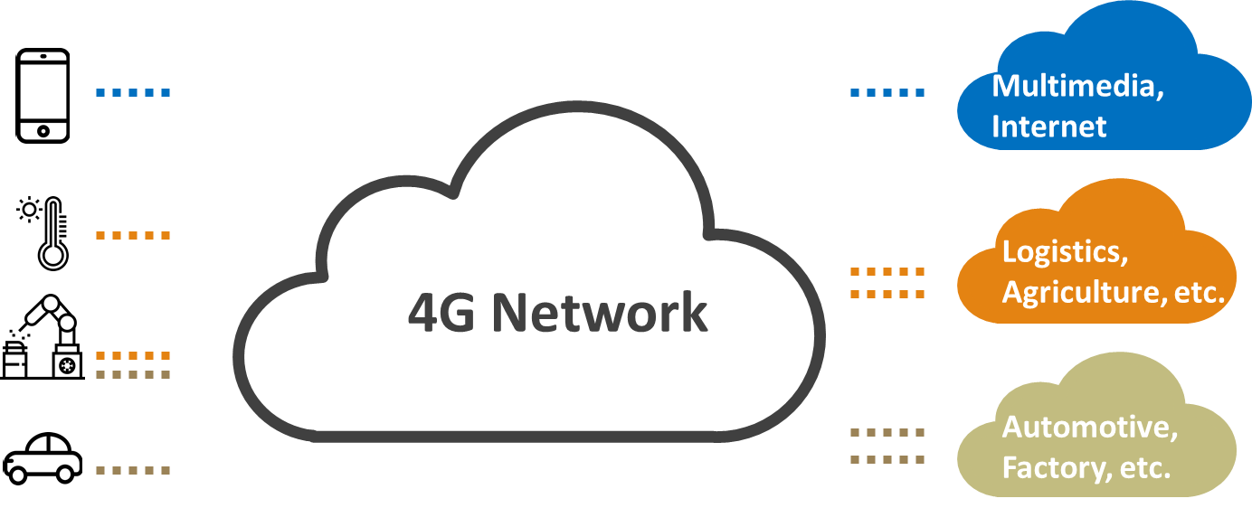
A uniform network for all the use cases
The requirements of the use cases are too heterogeneous that a single set of functions could efficiently satisfy all.
The requirements of the different use cases are highly varying in terms of:
  End-to-end network delay and capacity
  Reliability and security
  Number of devices connected and geographic coverage
  Mobility
  Usage cost expectations

Slide 16
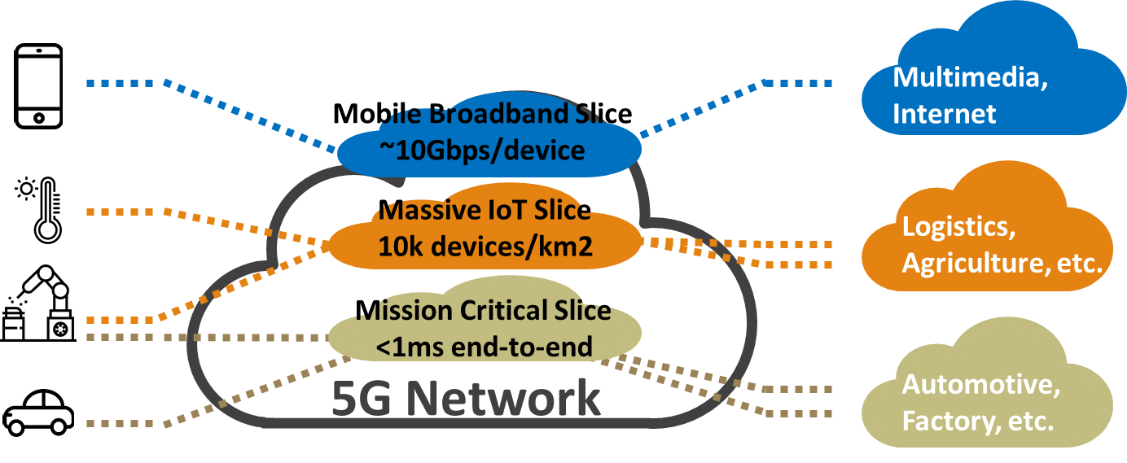
Network Slicing
Each of the communication services is supported by a dedicated virtualized network composed of software components customized for the specific requirements
The same wide area network infrastructure is used for deployment of dedicated networks
Slices could be administrated by the service owner

Slide 17
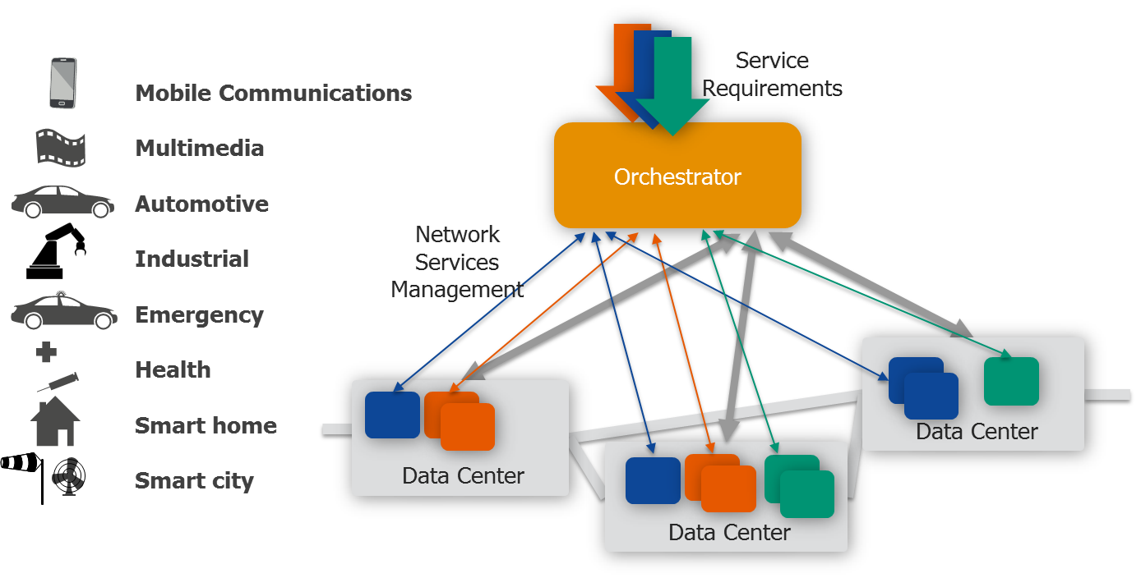
Network Slicing (cont.)
The network slices are deployed and managed autonomously based on the service requirements on top of the distributed operator infrastructure
Automatically customized at deployment and during runtime to service needs
Reduced network management knowledge required
A simplified infrastructure is exposed to the service owner

Slide 18
Why use a 5G system instead of a 4G one?
The 5G system provides a very high level of flexibility addressing the specific requirements of the use cases
Network functions can be customized depending on the communication requirements
The system can be deployed and use the infrastructure available at the location
  Adapt to the compute capabilities of the nodes
  Optimize the communication between locations
The system can integrate with different access networks (including WLAN and LTE)
Integrating with the local access networks
  Providing optimized communication for outside communication of local networks
  Providing mobile local networks
  Integrated with the large scale operator networks / with local administration
UE
UE
UE
UE
Infrastructure
Infrastructure
Local Access Network
Fixed or Mobile/ Backhaul
Wide Area Network
Infrastructure
Fog Nodes
Edge Nodes
Central Cloud

Slide 19
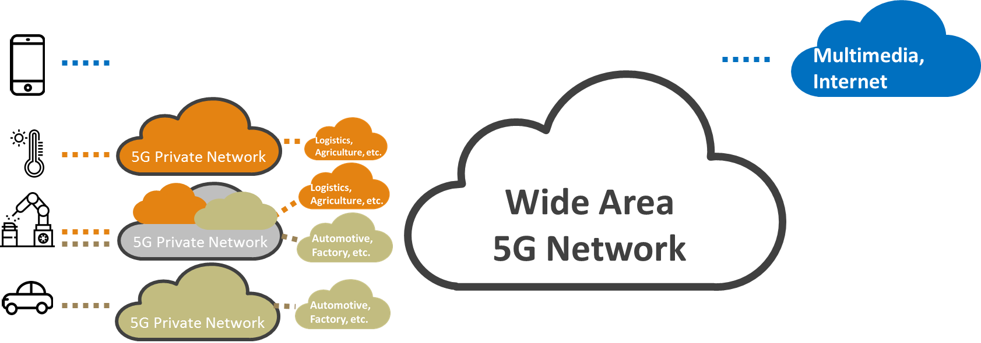
5G Private Networks
With 5G the delay, capacity, coverage/cell and reliability are highly increased, making the technology attractive for the enterprise and mission critical networks
The 5G networks are deployed in a smaller environment (less coverage and less devices connected) for addressing only one of the specific use cases
Networks are administrated like any private networks
The private networks may include multiple connectivity islands (enterprise locations) and/or mobile ones (e.g. private networks in vehicles

Slide 20
Why use a 5G system instead of a non-3GPP one?
The 5G system provides an increased level of security and reliability while having a large capacity and low delay
The 5G system includes the security and the reliability mechanisms of the wide area network which can be easily adapted for local private networks
  The security of the communication was one of the main requirements since GSM
  The 5G network inherits the complete resource allocation mechanisms at the base station (guaranteed resource allocation)
5G system is very flexible in terms of physical access technologies
  <1Ghz, <6Ghz, mmWave (x10GHz), fixed networks, satellite networks, unlicensed
  A very large number of devices can be connected
5G supports connectivity over unreliable backhauls (over third fixed or mobile networks)
UE
UE
UE
UE
Infrastructure
Infrastructure
Infrastructure
Local 5G Access
Third party network (fixed, mobile, satellite)
Fog Nodes
Local back-end
Central Office

Slide 21
Slices vs. 5G Private Networks
Depending on the use case and on the investment capacity a vertical may consider to use slices offered by operator or to deploy an own 5G private network
Slices (as evolution of VPN in 5G):
  Main advantage of 5G: customized network according to the requirements
  Offering coverage in the full operator network
  Providing customized network services with the reliability guaranteed by the operator
  Using a shared network environment
  Very low deployment costs (using the operator deployed infrastructure)
Private networks (as evolution of non-3GPP private networks to 5G ones)
  Main advantage of 5G: customized network according to the requirements
  Own administrated network
  Own authentication and authorization of the devices
  Complete isolation of the local connectivity
  Requires large investments especially towards wide area
Notes:
This is not an either/or question. At the current moment almost all enterprises have a private network (non-3GPP) and use a VPN service offered by the operator. This is a question of how the two will ponder to each other when the VPN will evolve to a slice and the private network will evolve to 5G.
The first point is intentionally the same

Slide 22
The Evolution of Dedicated Networks
5G Complete mix: Operators are offering private networks and slicing, private networks are extending to wide area using SD-WAN and other backhauling technologies
Private 5G deployments: private networks use 5G technologies to deploy distributed networks
Initial 5G deployments: Operators are offering “slices” to address the needs of the “verticals”
Current status: Private networks and Wide Area Networks are separate
Local Networks
Distributed Enterprise Networks
Wide Area Networks
Notes:
Current status: BYOD is the only common point. But this is with own authentication, authorization and mobility in the private network

Slide 23







Local (Edge) Networks
Transferring part of the functionality from the central nodes to the edge of the network
Independent Networks
Integrated Edge with Unreliable Backhaul
Edge Network
Edge Network
Apps
Apps
Apps
Apps
Apps
Apps
Infrastructure
Back-to-Back Backhaul Networks
End-to-end Integrated Edge
Edge Network
Edge Network
Apps
Apps
Apps
Apps
Apps
Apps
Apps
Apps
Apps
Infrastructure
Infrastructure

Slide 24
Edge (Distributed) Network Deployments
Edge Service Hosting nodes give the opportunity to localize communication and to optimize the usage of the backhaul resources
Edge networks have all the premises to remain as the basis of future communication
  Cloud computing and softwarization is a large success
  Hardware became performant and cheap
  Edge network administrators are already adopting a large amount of these technologies
Integration of existing and new local access networks
Moving the intelligence towards the edge
Softwarization of the network
UE
UE
UE
UE
Infrastructure
Infrastructure
Infrastructure
Local Access Network
Fixed or Mobile/ Backhaul
Wide Area Network
Fog Nodes
Edge Nodes
Central Cloud

Slide 25
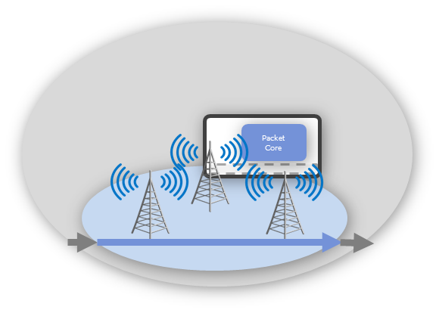
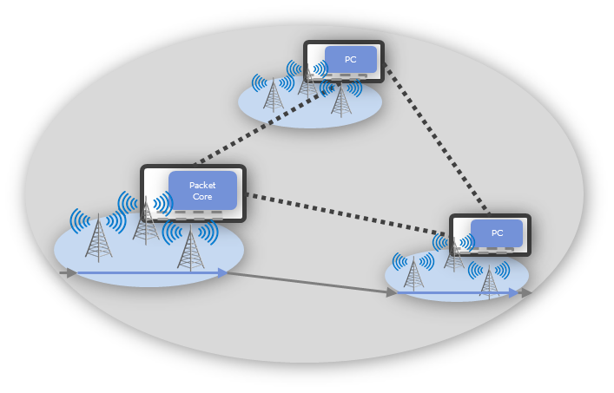
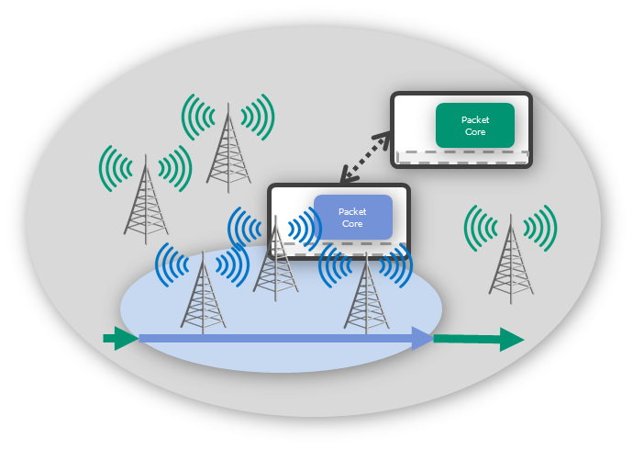
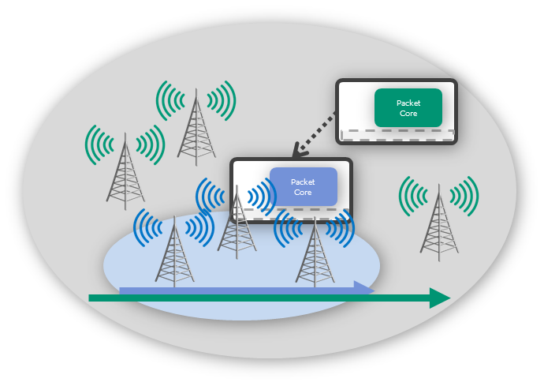
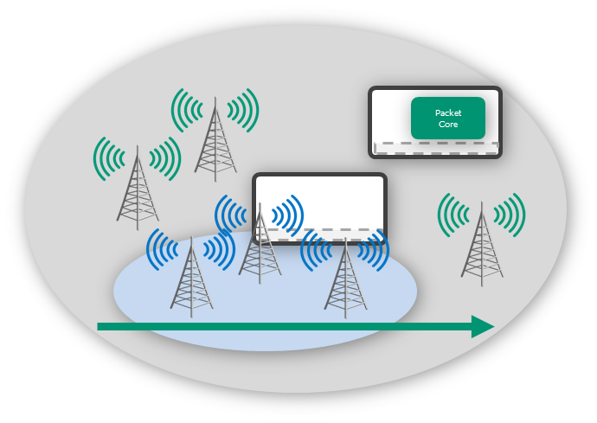
UE connectivity models for edge networks
Depending on the use case deployment, the Edge Networks may provide different connectivity models (and different edge/central split architectures)
Only local connectivity
Only local distributed connectivity
Roaming to macro-operator(s)
Additional connection
Integrated Operator

Slide 26
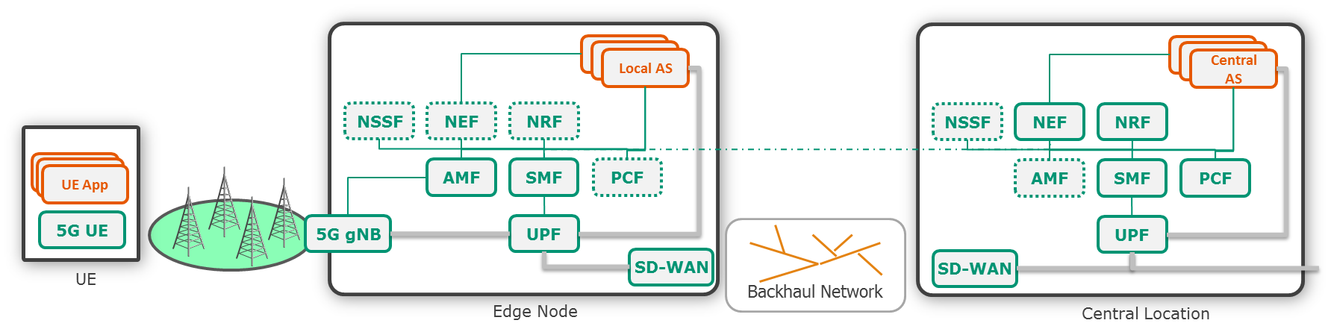
Only Local (Distributed) and Additional Connectivity
These edge networks are similar to the Local Access Networks and could be separately administrated from the end-to-end operator network
The local edge node has to assure the local connectivity (L-AMF) and the offloading towards the local Application Servers (L-SMF and an offloading UPF)
For multi-slice architectures also the NSSF has to be deployed
For backhaul to other locations an SD-WAN solution adapted to 5G is included:
  Selecting between multiple available backhauls (satellite, terrestrial, OTT over mobile operators, etc.)
  Establishing the best QoS across the available backhauls (gating, priorities, disconnections, etc.)
  Securing the backhaul connectivity
  Dynamic for nomadic and mobile edges

Slide 27
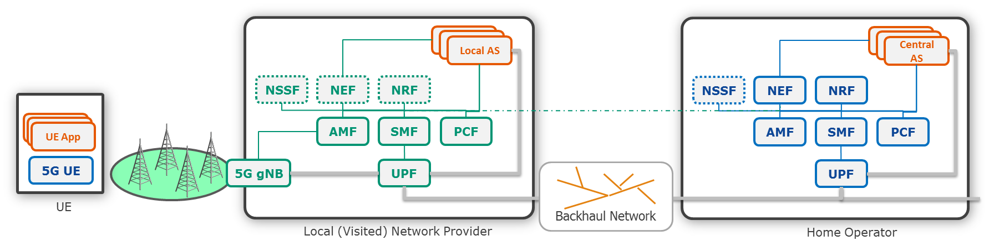
Roaming to the macro-operator network
An edge network can offer services to multiple devices pertaining to multiple operators
In case the edge networks will proxy the connectivity for multiple other operators, it has to provide (national) multi-operator roaming capabilities
A typical 5G roaming architecture adapted for local connectivity
  Agreement on the SLA offered to the subscribers incl. reliability of the local access network
Fast handover to a visited network has to be considered
  vAMF-hAMF communication during the handover procedure
  vSMF-hSMF clear role separation
  The UE has to be announced when joining the visited network that she can enjoy the local services

Slide 28
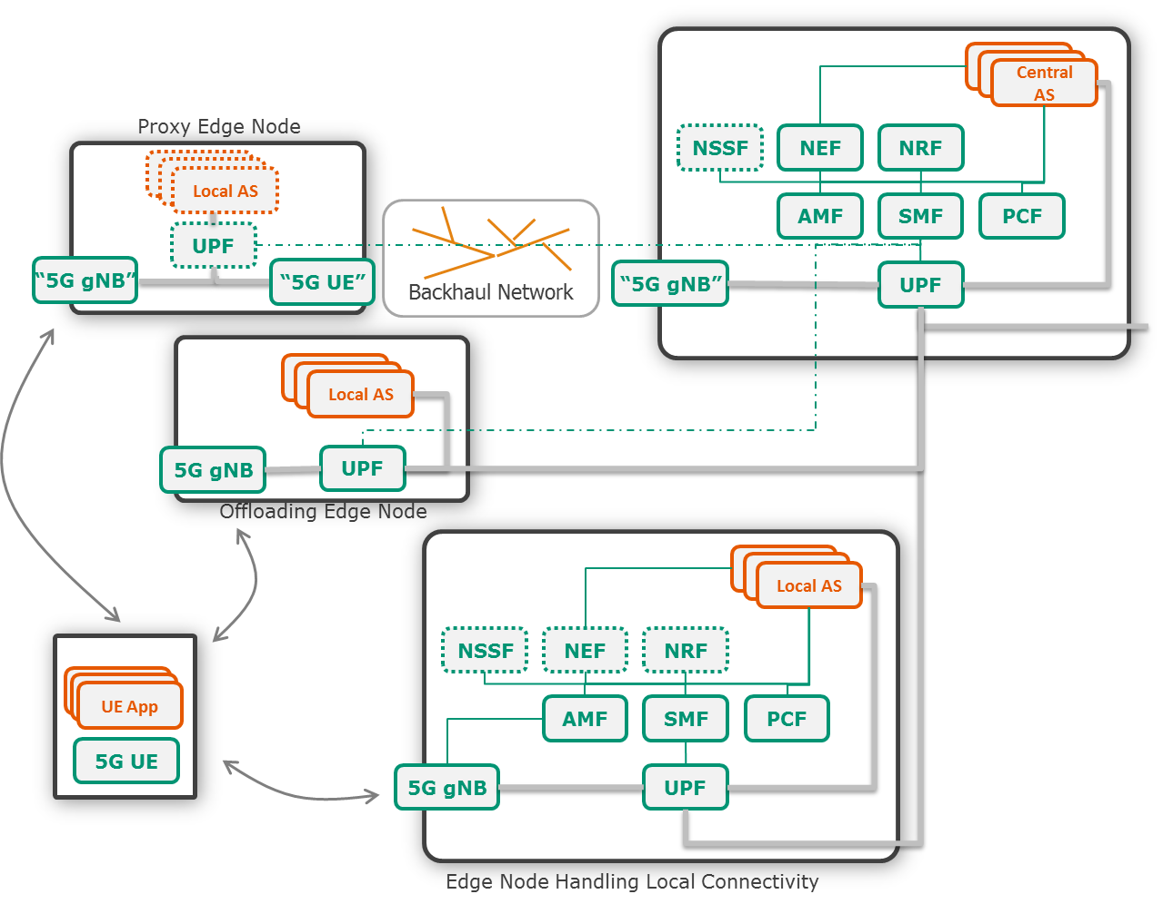
Integrated operator networks
The operators may deploy edge nodes for optimizing their network connectivity
Self-backhauling scenarios with the same or different access technology
  The backhaul may be over other access network (satellite, fixed networks, etc.)
  The proxy node may include local application servers or only proxy radio messages
Adding a service hosting node (edge applications) at the edge of the network
  A second authentication enables the connectivity to local applications
Optimizing local connectivity – handling locally mobility, session management, etc.
  Local operations are offloaded to an edge node
Notes:
Self-backhauling for the backhauling over wireless of small cells mainly and for indoor coverage. Could be used also for mobile edges. 3GPP Rel. 16 will define this
Optimizing local connectivity – providing a box to o

Slide 29

Mobile SD-WAN
SD-WAN is a critical technology for distributed edge network deployments as it provides the required management of the backhaul
The back-end of the remote mobile network has to be able to:
  Select the appropriate backhaul in a specific location
  Select the backhaul or interrupt communication depending on the applications
  Communicate with an end-to-end SDN network management
  Provide the secure association with central node
VNF
VNF
VNF
VNF
Satellite Network
End-to-End SDN
Management
VNF
VNF
SDN
Controller
Infrastructure
Terrestrial Network
VNF
VNF
VNF
VNF
VNF
VNF
VNF
VNF
VNF
VNF
Terrestrial Network
VNF
VNF
SDN
Controller
SDN
Controller
Infrastructure
Infrastructure

Slide 30


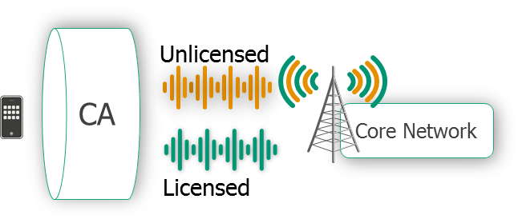
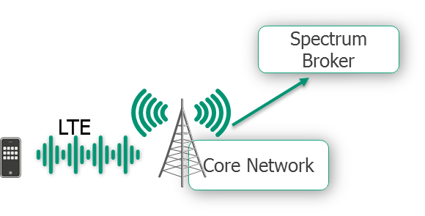
Spectrum allocation alternatives for local networks
Using Unlicensed Spectrum only
  Using an independent access point with a separated modem like WiFi now
  5G-U / LTE-U – deployment of an LTE base station in unlicensed spectrum (e.g. 5GHz)
Combining Licensed and Unlicensed spectrum
  Carrier aggregation with WiFi
  Licensed assisted access (aggregating unlicensed access in the same base station)
Using licensed spectrum with limited lease
  Licensed Shared Access (LSA) – spectrum is allocated through an independent broker
  Authorized Shared Access (ASA) – spectrum is leased by the operator
WiFi
Core Network
LTE-U
Core Network

Slide 31



R&D Tracks @ FOKUS
Fraunhofer FOKUS is offering activities which supply the different R&D steps
Long Term Research (2-5 years)
Development of new concepts, architectures, protocols, algorithms
Short Term Research (1-2 years)
Development of items in the immediate standardization interests
Testbed deployments
Transferring the knowledge at the customer premises, customization, integration and trials
5G Playground
Using the FOKUS 5G Playground for experiments, trials and pilots

Slide 32
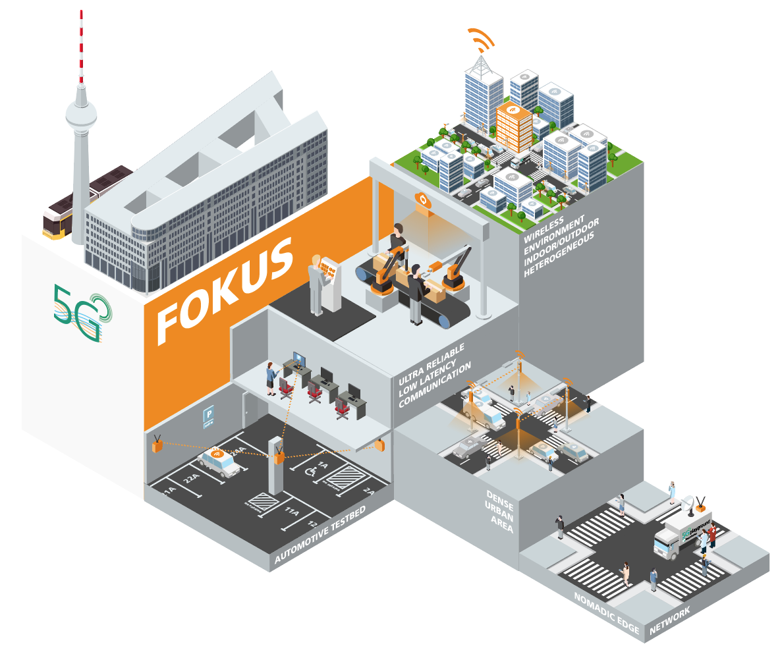
5G Playground @ FOKUS
Turn-key 5G testbed located within and around the Fraunhofer FOKUS premises empowering 5G Berlin with a pragmatic deployment
With experimental licenses in 700MHz, 2,6GHz, (3.5GHz planed)
Combined 4G, 5G and WiFi access networks
Including deployments for:
  Outdoor/indoor heterogeneous wireless
  Ultra-reliable low latency test factory
  Automotive testbed (parking place)
  Dense urban area environment
  Nomadic edge node
Providing a multi-slice environment for customized and independent deployments for each use case

Slide 33

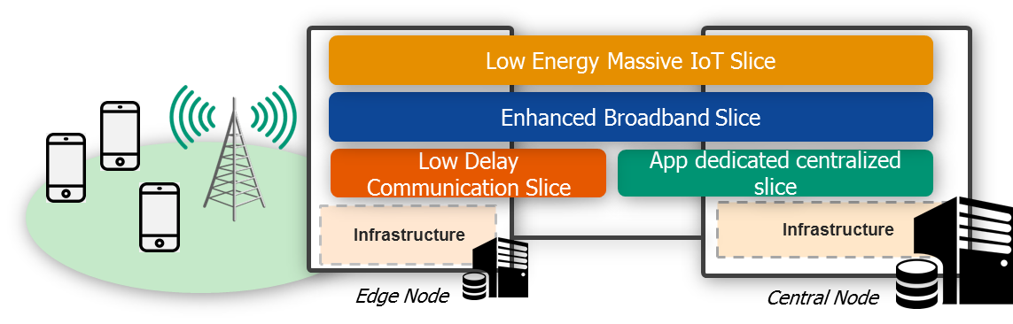
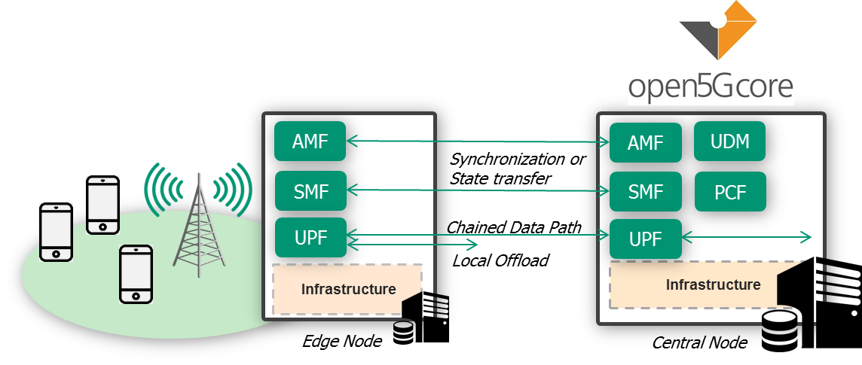
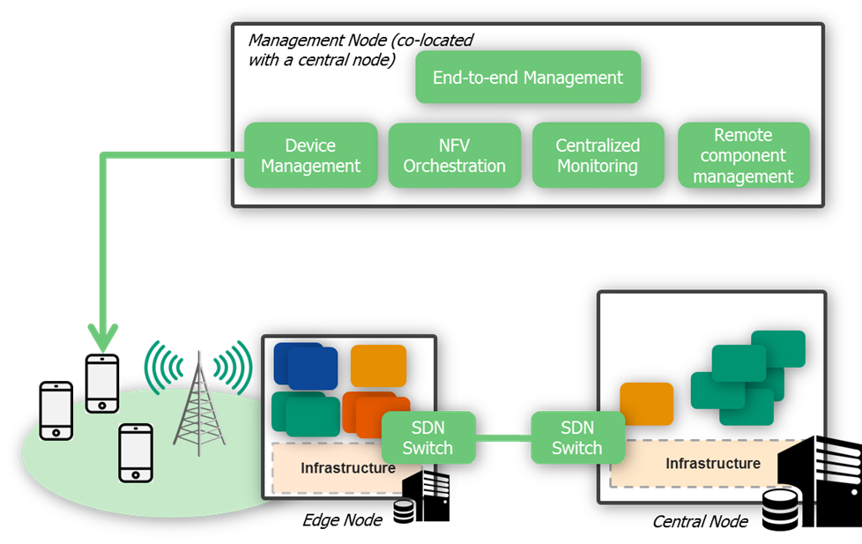
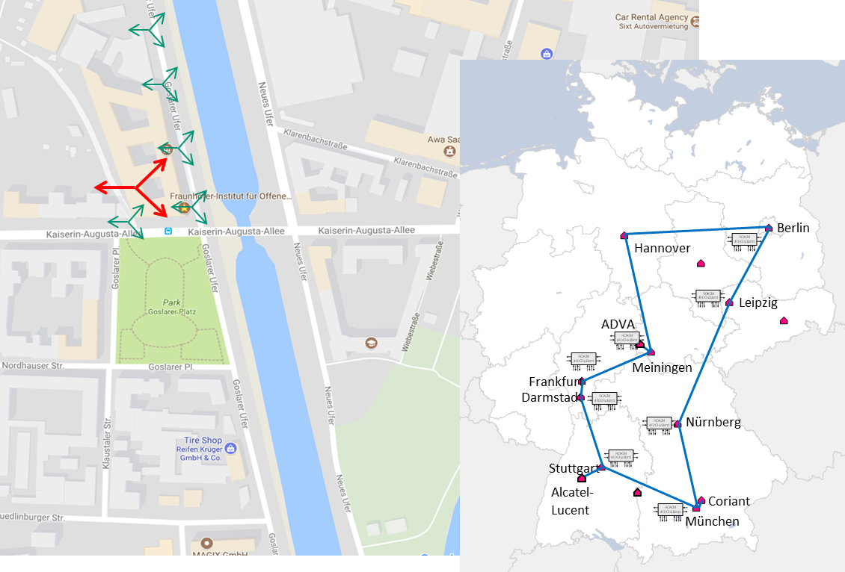
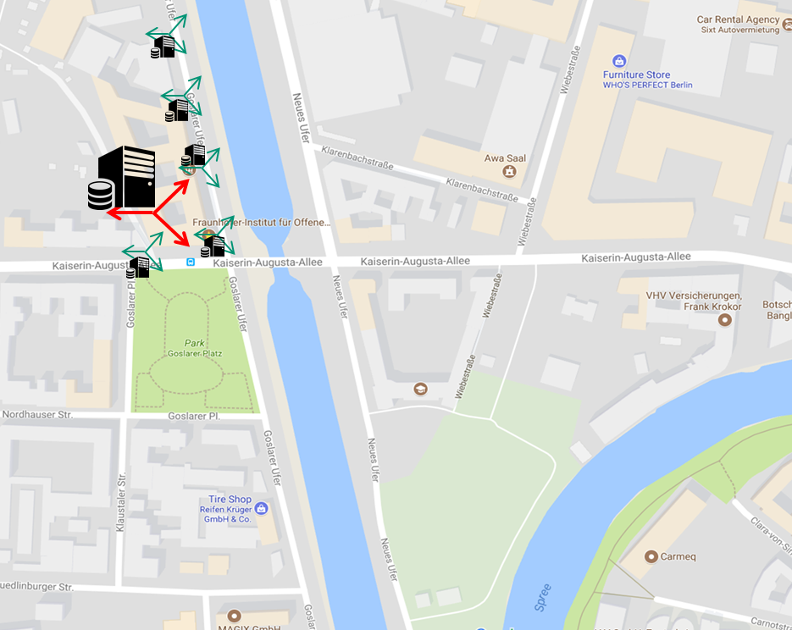
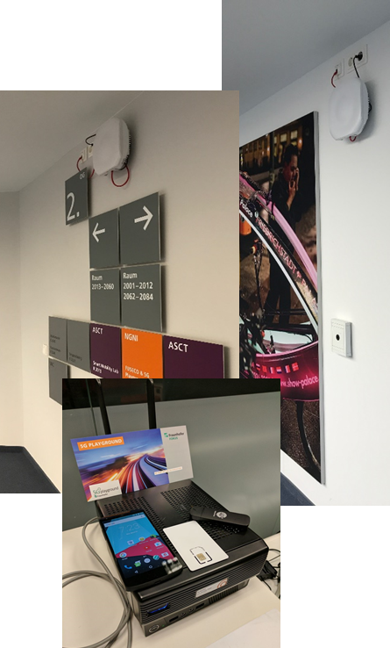
What is 5G Playground?
Generic Applications
5G PG is a comprehensive end-to-end testbed infrastructure
  Relying of multiple layers of infrastructure and software components
  Enabling direct integration of third party components and apps
  Enabling demonstration and validation of end-to-end use cases
5G PG relies on the following major layers
  An outdoor test field infrastructure
  An indoor test field infrastructure
  A network infrastructure
  A large set of components managing the network infrastructure
  A layer of software components enabling 5G connectivity
  A layer of software application enablers
    (massive IoT, enhanced broadband and low delay support)
  A set of generic applications, enabling the easy demonstration of use cases
Software Application
Enablers
5G Connectivity
Network Infrastructure
Management Layer
Network Infrastructure
Outdoor and Indoor Wireless
Test Field Infrastructure
© Fraunhofer FOKUS

Slide 34
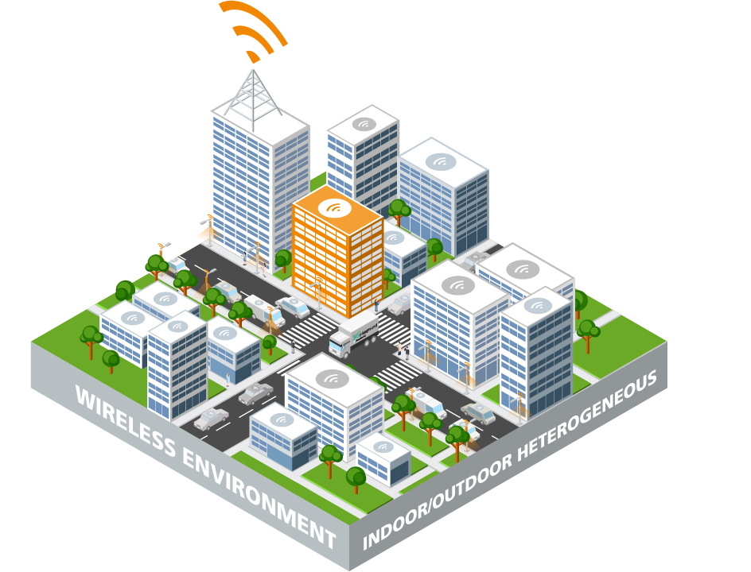
5G Playground: Heterogeneous outdoor/indoor islands
Key to the 5G success is the integration of wide areas outdoors with indoor deployments with the same or different administration
The outdoor deployment is designed to enable:
  Enhanced mobile broadband with high capacity 5G gNBs and mmWave backhauling
  Wide area connectivity for IoT overlays
  Seamless outdoor-indoor handovers (with same or different operators)
The indoor deployment is available since Nov 2017
The outdoor environment is planned for Sept. 2018
  A wide area network base station for 700MHz and 3,5GHz
  2 small cells in 2,6GHz with edge computing capabilities
  60Ghz wireless backhaul
  Automatic deployment of customized slices for use cases

Slide 35
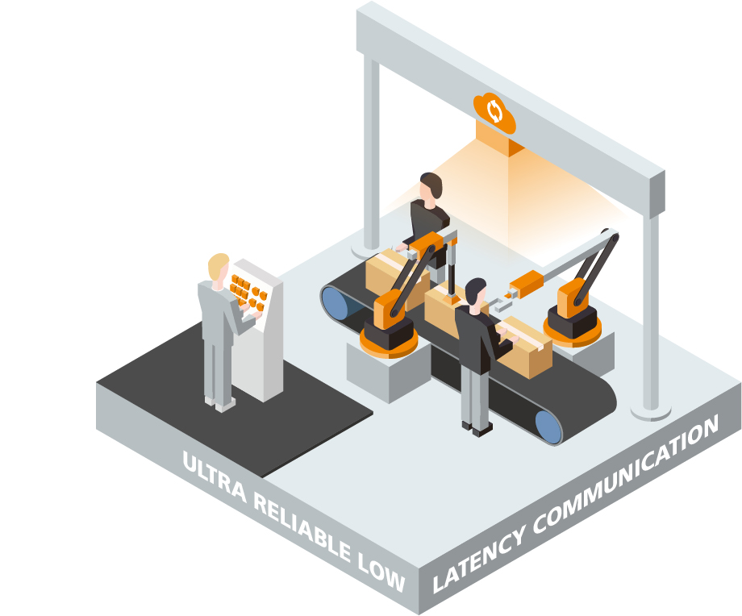
Ultra-Reliable Low-Latency Communication
A 5G environment designed for factory shop-floor communication
The factory shop-floor communication is meant to test the feasibility for 5G to replace existing wireless and wired private networks with 5G communication
  Embedding of the 5G in the existing processes is essential
The Shop-Floor is planned to November 2018 and includes:
  Integration of software PLCs with test factory appliances
  Establishment of reliable low-latency communication
  Support for IP and non-IP data exchange with remote servers
  Device and connectivity management

Slide 36
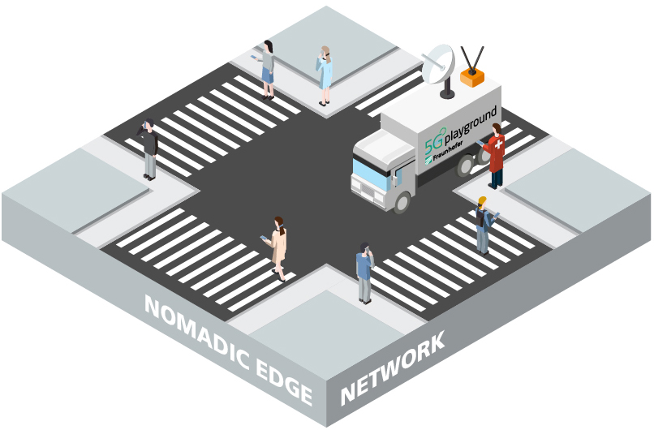
Nomadic Edge Network
To extend a network capacity to a specific location, one of the most attractive use cases is to make the network nomadic
The nomadic edge network is designed to test the feasibility of such a solution for 5G networks:
  Spectrum usage around the nomadic edge node (licensed and unlicensed)
  Connectivity of the devices to the edge node
  Power management
  Local offloading of the communication
  Backhaul selection between satellite and available terrestrial operators
  Communication over unreliable wireless backhaul
  Application of the nomadic node for eHealth scenarios
The nomadic edge node is planned for Nov. 2018:
  A mobile network within a vehicle
  Licensed and unlicensed 5G/LTE+ connectivity
  Dynamic SD-WAN solution for terrestrial and satellite
  Proxy connectivity through the outdoor deployment

Slide 37
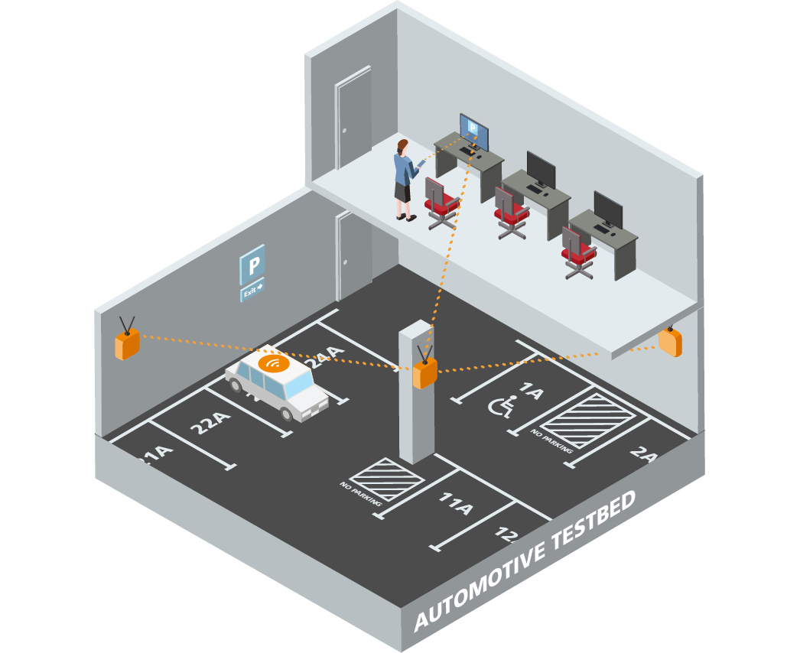
5G Playground: Automotive
For automotive use cases to be successful, the limit connectivity cases have to be also supported
The automotive testbed island is enabling remote communication from and to the cars for:
  Multimedia delivery to the car
  Data acquisition aggregation and transmission (video included)
  Low delay critical information (e.g. for remote steering)
The automotive island is planned (due Jan 2019) to include:
  Coverage of the underground parking lot with 3.5GHz base stations
  A single edge computing node connecting the base stations
  A multi-slice core network optimized for:
    Video data acquisition and dissemination
    Low delay, ultra-reliable communication

Slide 38
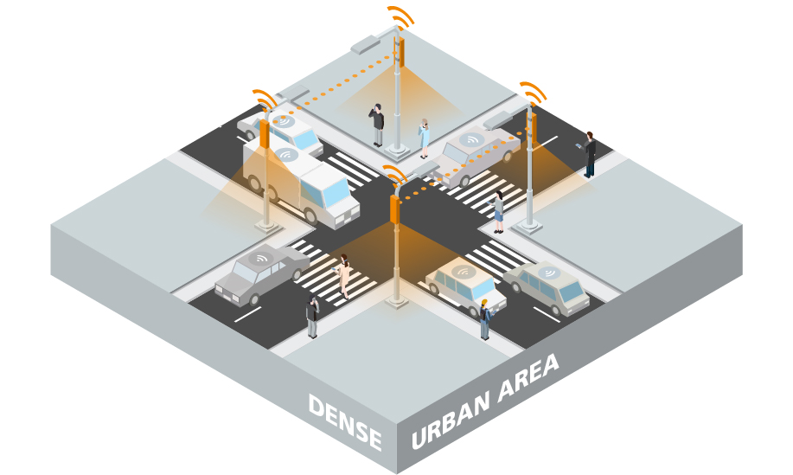
5G Playground: Dense Urban Area
To test the efficiency of 5G as well as of nomadic deployments, opening up the environment to a massive number of users represents the first step
The dense urban area deployment is meant to test:
  Providing 5G-like connectivity to today’s phones (5G over WiFi)
  Test network capacity with existing radio technologies
  The establishment of a wireless only infrastructure
  Assessing the live trialing with open access
The outdoor deployment is planned for the Berlin Festival of Lights 2019
  Non-3GPP (WiFi) access for the front-end to allow popular usage
  5G specific authentication and authorization over WiFi
  mmWave backhaul for wireless connected nodes
  A single-hop high capacity core network
  A comprehensive monitoring and assessment solution
  Live testing of security and reliability management features

Slide 39
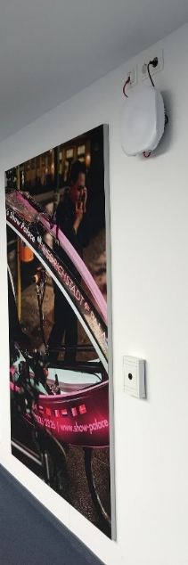
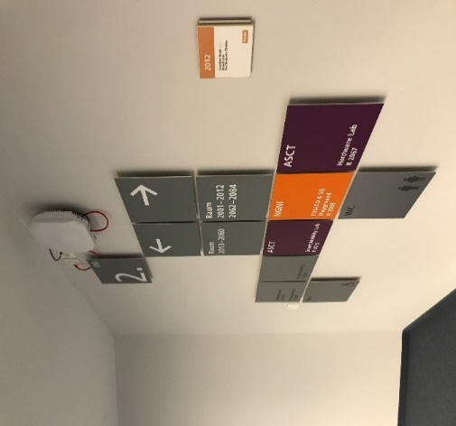
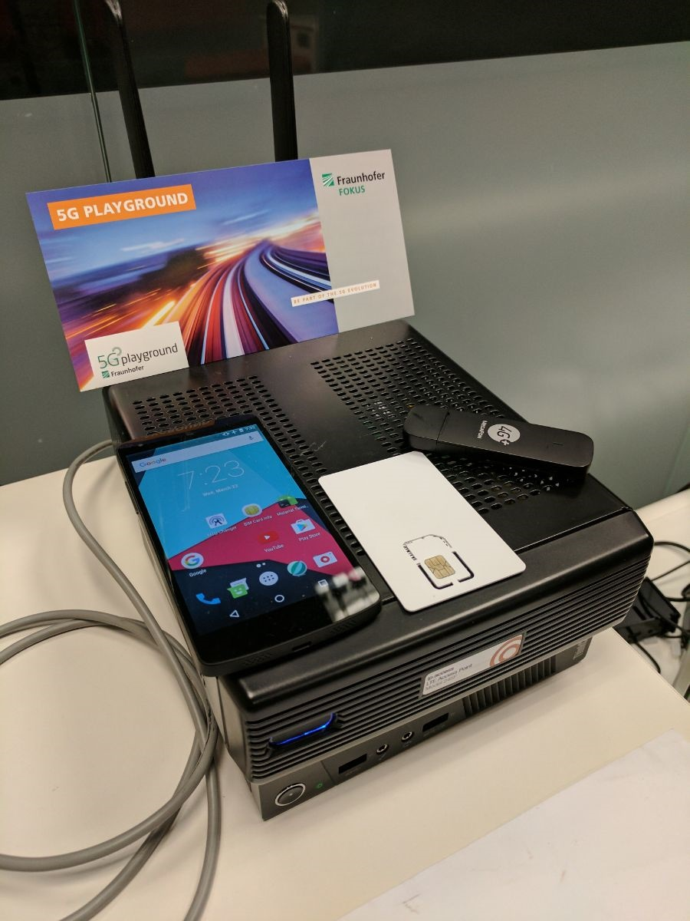
Indoor enterprise network
The indoor enterprise network of Fraunhofer FOKUS provides the following independent infrastructures:
  An indoor 5G/LTE/NB IoT network with dedicated network slices
    Enabling the demonstration of comprehensive use cases in a more controlled environment
    Enabling the evaluation of applications and components in a dedicated networks
    Supporting indoor/outdoor handovers
  A benchmarking environment
    Enabling the injection of different workloads in isolated conditions
      Synthetic workloads with different data load and mobility
      Massive IoT
      Multimedia with real data traffic injections
    Producing comprehensive automated evaluations
    Immediate feedback loop: results → customization → redeployment

Slide 40


Basic Network Infrastructure
Based on the existing infrastructure of TU Berlin and Fraunhofer
Mostly based on fiberglass and wireless bridges (mm-wave and optical) (not depicted)
Based on a distributed set of >10Gb Ethernet switches (not depicted)
With compute capabilities in the macro-nodes (medium scale data centers) with own storage
Edge data centers co-located with the micro- base stations with own storage
Connectivity to the DTAG optical fiber backbone via Winterfeldstrasse/DTAG
via Winterfeldstraße/DTAG
Hannover
Berlin
ADVA
Leipzig
Frankfurt
Meiningen
Darmstadt
Nürnberg
Stuttgart
Alcatel-
Lucent
Coriant
München

Slide 41



What is the 5G Playground
5G Playground provides a single stop for a comprehensive set of toolkits with virtually all that it is needed to be installed for a live 5G testbed
A comprehensive set of software toolkits enabling setup and development of 5G applications in an end-to-end testing environment.
A methodology and tools for benchmarking 5G prototypes and products.
A commodity providing cost efficient automatic installation and experiment control.
Management and orchestration for NFV environments, running on top of OpenStack (and soon OpenMANO).
A new, efficient approach for remote connectivity management of M2M and multimedia, based on standard protocols.
Extensive platform for SDN added value features for flexible routing, virtual environments and core network data paths.
R&D prototype for mobile core networks beyond 3GPP Release 13, supporting 5G, 4G (LTE) and WLAN.

Slide 42
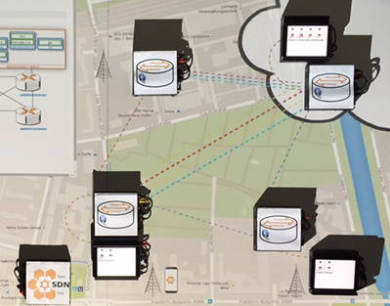
Clone and customize your own 5G Playground
The 5G Playground was designed from the initial phases for commodity for being deployed at customer premises
  Mirroring the advancements from the FOKUS and the Berlin testbed
  Providing a separate isolated testing facility
  Including only the interesting functionality from the comprehensive environment
  Customizing the test environment for the specific requirements
Your Premises
© Fraunhofer FOKUS

Slide 43
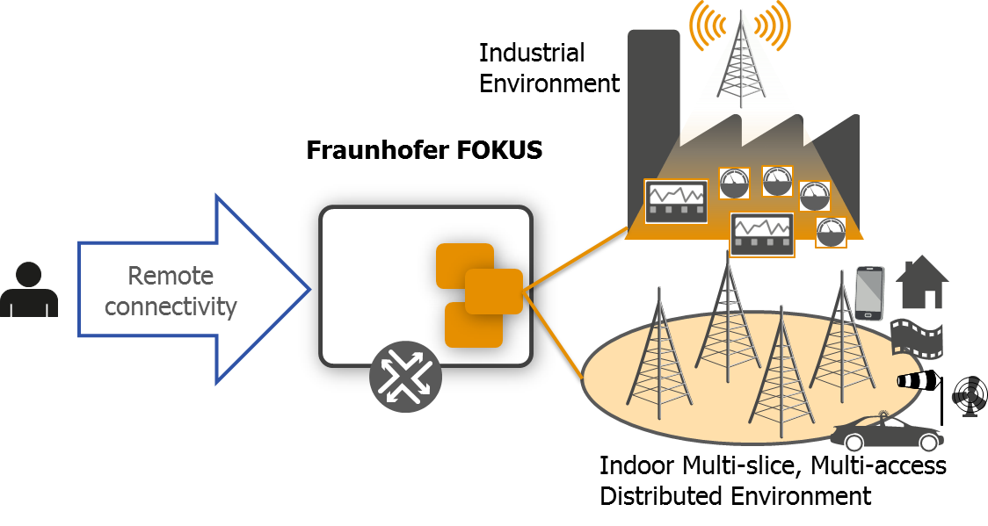
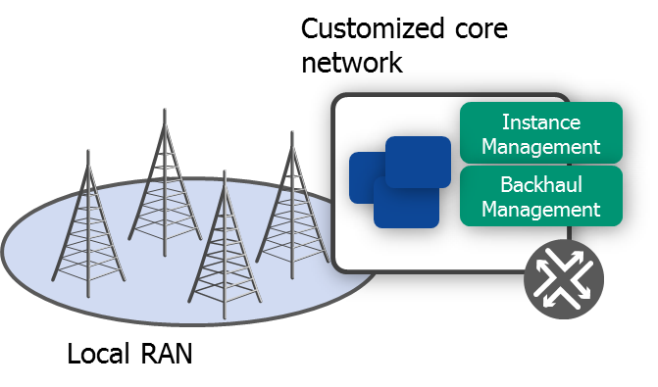
A remote testbed access is more expensive than a local one
Testbed at customer premises
Cloning and customizing the testbed at customer premises provides the needed know-how boost in the applied 5G research
Own hardware
Own administration
No travel costs
Demo available when needed
Remote testbed access
Provides initial demonstrations of a specific solution, with limited know-how transfer
Using FOKUS hardware
Employing a FOKUS administrator
Traveling to FOKUS
Sharing the environment

Slide 44
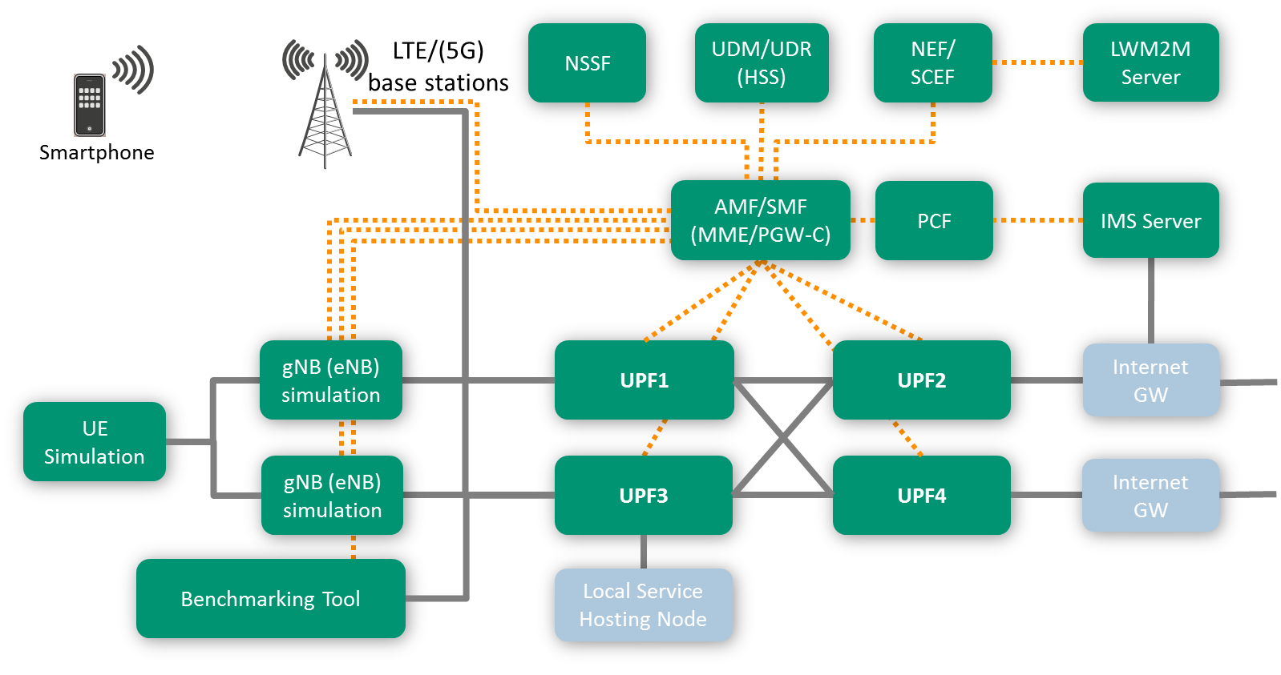
Open5GCore Rel. 3
R&D prototype of mobile core networks following 3GPP Release 13+ for seamless broadband connectivity, multimedia delivery and massive IoT
Support for (5G) and LTE – integrating with a very large number of off-the-shelf base stations / able to integrate with 5G radio prototypes
Cloud-native core network for NFV – can be deployed using OpenBaton as VMs on top of virtually any type of Linux OS (e.g. VMs, containers, namespaces, x64 or ARM based)
Comprehensive implementation of CUPS with data path diversity (with OF, soon PFCP)
Mobile edge network support – edge/central split
Highly customizable for dedicated/private networks
Benchmarking and experimentation
  Highly configurable metrics
  With synthetic workloads & replaying real workloads

Slide 45
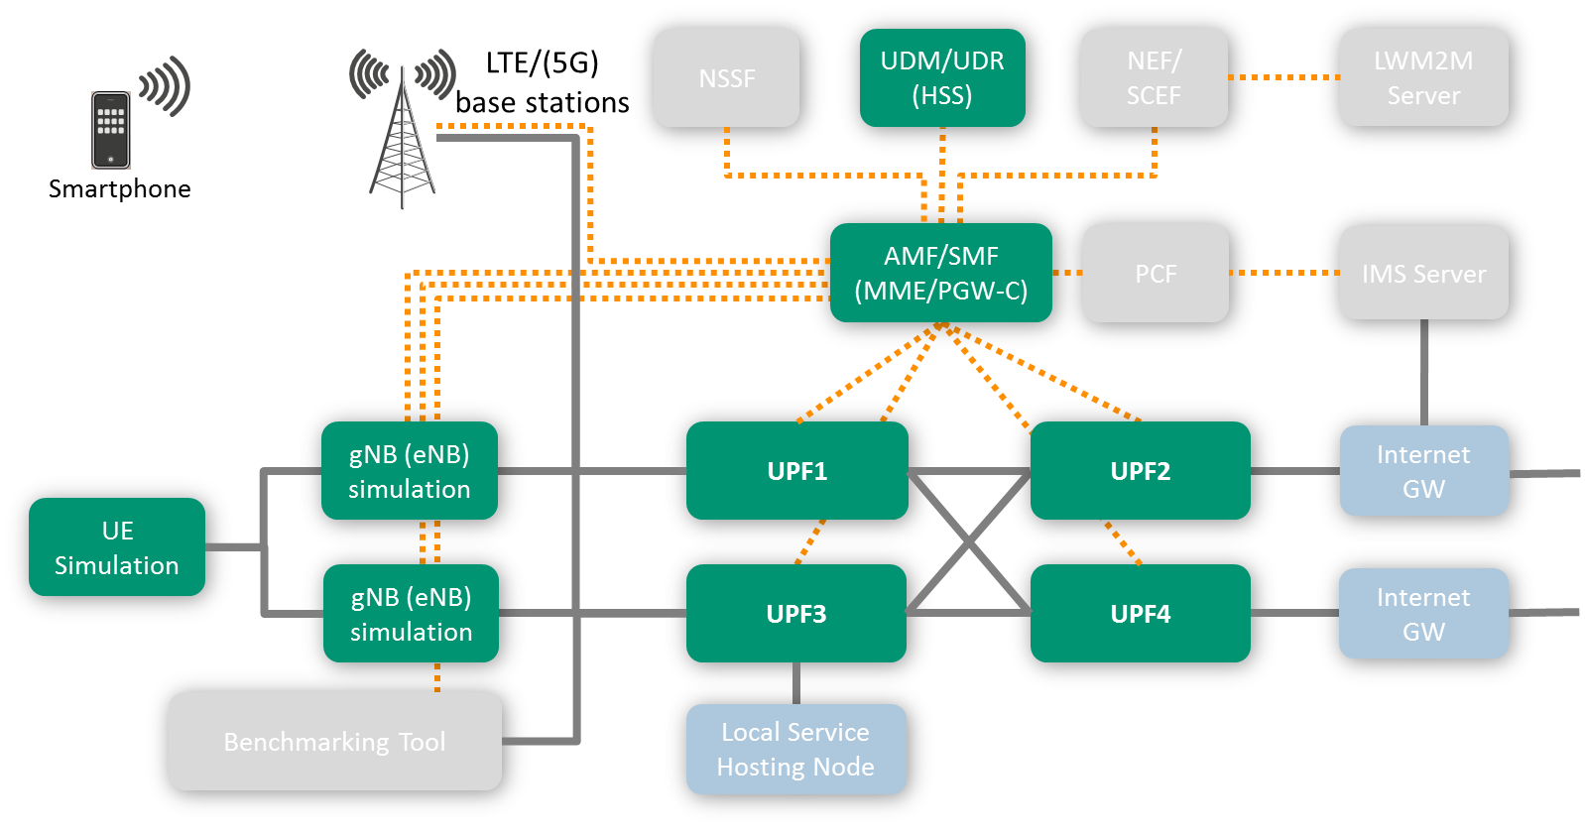
Fundamental 5G/4G core network functionality
Open5GCore implements the 3GPP 5G architecture and the 3GPP EPC architecture (Release 14).
Functionality includes the main network functions of the 3GPP 5G CN and the 3GPP EPC
  UE connectivity manager for Android and Linux
  AMF(MME-) – enabling authentication, authorization, handover, idle mode, SMS
  SMF(PGW-C+) – allocation of IP addresses and data paths, data path reselection
  UDM/UDR (HSS) – including S6a Diameter interface
  gNB(eNB) emulation with NAS overlay over IP communication
  UE emulation with NAS support
Integrates with commercial eNBs
Can be used with COTS phones

Slide 46
Data Path Diversity
Using the CUPS feature, Open5GCore implements a large number of deployment scenarios for data path diversity
The implemented functionality in the SMF enables the following scenarios:
  Support for multiple APNs and dedicated bearers
  Data path offloading for specific bearers (when connected to specific gNBs)
  Congestion triggered, network only data paths change
  Fast handover between Local Service Hosts (with and without IP address continuity)

Slide 47
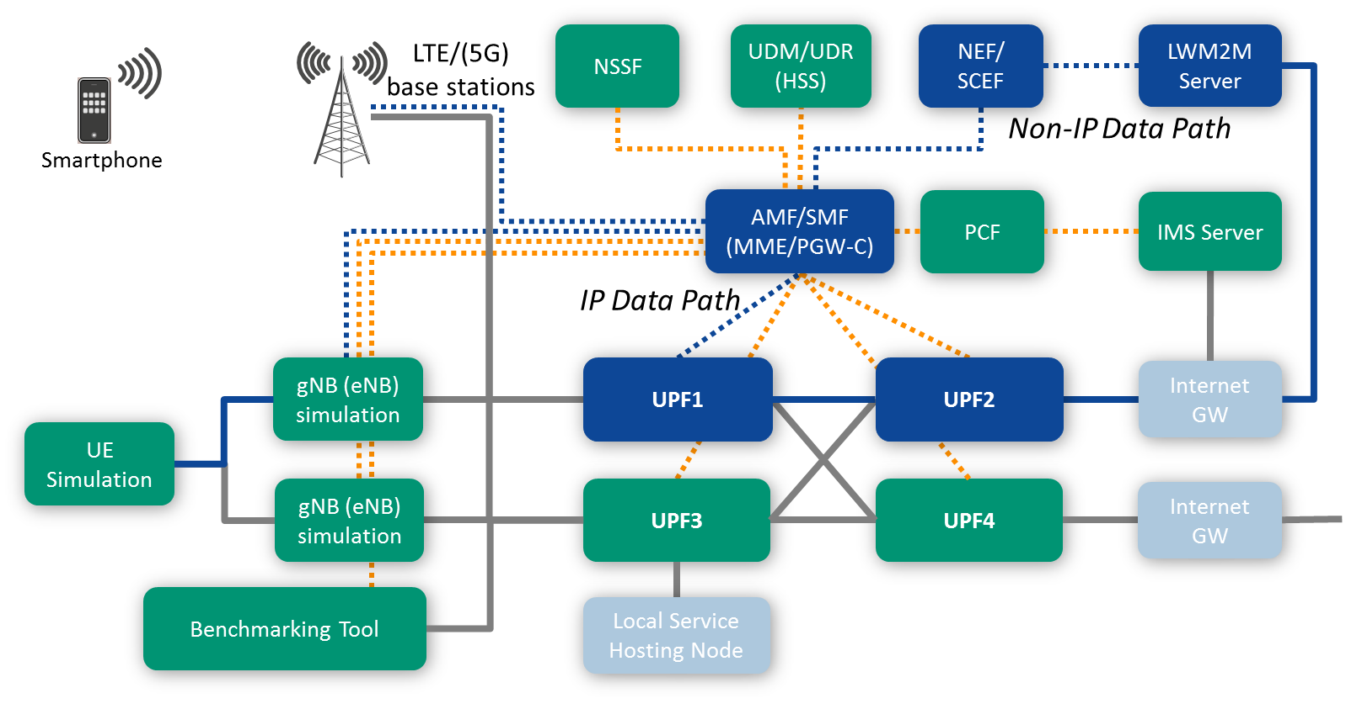
NB-IoT/SMS-S core network extension
A first implementation of the 5g SMS-S/3GPP NB-IoT features enabling the demonstration of low energy IoT communication
The SMS-S/NB-IoT extension is addressing the current stringent needs of the 5G use cases to provide low power, low cost efficient communication for a massive number of devices
A prototype including the following features:
  Control Plane CIoT EPS Optimization
  Attach without PDN connectivity
  Non-IP Data Delivery (NIDD) and IP data delivery
  Network Exposure Function (NEF)/Service Capability Exposure Function (SCEF)

Slide 48
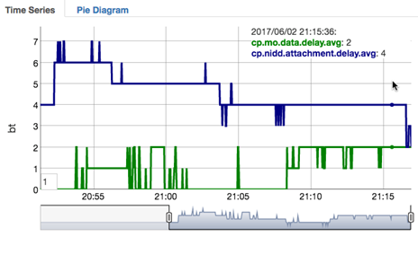
Benchmarking
Providing quantitative evaluations of different customized core networks on top of different resource infrastructures
The benchmarking tool and environment include the following functional features:
  Flexible and intuitive eNB topology configurations
  Flexible subscriber mobility and load patterns (can replay workloads)
  Support for x10000 emulated subscribers and x100 eNBs
  Support for S1-MME and S1-U interfaces and procedures
  Monitoring parameters - 50+ metrics including:
    Quality: Success rate, procedure delay at benchmarking tool
    Performance: procedure delay, compute and storage in the network
On demand extensible for different:
  RAN topologies or functionality,
  mobility and resource patterns
  interfaces towards the network

Slide 49
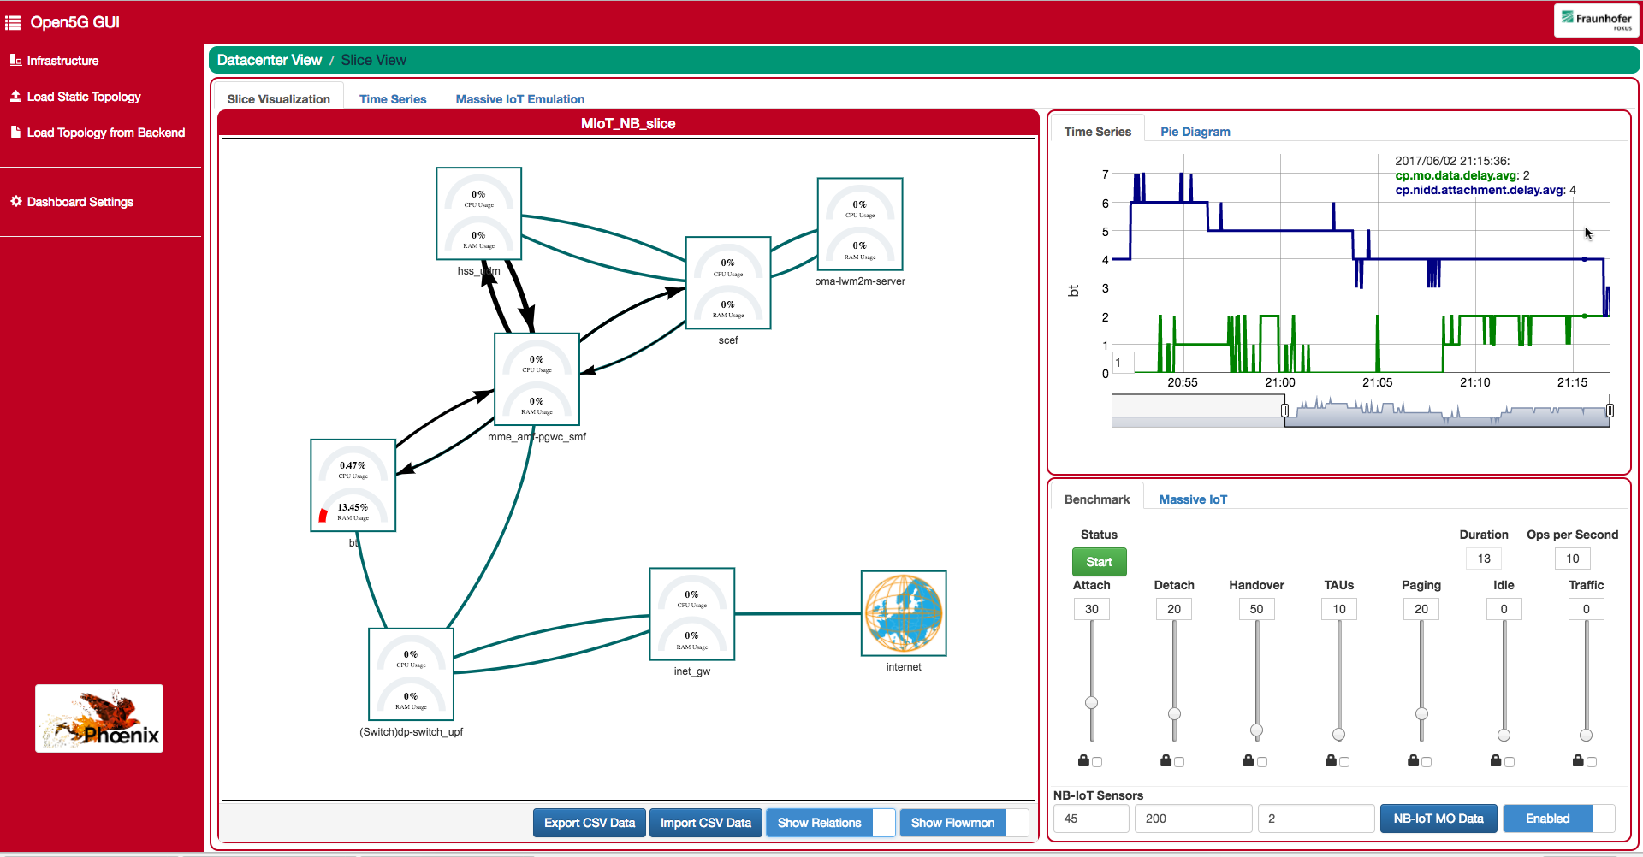
Benchmarking Tool Dashboard

Slide 50
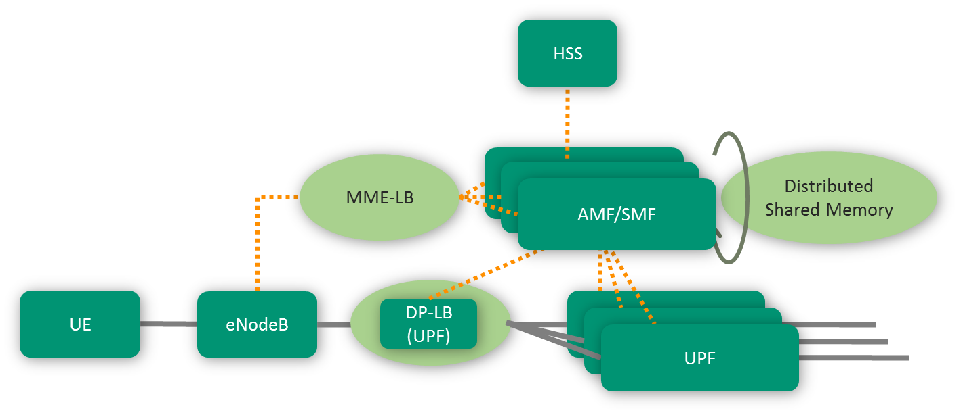
Elasticity Support
Enabling graceful scaling, load scheduling and high availability
The elasticity support enables the transparent deployment of multiple components of the same type addressing
  Scaling in cloud environments
  Distribution of load in distributed/edge environments
AMF/SMF(MME/PGW-C) Load Balancing
  Low footprint S1-AP load balancer for appropriate MME selection
  OpenFlow controlled data path load balancer
State sharing mechanisms
  Distributed shared memory
  ASN1 based protocol for state broadcasting
  Replication of forwarding rules to multiple switches

Slide 51
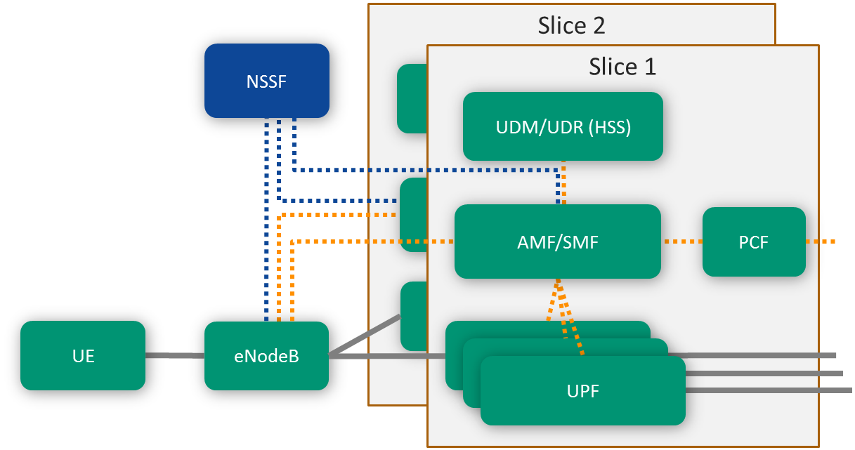
Multi-slice support
Open5GCore implements the 3GPP DÉCOR for slice selection as an independent network function
The Open5GCore Network Slice Selection Function (NSSF) can be placed as a separate component enabling:
  Indications to the AMF(MME-) to redirect the UE during attachment to another slice
  Indications to the gNB/eNB to direct the UE during sequent procedures to the appropriate slice
NSSF can be integrated with the MME LB and with the gNB to act as a proxy for multiple slices

Slide 52

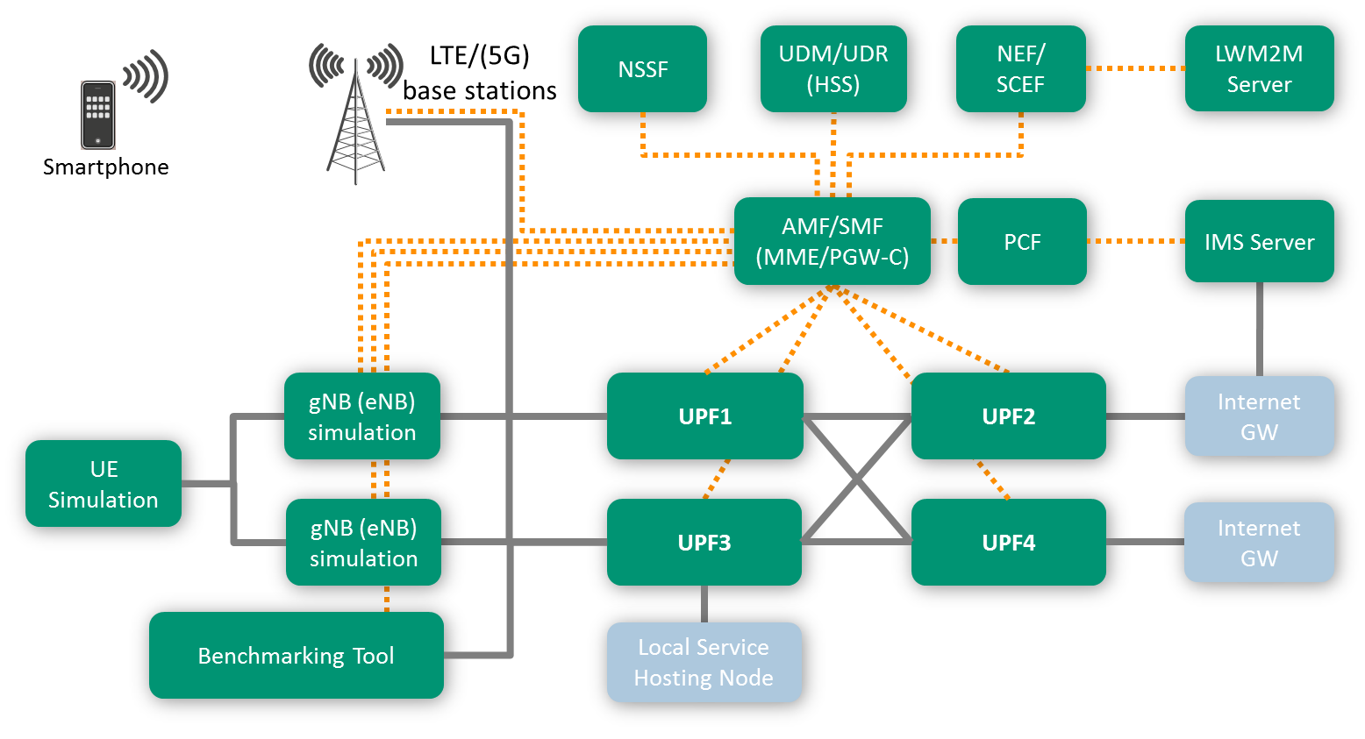
IMS Support
Open5GCore integrates with Kamailio IMS as a first step towards full VoLTE support
Kamailio IMS is an open source implementation of 3GPP IMS, supported by a large community, stemming from:
  SIP Express Router – high performance SIP router developed until 2005 at FOKUS
  OpenIMSCore – IMS modules for SER developed until 2009 at FOKUS
Kamailio IMS is deployed as part of the default Open5GCore setups enabling the establishment of seamless voice services
https://www.kamailio.org/w/2016/02/kamailio-ims-getting-started-box/

Slide 53
Roadmap for Open5GCore Rel. 4 and later
Multi-slicing support
VoLTE support
Open5GCore Rel. 4
5G N1 interface (gNB-AMF)
UE NAS only for non-3GPP access support
Service Based Architecture + NRF support
Edge router support
PFCP support
Possible items for the first part of 2019
Completion of the SBA
NEF/SCEF extensions
5G Location Services
gNB protocols support (RLC, PDCP, RRC)
v2x support
Emergency support for IMS
Data analytics function
Data path diversity support
AMF-SMF split
5G NAS v1(UE-AMF)
Initial N3IWF support for WLAN
Soft eUICC support
Multicast support
Mobile edge implementation
Open5GCore Rel. 5
Apr | May | June | Jul | Aug | Sep | Oct | Nov | Dec | Jan | Feb | Mar | Apr
2018
201
Customization of testbeds towards use cases and specific deployments (hardware, virtualization), integration of base stations and end devices is available anytime on-demand. pe

Slide 54
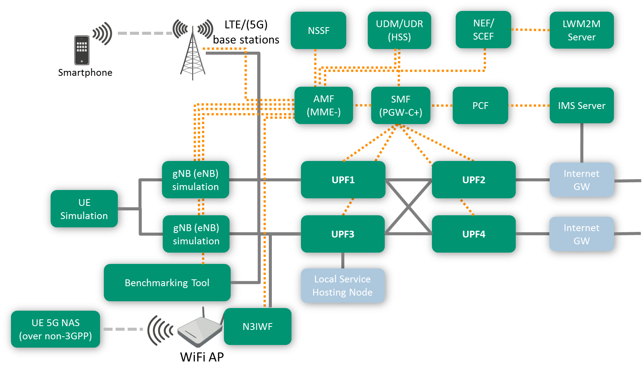
Open5GCore Rel. 4 (planned for September 2018)
Open5GCore Rel. 4 represents a strong implementation step towards 3GPP Release 15 features, enabling true 5G evaluations
AMF-SMF split – separation of the state machines within the control plane
Service Based Architecture implementation – HTTP/2, JSON, UDM interfaces
5G UE NAS only for non-3GPP integration with N1 over N3IWF
Replacement of OpenFlow with PFCP
Edge router support

Slide 55





Visit us!
www.berlin5gweek.org
The Future of Edge Computing
13 Nov 2018
www.edgecomputingforum.org
Future Industrial Internet –
How future standards,
technologies,
paradigms and applications
will shape the Industry 4.0
14 Nov 2018
www.iiot-forum.org
Preparing Industry Verticals
for Edge Computing,
Network Slicing & 5G
15 Nov – 16 Nov 2018
www.fuseco-forum.org

Slide 56


Visit us!
Preparing Industry Verticals for Edge Computing, Network Slicing & 5G
15 Nov – 16 Nov 2018 in the Fraunhofer Institute FOKUS, Berlin
For further information, please visit: www.fuseco-forum.org

Slide 57

For further information, technical questions, licensing and pricing requests, contact us at info@Open5GCore.net
www.5G-Playground.org

